Slide 1
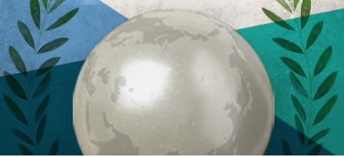
Global Integration My Journey into the Missio Dei Frontiers Kelly O’Donnell, PsyD Member Care Associates, Inc.
Frontier Mission in an Emergent World EMS-ISFM Conference, 7-8 October 2022 Do not reproduce without permission (MCAresources@gmail.com)
Image source: Cover detail from Global Member Care (volume 2) Crossing Sectors for Serving Humanity (2013)
Notes:
Dr. Kelly O’Donnell is a consulting psychologist based in Geneva and the CEO of Member Care Associates, Inc. (MCA). His multi-sectoral work in mission focuses on staff wellbeing and effectiveness, global mental health and sustainable development, and integrity and anti-corruption. Extensive resources and recent publications-presentations-projects are on the MCA website (membercare.org) and shared in their monthly Global Integration Updates and Member Care Updates. Kelly works closely with his wife Michèle, also a psychologist, and they have two adult daughters: Erin and Ashling.
Email: MCAresources@gmail.com

Slide 2
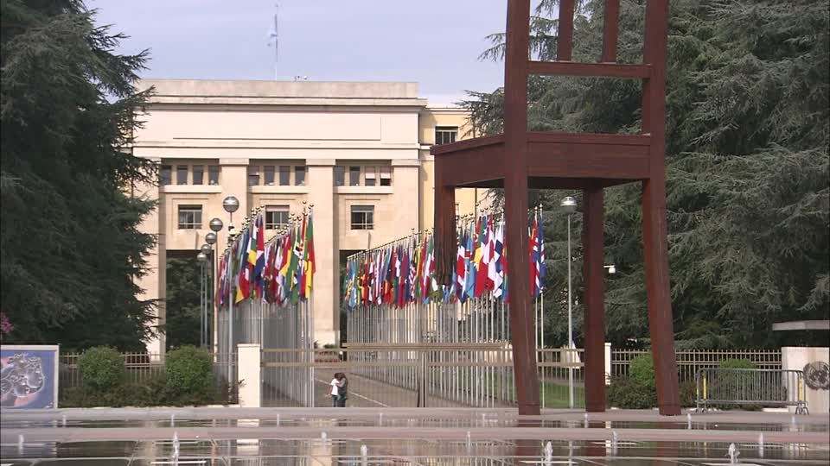
Purpose
Overview of the Global Integration (GI) framework
Examples of GI multi-sectoral work—Civil society, UN agencies, etc.
Seven suggestions for engaging in the missio Dei (MD) frontiers
GI gems: Least-reached Peoples and Places (LPPs)
Notes:
Global Integration My Journey into the Missio Dei Frontiers
This is a practical presentation in which I share personal examples as a pioneering Christian psychologist working internationally across sectors. I am especially interested in how my experiences can inform and inspire colleagues to further pursue “common ground for the common good” especially on behalf of least-reached peoples and places. Beginning with a brief overview of the Global Integration (GI) framework that guides and goads my work, I then share examples of my civil society involvement in UN agencies and efforts including the World Health Organization and the General Assembly along with involvement in graduate programs and church-mission settings. I conclude with seven suggestions for colleagues wanting to journey further into the missio Dei frontiers. Core reading: O’Donnell, K. & Lewis O’Donnell, M. (January 2020). Following Jesus globally: Engaging the world as Global Integrators. Lausanne Global Analysis, 9(1).

Slide 3
GI-MD Frontiers Core Resources
Global Integration
O’Donnell, K. & Lewis O’Donnell, M. (January 2020). Following Jesus globally: Engaging the world through global integration. Lausanne Global Analysis, 9(1). Global Member Care O’Donnell, K. & Lewis O’Donnell, M. (2016). Multi-sectoral member care: Engaging our world as global integrators. Journal of Psychology and Theology, 44(1), 303-314.
Global Mental Health O'Donnell, K., Eaton, J., & Lewis O'Donnell, M. Global mental health: Collaborating for sustainable development and wellbeing. In M. E. Congress, D. Meister S. Osborn, & H, Takooshian (Eds.). (2022). Behavioral Science in the Global Arena--Volume Two: Global Mental, Spiritual, and Social Health (pp. 3-21). Information Age Publishing.
Global Integrity O’Donnell K. and Lewis O’Donnell M. Living in global integrity: Moral wholeness for a more whole world. In R. van Rensburg, Z. Erdey Z., & T. Schirrmacher (Eds.). (2022). Essays on Holistic Biblical Ministries (pp. 335-354). Volume 22 of the World Evangelical Alliance’s World of Theology Series (free download). See the additional Multi-Sectoral Resources for this chapter.
Notes:
See also these core materials:
Global Integration
--Global Integrators (25 weblog entries) CORE Member Care: Reflections, Research, Resources for Good Practice (2015)
--Doomsday: Next Stop, Global Dis-Integration Global Integration Update (June 2017)
Global Member Care O’Donnell, K., Pidcoke, H., & Lewis O’Donnell, M. (2020). Engaging in humanity care: Stress, trauma, and humanitarian work. Christian Psychology Around the World, 14(1), pp. 153-167.
Global Mental Health O’Donnell, K. & Lewis O’Donnell, M. (2017). Well-being for all: Mental health professionals and the sustainable development goals. Journal of Psychology and Christianity, 36(1), 70-75.
Global Integrity
--A Summons to a Global Integrity Movement: Fighting Self-Deception and Corruption Lausanne Global Analysis (March 2018)

Slide 4
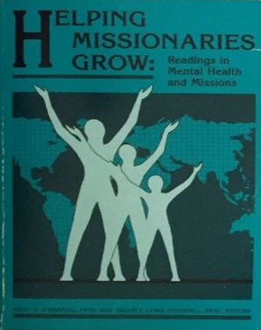
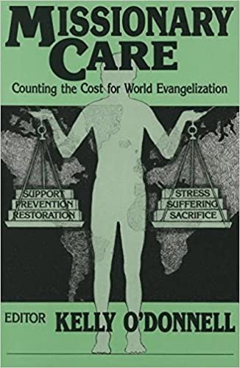
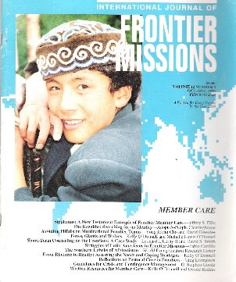
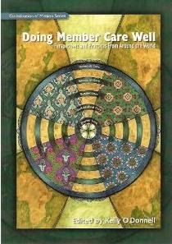
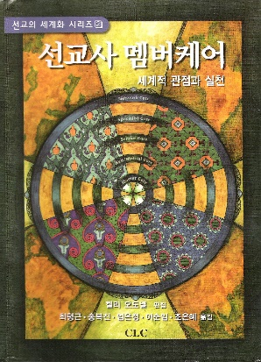
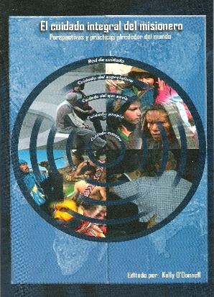
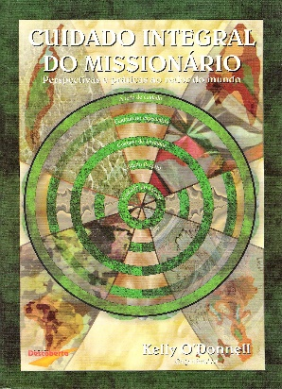
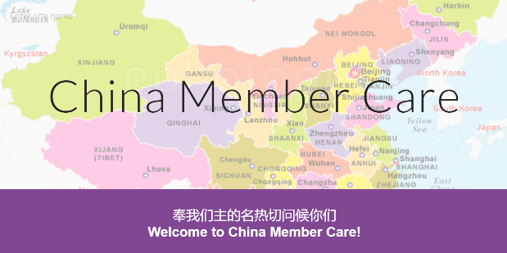
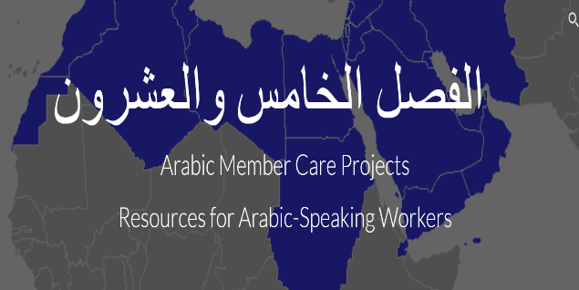
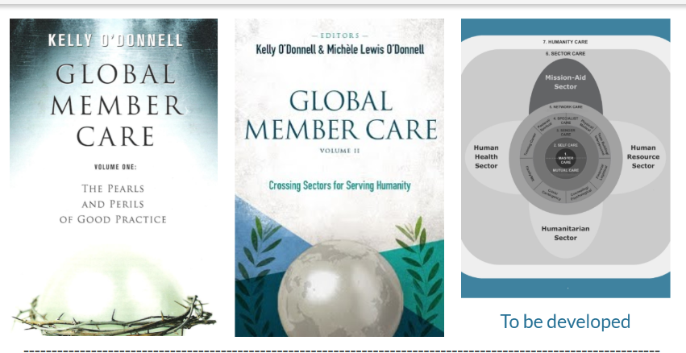
Member Care books
O’Donnells—MCA
MC Updates
O’Donnells--MCA
Notes:
Follow the flows--the historical “heart-streams” of member care:
O’Donnell K. (2015). The Missional Heart of Member Care. International Bulletin of Mission Research, 39(2), 91-96. «“This article presents a historical journey through several professional publications, organizations, and conferences dealing with the practice of member care. Starting in the pre-1960 era and traveling into the mid-2010s, I highlight trends in member care development. This chronology weaves my own commentary around a selection of core quotes from different authors. Knowing our history provides important perspectives for supporting the church’s endeavors to share the Good News and do good works among all peoples. This survey of materials reflects the initial predominance, in the field of member care, of Englishspeaking, internationally experienced Americans, often males, and many with mental health care backgrounds. These demographics underwent a large shift starting in the 2000s as member care increasingly globalized into a multidisciplinary, culturally contextualized field. Many outstanding colleagues have contributed to the development of this field, but space here allows for only a sampling. These colleagues’ exemplary lives of faith in action and the compelling voices in their writings still speak clearly and powerfully to us today (Heb. 11:4).”

Slide 5
GI Journey: Missio Dei Frontiers New and Old Treasures--GI Gems MT 13:51-52 “These are the ones who have helped restore to me the mislaid treasures of God” Phillip Yancey, Soul Survivor (2001)
Notes:
Matthew 13:51-52 (the final and interpretive parable of the kingdom parables)
New International Version
“Have you understood all these things?” Jesus asked.
“Yes,” they replied.
He said to them, “Therefore every teacher of the law who has become a disciple in the kingdom of heaven is like the owner of a house who brings out of his storeroom new treasures as well as old.”

Slide 6
Globalntegration
A missio Dei framework for
actively and responsibly engaging in our world,
collaborating locally to globally for God’s glory: --by connecting relationally and contributing relevantly --on behalf of human wellbeing and the issues facing humanity, --in light of our integrity and core values (e.g., ethical, humanitarian, human rights, faith-based).
“Instaurare omnia in Christo” (Ephesians 1:10)
Global integration: A Framework for Engaging with Our World Global Integration Update (December 2018)
Notes:
Definition of GI, Member Care Associates website “GI is a framework for actively and responsibly engaging in our world–collaborating locally to globally. It emphasizes connecting relationally and contributing relevantly on behalf of human wellbeing and the issues facing humanity, in light of our integrity, commitments, and core values (e.g., ethical, humanitarian, human rights, faith-based). GI encourages a variety of people to be at the “global tables and in the global trenches and everything in-between” in order to help research, shape, and monitor agendas, policies, and action for all people and the planet. It intentionally links being the people we need with building the world we need. As people of faith, practicing Christian spirituality, a foundational motive for GI is to seek God’s glory in all we do. We believe the GI framework and principles are crucial for a) member care/mission practice and direction; b) colleagues working in different sectors and settings; and c) all those who endeavor to live as global citizens (i.e. our common sense of belonging, identity, and mutual responsibility as humans). “ GI is a grid to guide and goad our journeys into the all-encompassing scope of the gospel among all persons and peoples, all places and spaces—into the missio Dei—restoring all creation to “shalom” in Jesus Christ--“instaurare omnia in Christo” (Ephesians 1:10).

Slide 7
.
Notes:
This slide and the previous slide go together to form the GI Framework--a grid to guide and a guide to goad!
It is well-worth looking both over carefully.

Slide 8
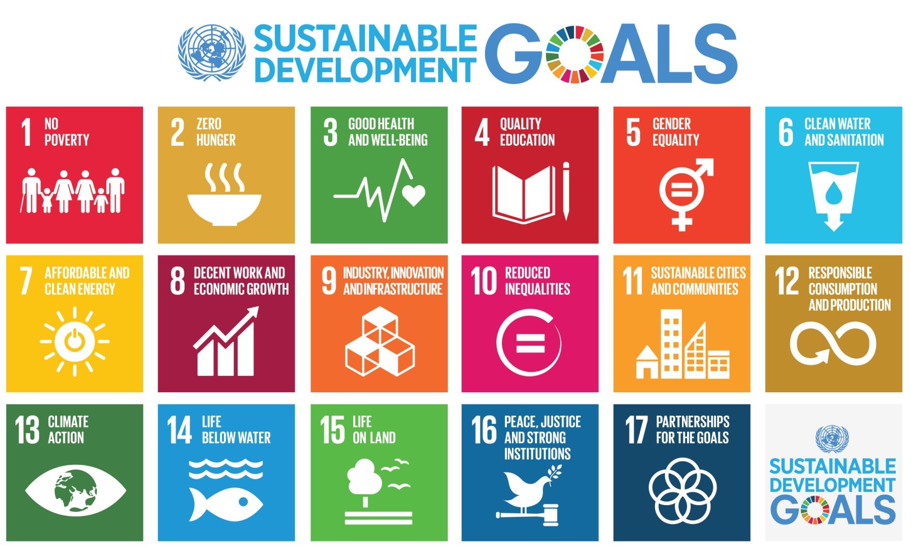
Transforming Our World: The 2030 Agenda for Sustainable Development United Nations, 25 September 2015
"Today we are also taking a decision of great historic significance. We resolve to build a better future for all people, including the millions who have been denied the chance to lead decent, dignified and rewarding lives and to achieve their full human potential. We can be the first generation to succeed in ending poverty; just as we may be the last to have a chance of saving the planet…” (paragraph 50)
People-Peace-Prosperity-Planet-Partnership
Notes:
Definitely a sense of urgency….

Slide 9
Global Integration Updates 2022
--October 2022: Perils, Paralysis, and Hope: Sustainable Development or Sustainable Destruction? “In this Update we feature the opening address to the UN General Assembly by UN Secretary-General António Guterres on 20 September 2022. The title and theme of this Update--perils, paralysis, hope--reflects our summary take-away from Guterres' address. We also share some Personal Reflections about "being people of faith-hope-love" And include the message by Archbishop Justin Welby on 19 September 2022 at the funeral service at Westminster Abbey for Elizabeth II, focusing on her life of service and faith. The funeral, much of which was organized in advance by the Queen herself, was viewed by an estimated and unprecedented global audience of over four billion people.”
–September 2022: Arming the World–Promoting Positive Peace
–August 2022: Repentance and Reconciliation–The Pope’s Pilgrimage of Penance
–July 2022: Transforming Mental Health for All--WHO World Mental Health Report
Notes:
See also these GI Updates for 2022: –June 2022: Moral Health for a More Whole World--Global Integrity Day-9 June –May 2022: Into the Global Fray–Four New Books from Friends –April 2022: Staring War in the Face: Saving “Succeeding Generations from the Scourge of War" –March 2022:Global Hearing Health–Hearing for Life –February 2022: Thinking Critically about Sustainable Development –January 2022: Peace on Earth–Sharing our Stories and Strategies

Slide 10
Faith-Based People-Organizations
“We believe that a variety of people must be at the “global tables” in order to help shape and influence agendas, policies, and action in the “global trenches.” That includes people from all countries, sectors, and faith backgrounds, who are informed and skilled, and dedicated to the common good. “
“Religion and faith, as we know, have a central place for most people in our world—including many “persons and communities of concern,” staff, organizations, governments, and donors. Faith-based people are thus often mainstream contributors and partners--and not marginal players-- when it comes to the efforts to transform the world. The emphasis on personal transformation (including virtue and moral integrity) is often an important added contribution from the faith-based sector.”
--Note: Faith is often the core part of one’s life/identity and not simply a component part. --Note: We are increasingly referring to ourselves/organisations as being ”faith-hope-love—based” in line with our fuller understanding of historic Christian spirituality.
--Global Integration Update (August 2015) Faith-Based Partners in Transformation
--United Nations Christian Association—Geneva:
Monthly Prayer and Events
Notes:
Faith-Based Initiatives Five Materials-Milestones
--Building from Common Foundations:The World Health Organization and Faith-Based Organizations in Primary Care (2008), Geneva Global , World Health Organization (overview and guidelines)
--Ending Extreme Poverty: A Moral and Religious Imperative (2015), World Bank (joint inter-religious statement)
--Laudato Si: Caring for Our Common Home (2015), Pope Francis (encyclical on creation care)
--Faith-Based Health Care (7 July 2015), The Lancet (special issue)
--International Partnership on Religion and Sustainable Development (organization/website)

Slide 11
Faith-Based Initiatives
"In parts of Africa where bandits and warlords shoot or rape anything that moves, you often find that the only groups still operating are Doctors Without Borders and religious aid workers: crazy doctors and crazy Christians. In the town of Rutshuru in war-ravaged Congo, I found starving children, raped widows and shellshocked survivors. And there was a determined Catholic nun from Poland, serenely running a church clinic. Unlike the religious right windbags, she was passionately “pro-life” even for those already born — and brave souls like her are increasingly representative of religious conservatives. We can disagree sharply with their politics, but to mock them underscores our own ignorance and prejudice.“
Source: Evangelicals a Liberal Can Love. Nicholas Kristof, New York Times (3 February 2008)
See also: --Some Myths about Faith-Based Humanitarian Aid. Wilfred Mlay, Humanitarian Exchange 27 (July 2004, pp. 48-51) --Partnering as Faith-Based People and Organizations (6 April 2019) K & M O’Donnell, International Trauma Collaborative, Multnomah University USA

Slide 12
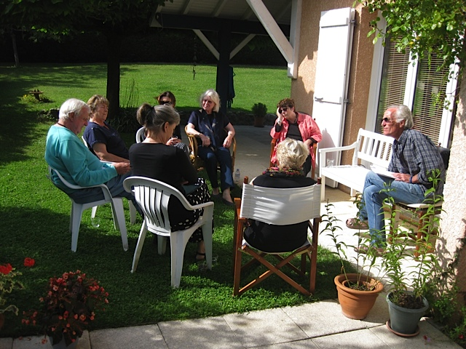
Trio Gatherings A relaxed, neutral place where colleagues can interact on important topics for mutual learning and mutual support
Global Citizenship and Poverty
Leadership in an Age of Turmoil
Notes:
Trio Gatherings provide a relaxed, neutral place where colleagues can interact on important topics for mutual learning and mutual support. They are informal and not sponsored by any organization/group. The gatherings are part of our commitment to encourage “global integration”—connecting relationally and contributing relevantly on behalf of the major issues facing humanity and in light of our core values and integrity. The hosts (Michèle and Kelly O'Donnell) are consulting psychologists working in the areas of personnel development for international organisations, humanitarian psychology, anti-corruption advocacy/action, and global mental health. The gatherings are done in sets of three, hence "Trio."
https://sites.google.com/site/virtrios/

Slide 13
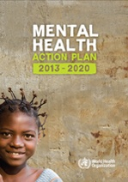
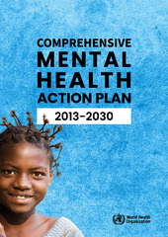
Global Mental Health for/from the Faith-Based Sector Mental Health as Mission SDG 3 : ”Ensure healthy lives and promote wellbeing for all ages” including mental health, substance abuse, suicide
Vision: “A world in which mental health is valued, promoted, and protected, mental disorders are prevented and persons affected by these disorders are able to exercise the full range of human rights and to access high-quality, culturally appropriate health and social care in a timely way to promote recovery, all in order to attain the highest possible level of health and participate fully in society and at work free from stigmatization and discrimination.” Mental Health Action Plan 2013-2030, World Health Organization (2013, 2021)
See: Global Mental Health as Mission (gmhM) Member Care Update April 2016
See also: Global Integration: Addressing the Pressing Issues Facing Our World Christian Psychology Around the World, March 2016, pages 191-194

Slide 14
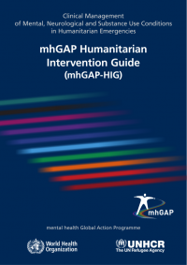
Two MH Resources—WHO Psychological First Aid (2011) mhGAP Humanitarian Intervention Guide (2015)

Slide 15
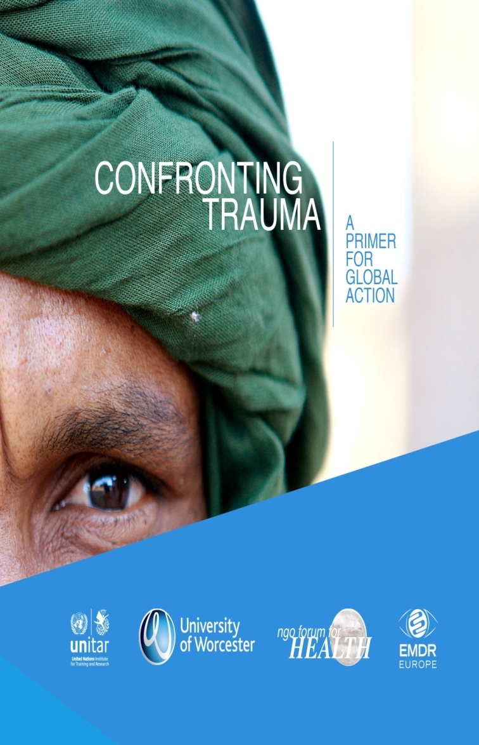
Trauma: --a global lens: across cultures, sectors, generations, SDGs, etc --prevention and treatment --social determinants of health & wellbeing United Nations Institute for Training and Research (UNITAR)
Video:
Living Peace: The Story of Abby and Kyalu Trauma and treatment in Democratic Republic of Congo, Promundo See also: --The Trauma Pandemic: A Global Lens for Global Action (6 April 2019) & Handouts K & M O’Donnell, International Trauma Collaborative, Multnomah University, USA --O’Donnell, K. (2017). Unbreakable? Recognizing humanitarian stress and trauma. Global Geneva, Issue 3, 56-57 (hard copy and online pp. 60-61)
Notes:
O’Donnell, K., and Pidkoke, H. (2017). Module One: Introduction to stress, resilience, and self-care. In Farrell, D., with Blenkinsop, C., Carriere, R., Croci, C., O’Donnell, K., and Pidcoke, H. Confronting stress and trauma: A resource kit for personnel dealing with violent conflicts and natural disasters; (pp. 25-63). University of Worcester in association with the United Nations Institute for Training and Research.

Slide 16
“Triple-Nexus: Humanitarian-Development-Peace Sectors
“We are a world in pieces. We need to be a world at peace.” UN Secretary-General António Guterres (UN General Assembly, 19 September 2017)
Integrity and Moral Health for a More Whole World (7 Nov 2018) video Health for Peace: Contributions from Peace Psychology (7 Nov 2018) power point Geneva Peace Week 2018, United Nations
See also: --Peace Psychology and Sustaining Peace Global Integration Update (May 2018) --Arming the World–Promoting Positive Peace Global Integration Update (September 2022)
Add info prepared for WFMH Moral Disengagement (GI update?) OCHA head etc
Pic of UN GA of Peacebilding HL meeting?
Peace Psychology for a Peaceful World

Slide 17
United Nations General Assembly High Level Meeting: Peacebuilding and Sustaining Peace
The High Level Meeting was called for and convened by H.E. Mr. Miroslav Lajčák, the president of the 72nd session of the General Assembly (24-26 April 2018, UN New York). It sought to build upon the peace emphases in the UN and especially to follow up a) two 2016 resolutions by the UN Security Council and the UN General Assembly on the Review of the United Nations Peace Building Architecture (more information HERE) and b) many other recent documents/resolutions including the Secretary General’s 2015 report the Future of the UN Peace Operations (implementation of the recommendations of the 2015 High-level Independent Panel on Peace Operations).
I (Kelly) attended in my capacity as a Representative of the World Federation for Mental Health to the UN. “I was impressed by Dialogue Three: Strategic Partnerships with the United Nations, especially by Jeffery Sachs' candid comments (starting around 23 minutes 30 seconds) on the need for clearer typologies of violent conflict; the reality of serious lying; proxy wars; major powers threatening overall world stability via the ongoing covert and overt operations; and the need for honest reporting and real debates regarding the arms trade that feed wars—follow the money and the arms and armies and you will see what is feeding wars and who is benefiting economically.”

Slide 18
Peace + Corruption et al .
See also the UN GA Special Session Against Corruption 2-4 June 2021 and the work and resources of the UN Office on Drugs and Crimes

Slide 19
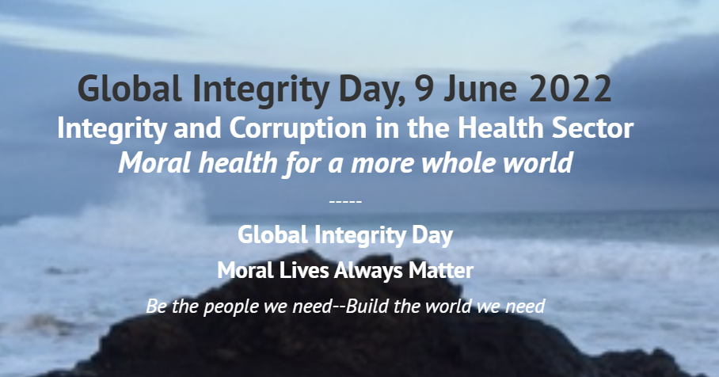
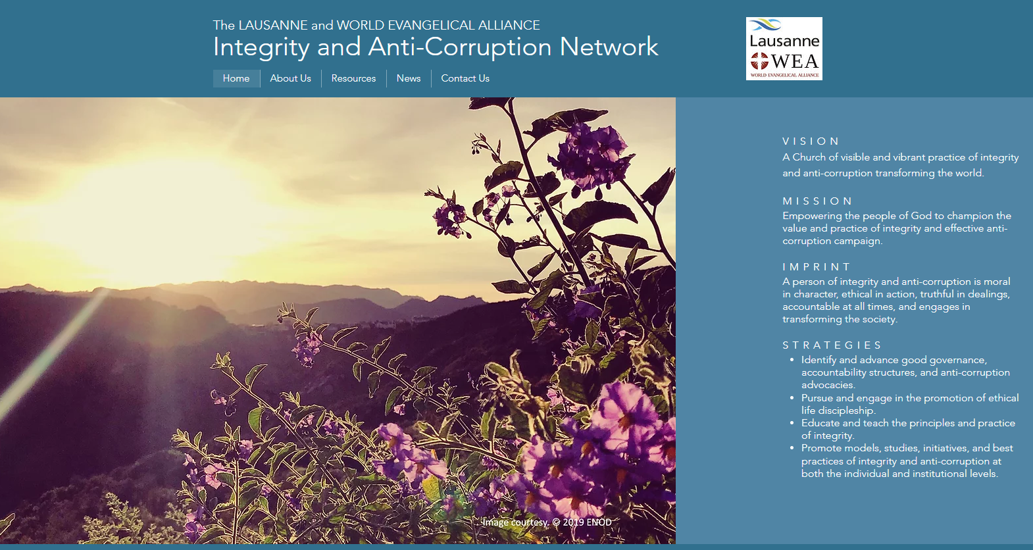

Slide 20
Global Integrity moral wholeness for a whole world
Integrity is moral wholeness—living consistently in moral wholeness. Its opposite is corruption, the distortion, perversion, and deterioration of moral goodness, resulting in the exploitation of people.
Global integrity is moral wholeness at all levels in our world—from the individual to the institutional to the international. Global integrity is requisite for “building the future we want—being the people we need.”
Core Resources
A Summons to a Global Integrity Movement: Fighting Self-Deception and Corruption Lausanne Global Analysis (March 2018)
CORE Member Care--25 entries on Global Integrity (2016)
“These entries explore the many facets of integrity with a view towards the global efforts to promote sustainable development and wellbeing.”
--Why Can’t Grace Go to School? EXPOSED Campaign (2014); corruption is close/complicated
--Courage or Cowardice? TedxTalk, Mukesh Kapila (2013); will the UN rep to Sudan whistleblow?

Slide 21
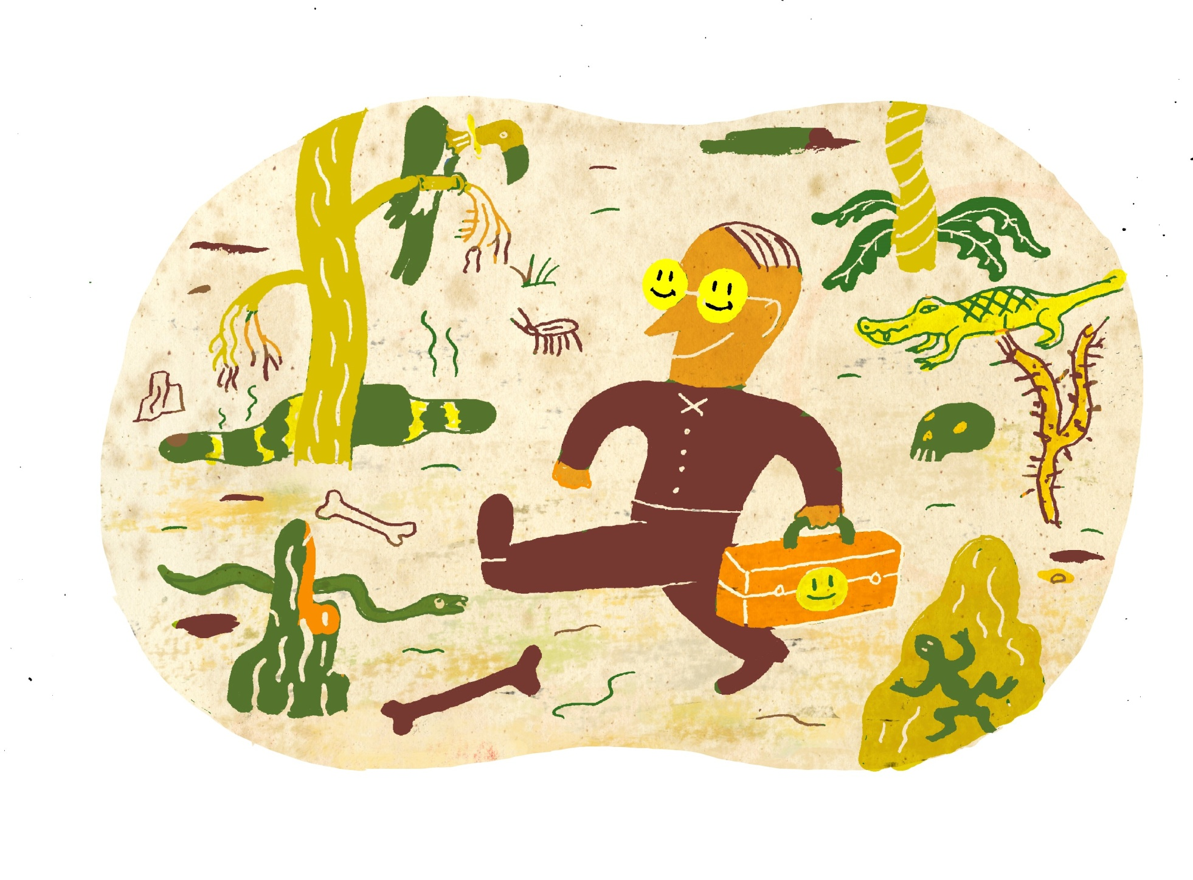
.
Integrity and Accountability for United Nations Staff Parts 1 and 2, UN Special (March 2017 and April 2017)
Image: Marc Rosenthal (website)

Slide 22
PETRA People Update (October 2022) Key resources to support integrity and anti-corruption in your life, organizations, and spheres of influence
“Corruption is criminal, immoral and the ultimate betrayal of public trust.….We must hold leaders to account….A vibrant civic space and open access to information are essential. And we must protect the rights and recognize the courage of whistle-blowers who expose wrongdoing….As an age-old plague takes on new forms, let us combat it with new heights of resolve.” UN Secretary-General António Guterres, Statement on corruption in the context of COVID-19 (15 October 2020)
Unveiling our Stories: Victims of Corruption is a short film series featured in the August 2022 update from the UNCAC-Civil Society Coalition (major coalition focusing on implementation of the 2003 UN Convention Against Corruption). Example film: Corruption Files: The Whistleblower.
Journey to the Truth is a series of podcasts by five journalists done by Journalists for Transparency (J4T). The series explores issues of transparency-corruption around the globe and is an initiative of the International Anti-Corruption Conference--next one Washington DC, Dec 2022
Five interviews with advocates around the world by Lausanne-WEA Global Integrity Network in its online conference on Integrity and Anti-Corruption on the Frontline” (30 April 2002, about 20 minutes each). Example: A Psychologist's Journey into Global Integrity--interview with Kelly

Slide 23
Pulling it All Together Seven Directional Commitments for GI in the Missio Dei Frontiers Based on Well-Being for All: MHPs and the SDGs Journal of Psychology and Christianity (March 2017)
Commitment 1. We commit to diligently pursue our own journeys of personal and professional growth: to grow deeply-go broadly into the missio Dei with the gospel. Commitment 2. We commit to integrate the inseparable areas of our character (resilient virtue) and competency (relevant skills) with compassion (resonant love). Commitment 3. We commit to go into new areas of learning and work: crossing sectors, cultures, disciplines, and comfort zones. Commitment 4. We commit to embrace our duty to work in difficult settings, including those permeated by conflict, calamity, corruption, and poverty as those in great need are often in places of great risk. Commitment 5. We commit to have clear ethical commitments and standards that guide our work, respecting the dignity and worth of all people and the planet. Commitment 6. We commit to working with others to promote wellbeing and sustainable development, building the future we want--being the people we need. Commitment 7. We commit to base our work on the practice of fervently loving other people—agape. This type of love is the foundational motive and the ultimate measure of our GI work in the Missio Dei Frontiers.
Notes:
Issues, Interests, Influences 1. Interests: Pursue your passions
--What issues matter to you the most?
List them.
2. Involvements : Till the terrain
--What types and levels of involvement are realistic for you, and with whom?
Continuum of Involvement
Informed----------Included----------Immersed
3. Influences: Get a grid
--What has influenced your desire and ability to connect-contribute in GI?
List 3 items for each of the categories below.
Principles/Beliefs
Documents/Materials
Organizations/Groups
People/Models
Milestones/Gravestones
Charting your future course
Source: “Charing Your Course through the Sectors” chapt 2 in Global Member Care vol 2 (2013
See also: Seven Is for Gis--Global Integrators 21, 15 Nov. 2015

Slide 24
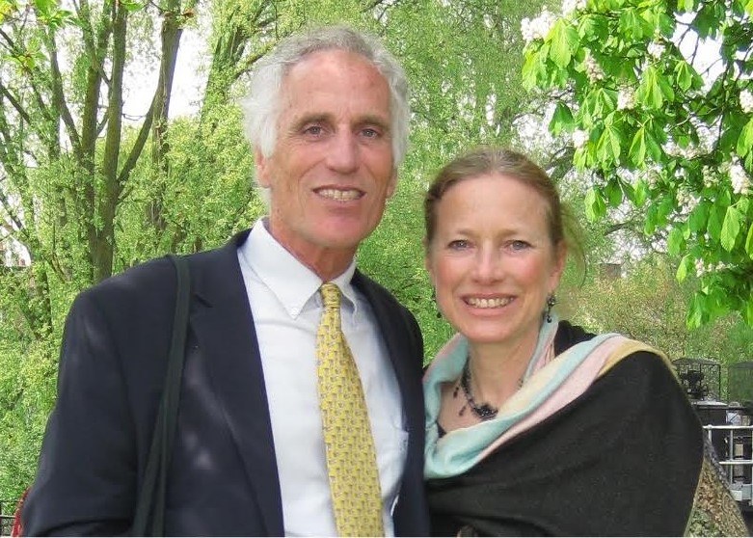
.
Thank you!
Global Integration: Our Journey into the Missio Dei Frontiers
Kelly and Michèle
Kelly and Michèle O’Donnell Consulting Psychologists, Member Care Associates, Inc.
mcaresources@gmail.com www.membercareassociates.org
Notes:
Dr. Kelly O’Donnell is a consulting psychologist based in Geneva and the CEO of Member Care Associates, Inc. (MCA). His multi-sectoral work in mission focuses on staff wellbeing and effectiveness, global mental health and sustainable development, and integrity and anti-corruption. Extensive resources and recent publications-presentations-projects are on the MCA website (membercare.org) and shared in their monthly Global Integration Updates and Member Care Updates. Kelly works closely with his wife Michèle, also a psychologist, and they have two adult daughters: Erin and Ashling.
Email: MCAresources@gmail.com

