Slide 1
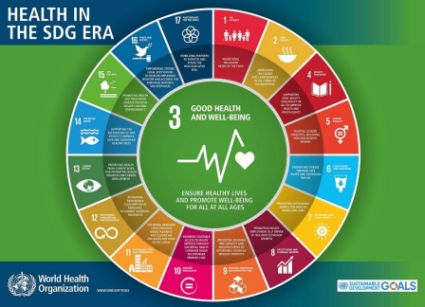
Wellbeing for All Global Mental Health Developments and Directions Congreso Argentino de Salud Mental 7 October 2020 Kelly O’Donnell, PsyD Member Care Associates MCAresources@gmail.com http://membercareassociates.org ©2020 Kelly O’Donnell—see the notes under the slides too
Notes:
Note: We are based in Geneva and the USA and speak regularly on the topics of global integration, global mental health, member care, and integrity/anti-corruption, in person and remotely. We have found that a 90 minute lecture at a graduate school, for example, is good to give an overview, perhaps even inspire folks, yet understandably it can usually only go so far and thus an overall strategy by graduate schools is needed for including “global” perspectives and material throughout the curriculum/training. This might require an intentional, informed, consensual shift. Key to this shift is cultivating a more “global” mentality and mentors/models with not just ‘international” (different nations) experience but multi-sectoral, global experience (with issues that transcend geo-political borders—problems without passports). Note for instance, within the multi-disciplinary field of psychology, the American Psychological Association’s recent Strategic Plan (2019) which explicitly calls the organization and its members to “Embrace a global mentality.”

Slide 2
Purpose
To orient colleagues in mental health and in different sectors to Global Mental Health (GMH).
To review recent developments and directions
(GMH markers).
To consider ways to connect and contribute to GMH on behalf of wellbeing for all people, locally through globally.

Slide 3
GMH Overview Three Resources
Global Mental Health: Collaborating Across Sectors for Sustainable Development and Wellbeing (June 2017) Medicus Mundi Switzerland, Bulletin
Global Mental Health: What’s Up? Recent Developments and Directions (June 2019) Global Insights, Office of International Affairs, APA (Full version here)
Mental Health for Sustainable Development: A Topic Guide for Development Professionals. (January 2020) K4D Emerging Issues Report

Slide 4
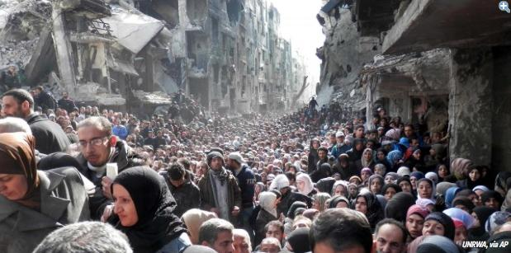
.
Wellbeing for All GMH Overview
To say “Your side of the global boat is sinking”... is crazy. We are all on the same precarious, perilous, and precious global boat.
Notes:
-- Palestinian refugees residing in Syria--forcibly displaced again--refugees twice over.
Yarmouk refugee camp, February 2014.
Current estimates of forcibly displaced people worldwide: 80+ million people (UNHCR)
--Syria (and Lebanon) – complex recent history of civil war: the Palestinians given refuge are twice refugees in the current Syrian civil war.
--Article: The Palestinians Fleeing Syria Are Among the Most Vulnerable Refugees (Dec. 4, 2015, thenation.com) Their special legal status leaves them stateless, even after decades of exile, and without the same rights as other refugees. By Mai Abu Moghli and Nael Bitarie link:https://www.thenation.com/article/the-palestinians-fleeing-syria-are-among-the-most-vulnerable-refugees/
History in Syria: several waves of Palestinian refugees since 1948 (by 2011, more than 560,000 refugees living in Syria). Also, there is a large Iraqi refugee population.
“Globe-ails” is a term we use to encapsulate the many major problems--ails--affecting the people-planet nexus, including our yearnings-groanings for the full restoration of humanity and the planet. See: --Doomsday: Next Stop, Global Dis-Integration? (Global Integration Update, June 2017)

Slide 5
My Journey into GMH GMH-Map
A collaborative project (2011-current) --to orient colleagues to Global Mental Health (GMH) --to promote sustainable wellbeing for all people/planet.
Examples of our 10+ GMH articles as well as presentations HERE.
Notes:
Excerpt from :
Global Mental Health: What’s Up? Recent Developments and Directions (June 2019) Global Insights, Office of International Affairs, APA (Full version here)
“GMH at first can seem daunting, even “foreign.” But the more you track with it, the more manageable and familiar it becomes. Two influential factors for GMH becoming more organized were the launch of the first Lancet Report on GMH (2007) and the formation of the Movement for Global Mental Health (2008). For more background information, see the historical notes in the Lancet Commission’s Report of GMH and Sustainable Development (2018, pages 1556-1561) and the GMH overview in O’Donnell and Eaton, 2017. For updates see the GMH-Map website with links to GMH newsletters, GMH texts,
and GMH critiques as well as Globally Minded for a GMH events list and a list of international psychology-related events from the American Psychological Association’s Office of International Affairs.”

Slide 6
.
“Mental health affects and is affected by many crucial issues pertinent to global development and quality of life, including poverty, food security, trauma, conflict, interpersonal violence, terrorism, gender equality, education, human security, natural disasters, and climate change.
…mental ill health [contributes] significantly to the total global burden of disease. Anxiety and depression for example, respectively affect an estimated 264 million and 322 million people and contribute to an estimated 3.4% and 7.5% of all years lived with disability. Depression is the single largest contributor to global disability. (WHO, 2017a)” [note: estimates vary]
O’Donnell and Eaton, 2017

Slide 7
.
“Despite the fact that there are hundreds of millions of people experiencing a mental, neurological, or substance use condition, the attention paid to these conditions has been scant historically.
Even in high income countries only 35-50% of the people with severe mental disorders receive treatment, and in low income countries the vast majority, typically 76-85%, receive little or no effective care (WHO, 2013, p. 8).
In sub-Saharan Africa, governments spend only around 1% of their health budgets on mental health, a number that is very similar to the proportion of international development assistance for health dedicated to mental health (Gilbert, Patel, Farmer, and Lu, 2015)
O’Donnell and Eaton, 2017
Notes:
Excerpt from:
Global Mental Health: What’s Up? Recent Developments and Directions (June 2019) Global Insights, Office of International Affairs, APA (Full version here)
“GMH has contributed to making the mental health and wellbeing of populations a primary global concern for the first time. It has brought together often divergent academic and practice traditions to offer the potential for evidence- and values-based action to impact on the quality of life of people around the world, who were previously neglected. In particular there has been progression the broader conceptualization of mental health and acknowledging its many determinants, the role of those with lived experience, and the development of psychological interventions that are culturally-sensitive and scalable, deliverable by supervised non-specialists. “The global community has a historic opportunity to reframe the global mental health agenda by use of the broader conceptualisation of mental health and disorder, and to position this agenda as an integral element of the [Sustainable Development Goals, SDGs]” (Lancet Commission’s Report of GMH and Sustainable Development, 2018, page 1561).”

Slide 8
.
Further, the extreme neglect, human rights abuse, and social exclusion of people with mental illness means that they could be seen as the epitome of people who are “left behind.”
In addition, “people with these disorders are often subjected to social isolation, poor quality of life and increased mortality. These disorders are the cause of staggering economic and social costs.” (WHO Department of Mental Health, The Bare Facts).”
O’Donnell and Eaton, 2017

Slide 9
Convention on the Rights of Persons with Disabilities (2006)
Article 1--Purpose
The purpose of the present Convention is to promote, protect and ensure the full and equal enjoyment of all human rights and fundamental freedoms by all persons with disabilities, and to promote respect for their inherent dignity.
Persons with disabilities include those who have long-term physical, mental, intellectual or sensory impairments which in interaction with various barriers may hinder their full and effective participation in society on an equal basis with others.​
Notes:
Quotes below from UN CRPD website. https://www.un.org/development/desa/disabilities/convention-on-the-rights-of-persons-with-disabilities.html
“The Convention on the Rights of Persons with Disabilities and its Optional Protocol (A/RES/61/106) was adopted on 13 December 2006 at the United Nations Headquarters in New York, and was opened for signature on 30 March 2007. There were 82 signatories to the Convention, 44 signatories to the Optional Protocol, and 1 ratification of the Convention. This is the highest number of signatories in history to a UN Convention on its opening day. It is the first comprehensive human rights treaty of the 21st century and is the first human rights convention to be open for signature by regional integration organizations. The Convention entered into force on 3 May 2008.
The Convention follows decades of work by the United Nations to change attitudes and approaches to persons with disabilities. It takes to a new height the movement from viewing persons with disabilities as “objects” of charity, medical treatment and social protection towards viewing persons with disabilities as “subjects” with rights, who are capable of claiming those rights and making decisions for their lives based on their free and informed consent as well as being active members of society.
The Convention is intended as a human rights instrument with an explicit, social development dimension. It adopts a broad categorization of persons with disabilities and reaffirms that all persons with all types of disabilities must enjoy all human rights and fundamental freedoms. It clarifies and qualifies how all categories of rights apply to persons with disabilities and identifies areas where adaptations have to be made for persons with disabilities to effectively exercise their rights and areas where their rights have been violated, and where protection of rights must be reinforced.
The Convention was negotiated during eight sessions of an Ad Hoc Committee of the General Assembly from 2002 to 2006, making it the fastest negotiated human rights treaty.”

Slide 10
Global Mental Health Defined
“Global Mental Health (GMH) is an emerging domain of research and practice that promotes equitable mental health and well-being for all.
GMH is international, interdisciplinary, culturally relevant and multi-sectoral.
GMH emphasizes the right to equity in health and encourages healthy behaviors and lifestyles.
GMH is committed to preventing and treating mental, neurological, and substance use conditions (MNS) especially for vulnerable populations such as poverty, conflict, and trauma and in low- and middle-income countries.
GMH seeks to improve policies and programs, professional practices and research, advocacy and awareness, and social and environmental factors that affect mental health and well-being.”
(O’Donnell and Lewis O’Donnell, 2016 and O’Donnell and Eaton, 2017).
Notes:
--GMH shaped by public health, human rights, clinical science, and cultural anthropology.
--It is not simply something that concerns specialists--“psychology-psychiatry, psychotherapy, and psychopharmacology.”
--Note: personally, 2009 is the year we began to intentionally connect with the young GMH movement. It would be accurate to say that the initial GMH “movement” was significantly shaped via the launching of: The Lancet’s GMH Special Issue (2007), the formation of the Movement for Global Mental Health (2008), and the mhGAP Program by the World Health Organization (2008). There were plenty of precursors and other influences as well. And there were concerns and detractors from the start about a perceived over emphasis on Western concepts for mental ill health, psychiatry, and pharmacology. --For a helpful critique of GMH, see Kirmayer and Peterson’s introductory article in the special issue on GMH in the Journal of Trans-Cultural Psychiatry (December 2014, this article is open access). https://journals.sagepub.com/doi/full/10.1177/1363461514557202

Slide 11
Message for World Mental Health Day-10 October 2018 UN Secretary-General António Guterres
“Health encompasses both physical and mental well-being. Yet, for too long, mental health has been mostly an afterthought, despite its overwhelming impacts on communities and young people, everywhere….Healthy societies require greater integration of mental health into broader health‑ and social‑care systems, under the umbrella of universal health coverage. The United Nations is committed to creating a world where, by 2030, everyone, everywhere has someone to turn to in support of their mental health, in a world free of stigma and discrimination. If we change our attitude to mental health—we change the world. It is time to act on mental health.”

Slide 12
Lancet Commission on GMH and Sustainable Development (October 2018)
Summary of Key Recommendations
Address mental health across all the Sustainable Development Goals
Include mental health in the essential package of services for Universal Health Coverage
Take a public health approach to prevention and promotion
Ensure inclusion of people with mental health conditions
Increase investment in mental health
Harness learning from research to help drive change
Measure progress against existing commitments
Source: MHIN Policy Brief October 2018
Notes:
“Lancet Commission on GMH and Sustainable Development (10 October 2018). The 2018 Commission
report was launched in London at the Global Ministerial Mental Health Summit (see below). “A decade
on from the 2007 Lancet Series on global mental health, which sought to transform the way policy
makers thought about global health, a Lancet Commission aims to seize the opportunity offered by
the Sustainable Development Goals to consider future directions for global mental health. The
Commission proposes that the global mental agenda should be expanded from a focus on reducing
the treatment gap to improving the mental health of whole populations and reducing the global
burden of mental disorders by addressing gaps in prevention and quality of care. The Commission
outlines a blueprint for action to promote mental wellbeing, prevent mental health problems, and
enable recovery from mental disorders.” (abstract) Note: The Lancet also announced the creation
of Countdown Global Mental Health, a monitoring and accountability mechanism that draws on the
Commission’s recommendations to assess mental health determinants, system and service
components, outcomes, and risk protection. Note also My Mind Our Humanity, the GMH campaign
led by young people to disseminate the Lancet Commission report to young people worldwide
#LancetGMH and #THEWORLDNEEDS.”
Above quote from: Global Mental Health: What’s Up? Recent Developments and Directions (June 2019) Global Insights, Office of International Affairs, APA (Full version here)

Slide 13
COVID-19 and the Need for Action on Mental Health UN Policy Brief, 13 May 2020. 17 pages including an Executive Summary
“Although the COVID-19 crisis is, in the first instance, a physical health crisis, it has the seeds of a major mental health crisis as well, if action is not taken. Good mental health is critical to the functioning of society at the best of times. It must be front and centre of every country’s response to and recovery from the COVID-19 pandemic. The mental health and wellbeing of whole societies have been severely impacted by this crisis and are a priority to be addressed urgently.” (Antonio Guterres, opening paragraph in the Executive Summary).
Video message/text by Antonio Guterres on the launch of the UN Brief on COVID-19 and Mental Health, 13 May 2020, (2 minutes 45 seconds).

Slide 14
The Impact of COVID-19 on Mental, Neurological, Substance Use Conditions WHO Survey, 5 October 2020
--130 countries surveyed during the period June-August 2020. --It provides information about the extent and types of disruption to MNS services due to COVID-19, and how countries are adapting to overcome these challenges. --Over 60% reported disruptions to mental health services for vulnerable people, including children and adolescents (72%), older adults (70%), and women requiring antenatal or postnatal services (61%).
67% saw disruptions to counseling and psychotherapy; 65% to critical harm reduction services; ---More than a third (35%) reported disruptions to emergency interventions…

Slide 15
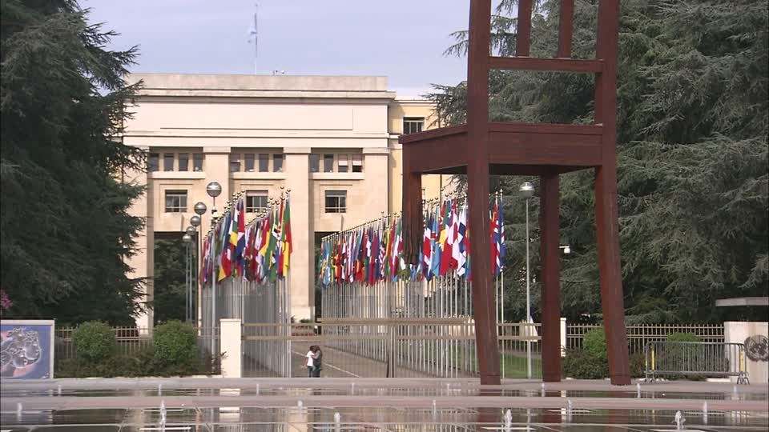
.
Wellbeing for All GMH Developments and Directions (10 GMH Markers)
Notes:
--The image is an entrance to the UN Geneva. Just outside of the UN (facing it) is a sculpture commemorating land mine victims. But there is so much going on in this picture, in this space….with humanity--broken people and the world powers-- facing each other…What do we do?

Slide 16
GMH Marker 1 There is a mental health pandemic And it is increasingly being acknowledged
There is a pandemic of mental ill health—estimates vary, but hundreds of millions--people
25% lifetime prevalence. 15-25% shorter life spans than general population
Depression and dementia are major/growing contributors to the global burden of disease.
Massive social and economic costs of not investing in prevention and care.
Notes:
Logo from the conference in Washington DC, April 2016.
See also World Economic Forum, Davos (22-25 January 2019). One of the highlights: Mental Health. Mental health was highly visible at Davos, including major media coverage and stories, a panel session, press conference, Mental Health Matters plenary session, etc. WEF also published a series of articles on mental health: Its Time to End Stigma about Mental Health, How Zimbabwe’s Grandmothers Are Turning the Tide on Mental Health, Why This Year We Must Take Action on Mental Health, and Three Ways the World Must Tackle Mental Health. This is the first time WEF has spotlighted mental health to this degree. Read more about it in the short summary by United for Global Mental Health.

Slide 17
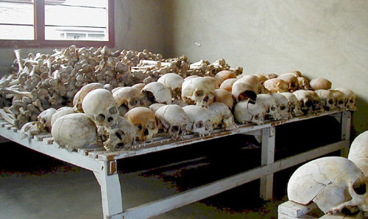
GMH Marker 2 There is a trauma—and violence--pandemic “You can’t just Pontius Pilate 800,000 people.” Romeo Dallaire
.
Notes:
Quote: Romeo Dallaire, the Commander of the UN Peacekeeping Force during the Rwandan genocide. He pleaded for UN intervention prior to the genocide---and invented a verb to describe how easy it is to forget about the genocide now and wash our hands of what it represents. Ken Ringle, “The Haunting: He Couldn’t Stop the Slaughter in Rwanda. Now He Can’t Stop the Memory.” The Washington Post, Saturday, June 15, 2002, Page C01.
Image: Murambi Genocide Memorial. “Here, on April 21st, 1994, between 40,000-50,000 Tutsis and Hutu sympathizers were murdered. The perpetrators carried out the slaughter in over eight hours. The site is a haunting reminder of what this country has endured and what it is still overcoming.” Quote from Letter from Rwanda: A Privileged Engagement (November 2018, Global Geneva magazine), Ashling O’Donnell
http://www.global-geneva.com/letter-from-rwanda-a-privileged-engagement/

Slide 18
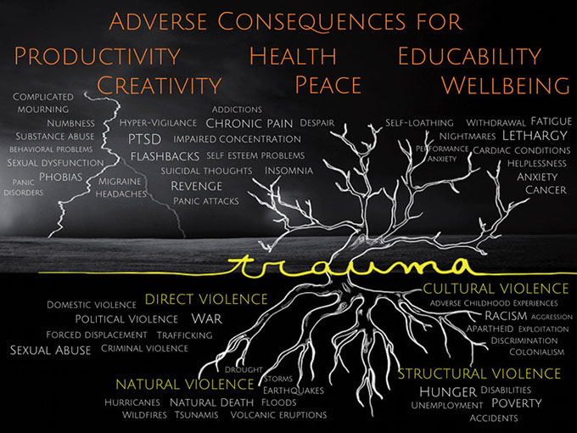
Image courtesy GIST-T
Notes:
Quote from GIST-T website (Global Initiative for Stress and Trauma Treatment).
“Trauma darkens people’s lives—worldwide. Much of that trauma remains hidden, especially in the developing world: unrecognized, undiagnosed, and therefore left untreated.” The causes and consequences of trauma…
This trauma tree is a visual metaphor of the causes and consequences of traumas and traumatic stress.
The image of this trauma tree shows the origins or causes of trauma, depicted as root systems, which can be grouped into four categories, or ‘Four Violences’, a distinction borrowed from Johan Galtung¹:
• Direct violence comprises acts intended to harm human beings
• Natural violence, or the violence of nature, in contrast to direct violence, is both unintended and mostly unavoidable
• Structural violence occurs when a social structure harms people and prevents them from meeting their basic needs—physical, economic or social
• Cultural violence manifests itself in prevailing attitudes, based on beliefs about power and ‘necessity’ of violence.
These Four Violences cause the many unseen scars of ‘silent’ and ‘loud emergencies’, of life’s adversities or accidents and of manmade or natural disasters. Those scars are shown here as the trauma-based disorders and diseases, growing out of the leafless branches of the trauma tree.
These trauma-based disorders and diseases affect not only individuals, but also families, communities and even whole societies. They create an ecosystem of profoundly adverse consequences for human development, for world development, and even for world peace.”

Slide 19
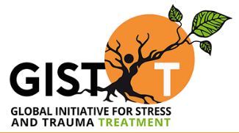
A global lens for trauma: Four Violences Quantified
Direct violence:
1.5 billion people live in countries afflicted by political or criminal violence and war, 300 million people live amidst violent insecurity.
One-third of all women in the world experience sexual, physical or other abuse in their lifetime women are more than twice as likely as men to have PTSD.
“Silent emergencies” - stress at work, bullying, divorce, abandonment, neglect, emotional abuse, etc.
Natural violence:
268 million people are affected annually by natural disasters
Loss of a loved one – in 2012, 56 million people died
Notes:
(4 Violences—Johan Galtung)
Stats from Global Initiative for Stress and Trauma Treatment (GIST-T)
--Direct Violence -GBV – various forms, honor killings, trafficking, domestic violence, dowery killings
--Natural Violence -only momentary attention and relief aid, although its adverse consequences may linger for years.
--Structural Violence - Poverty as a pervasive and insidious social-global reality is a type of traumatic condition of chronic adversity with devastating consequences for mental health. --Cultural violence - Discrimination, oppression, apartheid, colonialism, exploitation and racism all exert a chronic stress that may lead to trauma.

Slide 20
A global lens for trauma: The Four Violences Quantified
Structural violence:
1.22 billion people lived in extreme poverty in 2010 (WB)
< US$1.50 a day; in all, 2.4 billion lived on < US$2 a day that year
Hunger and malnutrition (925 million); 218 million are child laborers
Cultural violence:
Discrimination, oppression, apartheid, colonialism, exploitation and racism all exert a chronic stress that may lead to trauma.
Notes:
Stats from Global Initiative for Stress and Trauma Treatment (GIST-T)
(4 Violences—Johan Galtung)

Slide 21
GMH Marker 3 Mental health affects us all Who is hurting—hiding--helping? We all very likely know someone with a mental health condition!
Film trailer:
https://www.youtube.com/watch?v=Y8Tbiciyzq0
Film website:
http://hiddenpicturesthemovie.com/

Slide 22
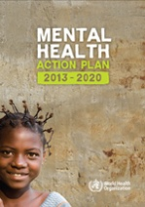
GMH Marker 4 There is no health without mental health WHO Mental Health Action Plan 2013-2020
Vision: “A world in which mental health is valued, promoted, and protected, mental disorders are prevented and persons affected by these disorders are able to exercise the full range of human rights and to access high-quality, culturally appropriate health and social care in a timely way to promote recovery, all in order to attain the highest possible level of health and participate fully in society and at work free from stigmatization and discrimination.”
Notes:
"[The Mental Health Action Plan] takes a comprehensive and multisectoral approach, through coordinated services from the health and social sectors, with an emphasis on promotion, prevention, treatment, rehabilitation, care and recovery. …The action plan has, at its core, the globally accepted principle that there is "no health without mental health." (Mental Health Action Plan 2013-2020, World Health Organization, WHO, 2013, p. 6)

Slide 23
Four Objectives Mental Health Action Plan
Strengthen effective leadership and governance for mental health.
Provide comprehensive, integrated and responsive mental health and social care services in community-based settings.
Implement strategies for promotion and prevention in mental health.
Strengthen information systems, evidence and research for mental health.

Slide 24
Overview: Mental Health Action Plan 2013-2020
Vision A world in which mental health is valued, promoted, and protected, mental disorders are prevented and persons affected by these disorders are able to exercise the full range of human rights and to access high-quality, culturally appropriate health and social care in a timely way to promote recovery, all in order to attain the highest possible level of health and participate fully in society and at work free from stigmatization and discrimination.
Cross-cutting Principles
Universal health coverage Regardless of age, sex, socioeconomic status, race, ethnicity or sexual orientation, and following the principle of equity, persons with mental disorders should be able to access, without the risk of impoverishing themselves, essential health and social services that enable them to achieve recovery and the highest attainable standard of health. | Human rights Mental health strategies, actions and interventions for treatment, prevention and promotion must be compliant with the Convention on the Rights of Persons with Disabilities and other international and regional human rights instruments. |  | Evidence-based practice Mental health strategies and interventions for treatment, prevention and promotion need to be based on scientific evidence and/or best practice, taking cultural considerations into account. | Life course approach Policies, plans, and services for mental health need to take account of health and social needs at all stages of the life course, including infancy, childhood, adolescence, adulthood and older age. | Multisectoral approach A comprehensive and coordinated response for mental health requires partnership with multiple public sectors such as health, education, employment, judicial, housing, social and other relevant sectors as well as the private sector, as appropriate to the country situation. |  | Empowerment of persons with mental disorders and psychosocial disabilities Persons with mental disorders and psychosocial disabilities should be empowered and involved in mental health advocacy, policy, planning, legislation, service provision, monitoring, research and evaluation.
Goal To promote mental well-being, prevent mental disorders, provide care, enhance recovery, promote human rights and reduce the mortality, morbidity and disability for persons with mental disorders
Objectives and Targets
1. To strengthen effective leadership and governance for mental health Global target 1.1: 80% of countries will have developed or updated their policy/plan for mental health in line with international and regional human rights instruments (by the year 2020). Global target 1.2: 50% of countries will have developed or updated their law for mental health in line with international and regional human rights instruments (by the year 2020). |  | 2. To provide comprehensive, integrated and responsive mental health and social care services in community-based settings Global target 2: Service coverage for severe mental disorders will have increased by 20% (by the year 2020). |  | 3. To implement strategies for promotion and prevention in mental health Global target 3.1: 80% of countries will have at least two functioning national, multisectoral mental health promotion and prevention programmes (by the year 2020). Global target 3.2: The rate of suicide in countries will be reduced by 10% (by the year 2020). |  | 4. To strengthen information systems, evidence and research for mental health Global target 4: 80% of countries will be routinely collecting and reporting at least a core set of mental health indicators every two years through their national health and social information systems (by the year 2020).

Slide 25
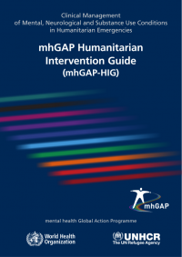
Two MH Resources—WHO Psychological First Aid (2011) mhGAP Humanitarian Intervention Guide (2015)
Notes:
Psychological First Aid: Guide for Field Workers (WHO, World Vision, War Trauma Foundation, 2011) is the most widely used resource for helping front-line workers to provide psychosocial support to people and communities affected by distressing events.
mhGAP Humanitarian Intervention Guide 2.0, 2016 https://www.who.int/publications-detail-redirect/mhgap-intervention-guide---version-2.0
“This is the second version (2016) of the mhGAP Intervention Guide (mhGAP-IG) for mental, neurological and substance use (MNS) disorders in non-specialist health settings. It is for use by doctors, nurses, other health workers as well as health planners and managers. The Intervention Guide presents the integrated management of priority MNS conditions using algorithms for clinical decision making. This update of the 2010 edition is based on new evidence as well as extensive feedback and recommendations from experts in all WHO regions who have used mhGAP-IG Version 1.0. The key updates include: content update in various sections based on new evidence; design changes for enhanced usability; a streamlined and simplified clinical assessment that includes an algorithm for follow-up; inclusion of two new modules - Essential Care and Practice that includes general guidelines and Implementation module to support the proposed interventions by necessary infrastructure and resources; and, revised modules for Psychoses, Child and Adolescent Mental and Behavioural Disorders and Disorders due to Substance Use.”

Slide 26
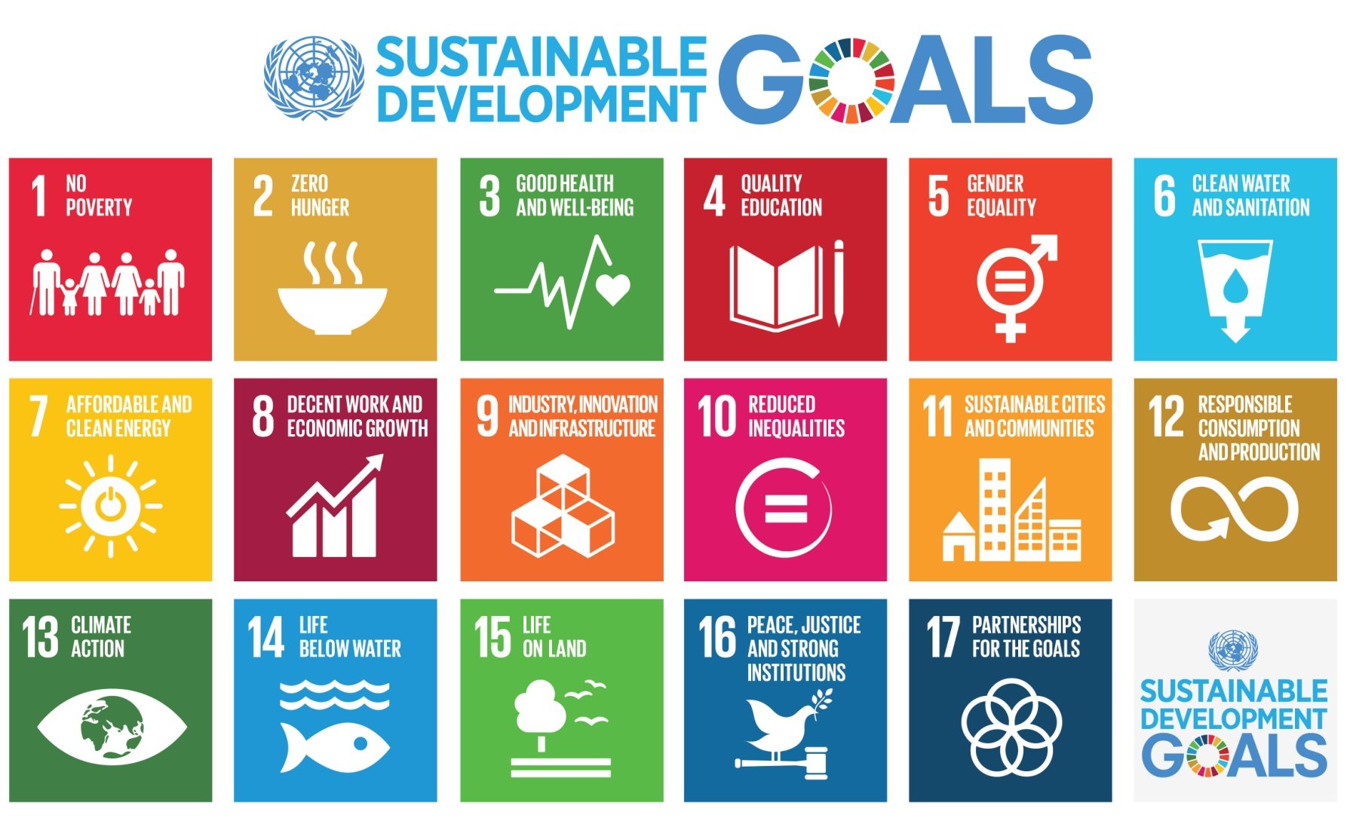
GMH Marker 5 There is no sustainable development without mental health Transforming Our World: The 2030 Agenda for Sustainable Development (Sept. 2015)
.
"Today we are also taking a decision of great historic significance. We resolve to build a better future for all people, including the millions who have been denied the chance to lead decent, dignified and rewarding lives and to achieve their full human potential. We can be the first generation to succeed in ending poverty; just as we may be the last to have a chance of saving the planet…” (paragraph 50)
The five overlapping themes in the SDGs: People-Peace-Prosperity-Planet-Partnership
Notes:
We are aware that there are different perspectives about the United Nations. It has many strengths and weaknesses, accomplishments and failures. In spite of its shortcomings, we are convinced of its critical importance in our world along with the huge opportunities--and moral responsibilities--that are before us all via the sustainable development Agenda. We encourage you to carefully review the Agenda, noting especially its core which consists of 17 goals and 169 targets. It is a plan of action that involves five overlapping areas: People, Planet, Prosperity, Peace, and Partnerships.
--How are we connecting and contributing to the SDGs? --Will the SDGs morph into the Sustainable Survival Goals? See: Global Integration Updates (Member Care Associates) Doomsday? Next Stop, Global Dis-Integration (June 2017) and Faith-Based Partners in Transformation (August 2015)

Slide 27
Notes:
Multi-dimensional poverty…not just “economic poverty.”
Update:
Achieving the SDGs; Delivering on Mental Health for All, webinar 24 September 2020, Devex and GMH Action Network https://pages.devex.com/unga75-uhc-pavilion.html
“In 2020 the focus of UNGA is the “Decade of Action”, focussing on the final ten years of action on the Sustainable Development Goals (SDGs). To achieve the SDGs — and particularly Goal 3 of ensuring healthy lives and promoting well-being for all — it is vital that we include mental health. Ensuring good mental health for all means guaranteeing the fundamental right to mental health support, not only through equitable access to mental health services through health systems, but by the promotion of good mental health throughout society and the environments we live in. Therefore, in order to promote wellbeing and productivity mental health investment needs to happen across multiple social and economic development issues. Our mental health has an impact on every aspect of our lives, and likewise, mental health is intertwined with all SDGs; it is currently the most untapped and underinvested resource to ensure progress on the SDGs. As we gear up to the decade of delivery, to not only build back societies and health systems following the pandemic — but also to resume efforts to achieve the SDGs — we must ensure accelerated action to guarantee mental health for all. With hundreds of millions of people trapped at home during the pandemic, and its consequent lockdowns, and so many experiencing traumatic events, and the severe interruption to mental health services, mental health has become an even more prominent issue – it is crucial that strong mental health policies are at the center of recovery efforts.”

Slide 28
SDGs—and SDG 3
Goal 1 End poverty in all its forms everywhere
Goal 2 End hunger, achieve food security and improved nutrition and promote sustainable agriculture
Goal 3 Ensure healthy lives and promote well-being for all at all ages.
Goal 3.4 By 2030, reduce by one third premature mortality from non-communicable diseases through prevention and treatment and promote mental health and well-being
Goal 4 Ensure inclusive and equitable quality education and promote lifelong learning opportunities for all
Goal 5 Achieve gender equality and empower all women and girls
Goal 6 Ensure availability and sustainable management of water and sanitation for all
Goal 7 Ensure access to affordable, reliable, sustainable and modern energy for all
Goal 8 Promote sustained, inclusive and sustainable economic growth, full and productive employment and decent work for all
Goal 9 Build resilient infrastructure, promote inclusive and sustainable industrialization and foster innovation
Goal 10 Reduce inequality within and among countries
Goal 11 Make cities and human settlements inclusive, safe, resilient and sustainable
Goal 12 Ensure sustainable consumption and production patterns
Goal 13 Take urgent action to combat climate change and its impacts
Goal 14 Conserve and sustainably use the oceans, seas and marine resources for sustainable development
Goal 15 Protect, restore and promote sustainable use of terrestrial ecosystems, sustainably manage forests, combat desertification, and halt and reverse land degradation and halt biodiversity loss
Goal 16 Promote peaceful and inclusive societies for sustainable development, provide access to justice for all and build effective, accountable and inclusive institutions at all levels
Goal 17 Strengthen the means of implementation and revitalize the global partnership for sustainable development
Notes:
There are three “Targets” under Goal 3 that have important implications for not just mental health but overall health and sustainable development themselves (the SDGs have 169 Targets):
By 2030, reduce by one third premature mortality from non-communicable diseases through prevention and treatment and promote mental health and well-being (3.4)
Strengthen the prevention and treatment of substance abuse, including narcotic drug abuse and harmful use of alcohol (3.5)
Achieve universal health coverage, including financial risk protection, access to quality essential health-care services and access to safe, effective, quality and affordable essential medicines and vaccines for all (3.8).

Slide 29
GMH Marker 6 “Nothing about us without us” Empowerment and Human Rights
“Listen to and engage people with lived experience.
Facilitate meaningful participation at all stages of development and implementation of services. Strengthen the advocacy voice of people affected to hold governments accountable.”
--One of the seven key recommendations, Lancet Commission on GMH and SD, October 2018
Notes:
Seven key recommendations of the Lancet Commission --1. Reframe mental health within the Sustainable Development Goal Framework Mental wellbeing is a universal attribute, and we need to think beyond just treating mental illness. Integrate mental health into development work across sectors, not just health services. --2. Establish mental health care as a pillar of Universal Health Coverage Ensure that there is parity in investment and prioritisation for mental health care, and address gaps in accessibility and quality of services, with care being available at primary level. --3. Use public policies to protect mental health Promote mental health and prevent illness by implementing targeted public health strategies at key stages in the life course, including in maternal and infant health, education and suicide. --4. Listen to and engage people with lived experience Facilitate meaningful participation at all stages of development and implementation of services. Strengthen the advocacy voice of people affected to hold governments accountable. --5. Invest far, far more in mental health Increase dedicated mental health funds to 5-10% of national or agency health budgets, and include mental health in funds for research and implementation in other sectors. --6. Use research to guide innovation and implementation Invest in research, and make use of new evidence for service reform and improving population wellbeing - from neurosciences to implementation science. --7. Strengthen monitoring and accountability Follow through on commitments to meet key development targets. Ensure mental health indicators are present in national health information systems and programme evaluation.

Slide 30
Cape Town Declaration (2011) Pan African Network of People with Psychosocial Disabilities
“We recognise that people with psychosocial disabilities have been viewed in bad ways, with derogatory words being used to describe us such as mentally disturbed, having unsound minds, idiots, lunatics, imbeciles and many other hurtful labels We are people first!
We have potentials, abilities, talents and each of us can make a great contribution to the world. We in the past, presently and in the future, have, do and will continue to make great contributions if barriers are removed….
For as long as others decide for us, we do not have rights. No one can speak for us. We want to speak for ourselves.
We want to be embraced with respect and love….
We wish for a better world in which all people are treated equally, a world where human rights belong to everyone. We invite you to walk beside us. We know where we want to go”.

Slide 31
QualityRights Initiative World Health Organization
Improve quality of care and human rights in inpatient and outpatient mental health services.
Create community based and recovery-oriented services that respect and promote human rights.
Promote human rights, recovery, and independent living in the community.
Develop a movement of people with mental disabilities to provide mutual support, conduct advocacy and influence policy-making processes.
Reform national policies and legislation. See infromain on training and tools HERE

Slide 32
GMH Marker 7 Do task shifting and task sharing (and stop protecting your professional turf)
SUNDAR (beautiful) Vikram Patel
Simplify message
UNpack treatments (core components)
Deliver where people are
Affordable and available human resources
Reallocation of specialists
See: -- Mental Health for All and Involving All, TedTalk (September 2012) Vikram Patel

Slide 33
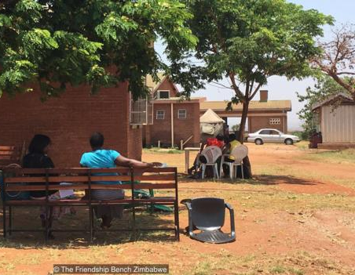
The Friendship Bench
“The Friendship Bench project is an evidence-based intervention developed in Zimbabwe to bridge the mental health treatment gap. Their mission is to enhance mental well-being and improve quality of life through the use of problem solving therapy delivered by trained lay health workers. The Friendship Bench focuses on people who are suffering from common mental disorders, such as anxiety and depression. Produced by: Nicky Wimble, United For Global Mental Health”
Video: https://www.youtube.com/watch?v=Th77mCuL5GY

Slide 34
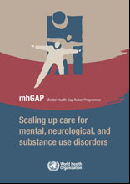
GMH Marker 8 Scale up GMH all government--all society—all settings primary health care—universal health coverage ‘from global-political declarations to community action-impact’
Notes:
For a overview and critique of GMH (as of 2014) See Kirmayer and Pedersen (October 2014): Toward a New Architecture for GMH, Transcultural Psychiatry (https://journals.sagepub.com/doi/abs/10.1177/1363461514557202). Abstract:
“Current efforts in global mental health (GMH) aim to address the inequities in mental health between low-income and high-income countries, as well as vulnerable populations within wealthy nations (e.g., indigenous peoples, refugees, urban poor). The main strategies promoted by the World Health Organization (WHO) and other allies have been focused on developing, implementing, and evaluating evidence-based practices that can be scaled up through task-shifting and other methods to improve access to services or interventions and reduce the global treatment gap for mental disorders. Recent debates on global mental health have raised questions about the goals and consequences of current approaches. Some of these critiques emphasize the difficulties and potential dangers of applying Western categories, concepts, and interventions given the ways that culture shapes illness experience. The concern is that in the urgency to address disparities in global health, interventions that are not locally relevant and culturally consonant will be exported with negative effects including inappropriate diagnoses and interventions, increased stigma, and poor health outcomes. More fundamentally, exclusive attention to mental disorders identified by psychiatric nosologies may shift attention from social structural determinants of health that are among the root causes of global health disparities. This paper addresses these critiques and suggests how the GMH movement can respond through appropriate modes of community-based practice and ongoing research, while continuing to work for greater equity and social justice in access to effective, socially relevant, culturally safe and appropriate mental health care on a global scale.”

Slide 35
.
“Evidence-based psychological interventions commonly used in high-resource settings can be effective in low-resource contexts, including when they are delivered by trained and supervised non-specialists. These interventions have proved helpful in the treatment of common mental health problems, such as depression, anxiety and traumatic and chronic stress, as well as other difficulties, such as harmful alcohol use. Cultural and contextual adaptations can increase the effectiveness of psychological interventions, and make them more accessible to people affected by crises. Treatments are best delivered in local languages, using recognisable terminology and case examples, and implemented in ways that do not exacerbate stigma or exclusion. Humanitarian settings demand psychological interventions that are as brief and as low-cost as possible, and which optimise limited human resources.”
Scalable psychological interventions for people affected by adversity, Schaefer et al (July 2018) Mental Health and Psychological Support in Humanitarian Crises, Humanitarian Exchange/HPN, ODI

Slide 36
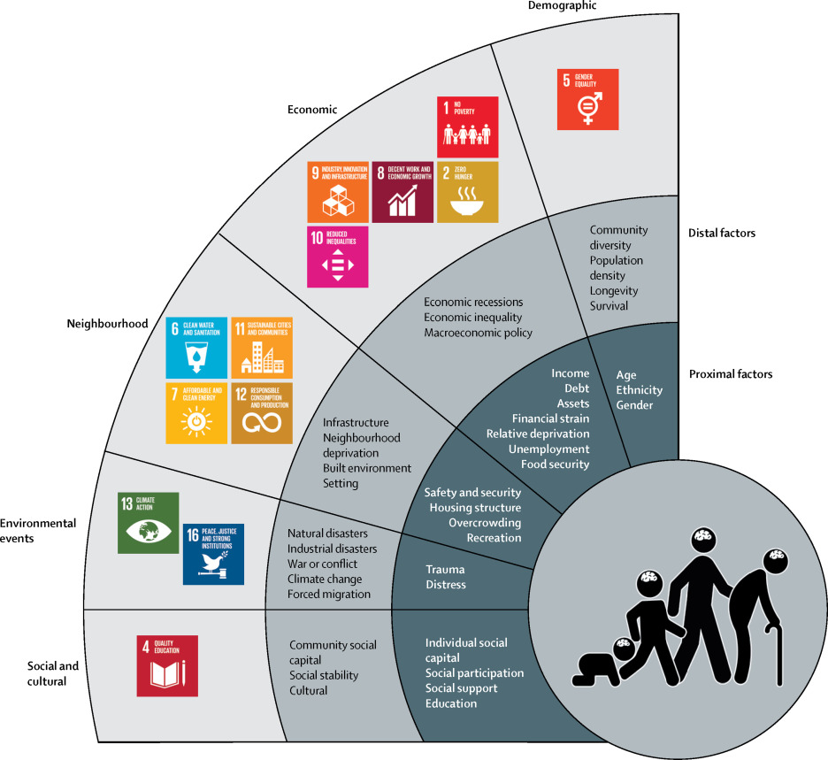
GMH Marker 9 Society-culture impact mental health (social determinants of health—not only bio-medical causes)
Notes:
Reference: Social determinants of mental disorders and sustainable development goals: A systematic review of reviews. Lund at al (1 April 2018) The Lancet

Slide 37
Social Determinants of Health
“Because mental disorders are so strongly socially determined, the global burden of these disorders is unlikely to be relieved by improved access to mental health treatments alone. In the words of the final report of the WHO Commission on the social determinants of health in 2008: “Why treat people only to send them back to the conditions that made them sick in the first place?”
Social determinants of mental disorders and sustainable development goals: A systematic review of reviews. Lund at al (1 April 2018) Lancet
Idioms of Distress-- the socio-cultural understanding of mental ill health
Diagnostic shifts—continuum of severity (distress, disability, duration) vs being a “disorder or a disease”, and the socio-cultural context for mental ill health
Notes:
Note from CORE Member Care weblog, 16 December 2015—Kelly O’Donnell http://coremembercare.blogspot.com
--We also want to mention the need to address global injustices and global inequities related to the current global governance systems--a central issue which relates to but is not sufficiently addressed by SDG 10: "Reduce inequality within and between countries." For example with regards to health, consider this perspective: "Power asymmetry and global social norms limit the range of choice and constrain action on health inequity; these limitations are reinforced by systemic global governance dysfunctions and require vigilance across all policy arenas....Global governance for health must be rooted in commitments to global solidarity and shared responsibility; sustainable and healthy development for all requires a global economic and political system that serves a global community of healthy people on a healthy planet. " (The Lancet-University of Oslo Commission on Global Governance for Health, The Lancet, Feb. 2014, p. 5)

Slide 38
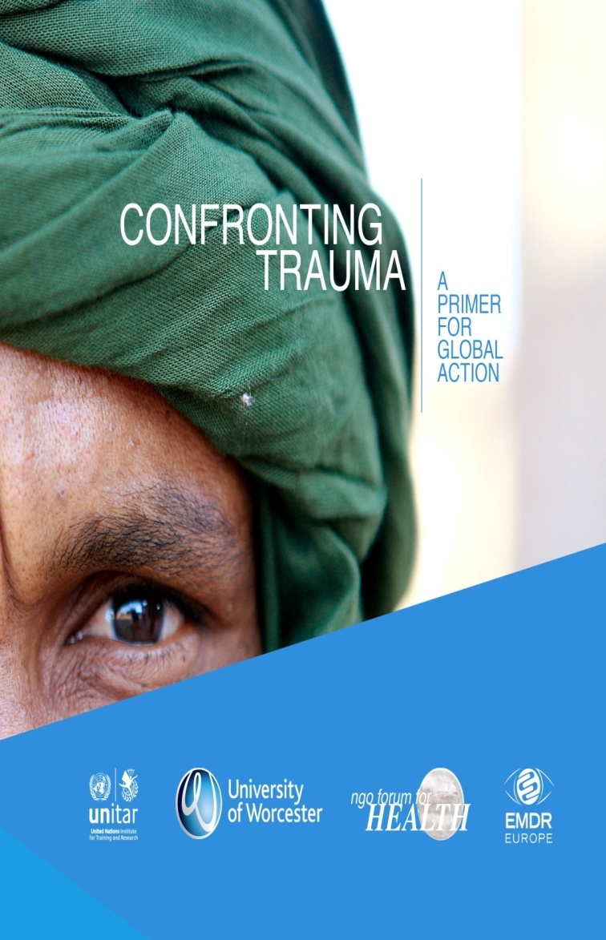
Social Determinants: war, conflict poverty, corruption, injustice, inequity, trauma, adverse childhood experiences, etc.
Video:
Living Peace: The Story of Abby and Kyalu Trauma and treatment in Democratic Republic of Congo, Promundo (watch the overview here)
Notes:
Two examples of our GMH work in and from Geneva, trauma emphasis.
See also our presentation:
The Trauma Pandemic: A Global Lens for Global Action (plenary, International Trauma Collaborative, 6 April 2019)

Slide 39
GMH Marker 10 Being Global Citizens Embracing our common identity, belonging, and responsibilities as humans (not global homogeneity, cultural conformity, national non-sovereignty…)
Gyeongju Action Plan (2016) “Education for Global Citizenship: Achieving the SDGs Together”
“In addition to literacy and numeracy, education must advance the cause of global citizenship which: promotes integrated development of the whole person emotionally, ethically, intellectually, physically, socially, and spiritually; imbued with an understanding of our roles, rights and responsibilities for the common good in service to humanity and the advancement of a culture of peace, non-violence, freedom, justice, and equality…“empowers learners to assume active roles to face and resolve global challenges and to become proactive contributors to a more peaceful, tolerant, inclusive, and secure world” [UNESCO 2014]; nurtures a sense of solidarity and empathy in order to end poverty, protect the planet, ensure human rights, and foster prosperous and fulfilling lives for all….We commit to…An education that teaches conflict resolution, a deep appreciation for diversity, ethical reasoning, gender equality, human rights and responsibilities, interdependence, multilingual and multicultural competence, social justice, sustainable development, and values.” (pages 1,2) [bold font added for emphasis]

Slide 40
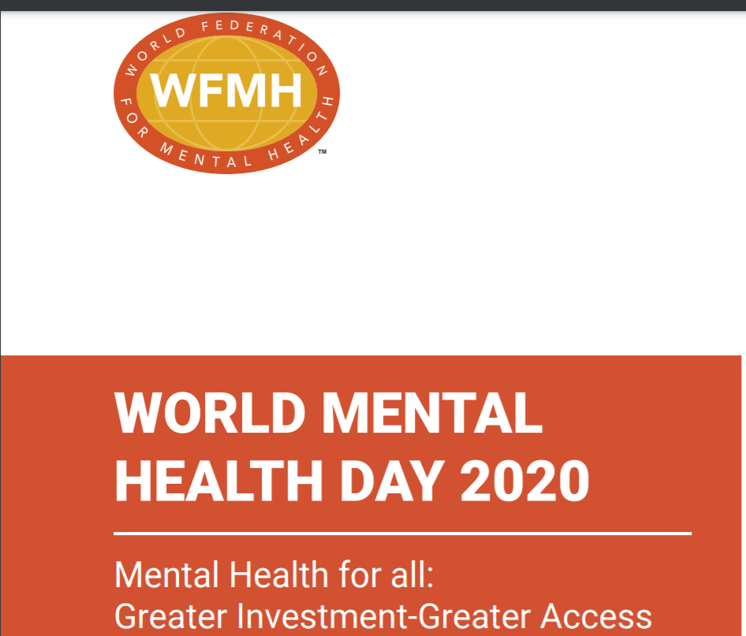
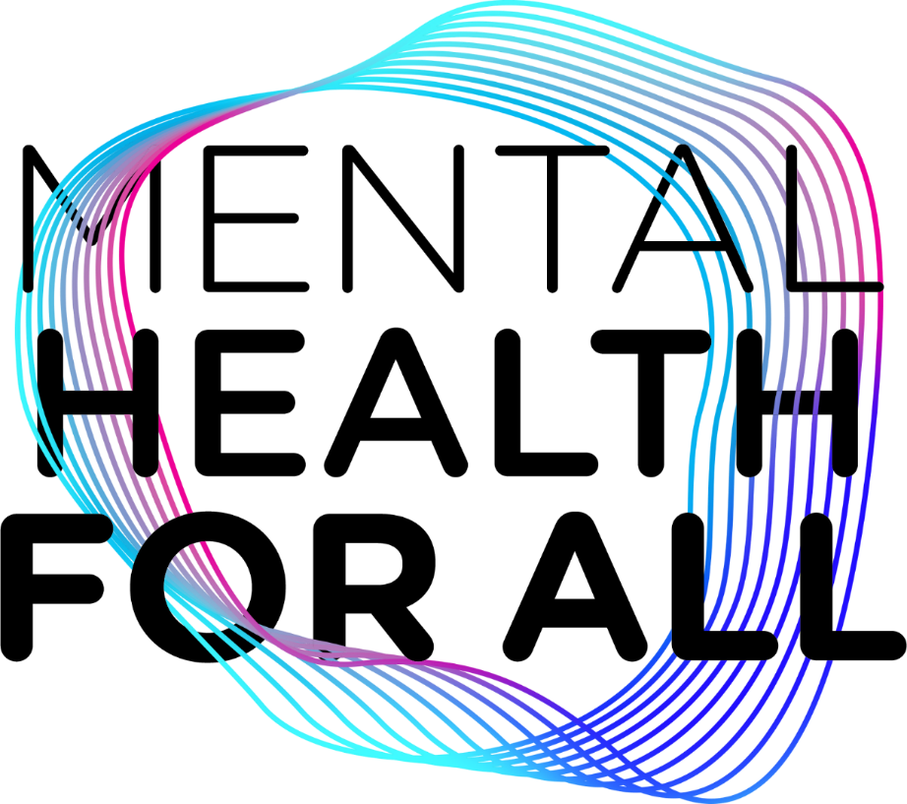
GMH Markers--Summary Invest in Mental Health for All!
“It’s time for the world to listen. It’s time for leaders to act. It’s time for mental health for all.” Amina Mohammed, UN Deputy Secretary-General ,18 May 2019 (two minute video message)
Notes:
1. World Mental Health Day 2020—Mental Health for All: Greater Investment—Greater Access https://wfmh.global/wp-content/uploads/WMHD2020_v16_resized.pdf
“World Mental Health Day, a programme of the World Federation for Mental Health, annually raises awareness within the global community about the mental health challenges, gaps and priorities through collaborative and unifying voices aimed at taking action, addressing and creating lasting change in a world where we need to restore the dignity of all living with mental health needs. World Mental Health Day was first observed on 10 October 1992 as an annual activity of the World Federation for Mental Health aimed at promoting mental health advocacy and educating the public on relevant issues. Celebrated on the 10th October, it provides an opportunity to place the spotlight on the mental health challenges experienced in our world today.” page 10, Ingrid Daniels, WFMH President
2. “Speak Your Mind—A Global Campaign for Mental Health, is a nationally driven globally connected mental health campaign coordinated by United for Global Mental Health. It was launched in Geneva on 19 May 2019. By sharing powerful messages through carefully crafted communications strategies, the Campaign seeks raise the profile of mental health, not only to change policy, but to speak directly to the public about mental health. The Campaign was developed at a meeting in Johannesburg in January 2019, where groups from 10 countries came together to decide on what they felt were key messages, and how they could design effective national campaigns, as well as drive a global campaign. #GoSpeakYourMind #mentahealthforal

Slide 41
Current Trends in Global Mental Health Summary of Comments by Shekhar Saxena GMH Action Network--United for GMH, General Assembly Sept 2020
Global mental health over the last ten years
We have seen very high levels of political commitments to mental health: WHO MH action plan, UN SDGs inclusion of mental health, World Bank commitment organising meetings with WHO, UN Secretary-General
Recognition of the social and economic determinants of mental health
Strengthening of civil society movement including leadership by persons with lived experience
Stronger research base in LMICs especially for psychosocial interventions.
BUT investment remains very poor
More summary comments in the note section below.
Notes:
Saxena, continued:
The year 2020 has been an exceptional year
MH needs have become much larger with COVID-19 (especially if you take spectrum focus of mental health)
Awareness of mental health has increased massively (focus globally on mh in the media)
Digital delivery of services have become more acceptable (although it doesn't fully replace in person services)
BUT health budgets are even more stretched than before. Funding to mental health is likely to come down rather than increase
What is needed now?
More effective advocacy - We must find better ways to influence policy and practice, to ensure better coordination among all stakeholders. The network can be a major instrument to achieve this.
Fulfillment of commitments by governments
Better involvement of large foundations and large CSOs in mental health
Better monitoring and accountability
GMHAN can play an effective role in all of these elements.

Slide 42
Global Mental Health: What’s Up? Recent Developments and Directions "The GMH markers represent many advances on behalf of “mental health and wellbeing for all.” They point to what we sense is a tangible shift into a new phase for GMH: a collective game changer with serious positive implications for on the ground, community-based improvements in mental health.
“We are seeing a convergence of many efforts, the fruit of the labor of thousands of civil society, lived-experience, local and faith-based, business, academic, and government colleagues around the world. “
“This next GMH phase--Generation 2.0--is increasingly “human.” It is about investing in our common humanity, our human family. It is people committed to people in order to resolutely make healthy lives—including mental health--and wellbeing for all a reality. It is everyone’s responsibility.”
Notes:
Global Mental Health: What’s Up? Recent Developments and Directions Global Insights, Office of International Affairs, American Psychological Association (June 2019) Click HERE for the full version.
“Some of the many areas impacted—the advances and shifts—include greater awareness, acceptance, advocacy, collaboration, and action for: health budgets, policies, and laws; scaling up, task shifting, and the central roles of people with lived experience; parity, primary health care, and universal health coverage; humanitarian action, trauma-informed care, and peacebuilding; health, mental health, and social work training programs in academic, organizational, and community settings; implementation science, indigenous psychologies, and culturally-appropriate and faith-sensitive services; and social and commercial determinants of health, stigma, and human rights.”

Slide 43
More Resources for Connecting and Contributing
Global Mental Health
GMH Action Network, United for GMH
Mental Health Innovation Network
Movement for Global Mental Health
UN IASC MHPSS Reference Group
MHPSS Network
WHO, Mental Health
World Federation for Mental Health (World Metal Health Day, 10 October)
Global Psychology
International Union of Psychological Science
American Psychological Association: --Office of International Affairs --Division 52: International Psychology
Psychology Coalition at the United Nations

Slide 44
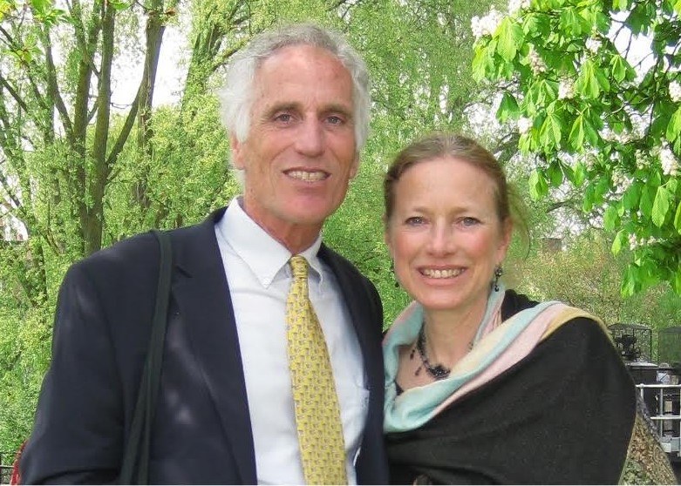
.
Wellbeing for All Global Mental Health Developments and Directions
Kelly and Michele O’Donnell, Member Care Associates, Inc. mcaresources@gmail.com www.membercareassociates.org
Notes:
--Dr. Michèle Lewis O’Donnell and Dr. Kelly O’Donnell are consulting psychologists based in Geneva. Respectively they are the COO and CEO of Member Care Associates, Inc (MCA), an NGO focusing on the wellbeing and effectiveness of staff and their organizations. Their multi-sectoral emphases for consultation, training, and writing include: personnel development, Global Mental Health, and integrity/anti-corruption. Kelly and Michèle are International Affiliates of the American Psychological Association and Representatives of the World Federation for Mental Health to the United Nations. Their publications include over 70 articles and five books in the member care and mental health fields (see recent publications) as well as ongoing Member Care Updates and Global Integration Updates (archived on the MCA website). They did their doctoral training in clinical psychology and theology at Rosemead School of Psychology, Biola University, USA and have two wonderful adult daughters, Erin and Ashling, raised in five countries. MCAresources@gmail.com

