Slide 1
Globalntegration Connecting and Contributing as Faith-Based MHPs Kelly O’Donnell, PsyD and Michèle Lewis O’Donnell, PsyD Member Care Associates, Inc.
Spiritual and Religious Issues in Professional Psychology GFU—31 March 2016
Do not reproduce without permission (MCAresources@gmail.com)
Image source: Cover detail from Global Member Care (volume 2) Crossing Sectors for Serving Humanity (2013)

Slide 2
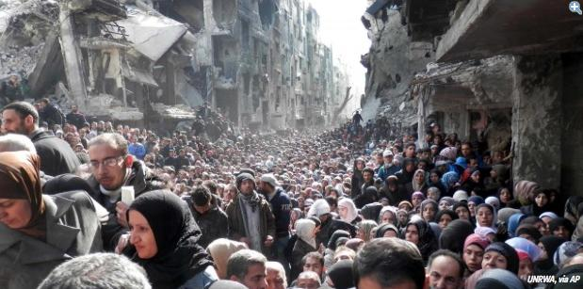
Purpose
Discuss how can MHPs with faith-based values connect and contribute with our globalizing world and its major challenges
Notes:
Image from webinar announcement Humanitarian Practice Group, 15 March 2016

Slide 3
Presentation Overview
Part 1: Global Frameworks
--Global Integration
--UN Sustainable Development Agenda
--WHO MH Action Plan
--One Humanity: Shared Responsibility
(Global Religious Forum for the World Humanitarian Summit)
Part 2: Global Context
--WB development, IFRC disasters, GPP peacebuilding
--Faith-based initiatives: materials and milestones
Part 3: Global Mental Health
--Definition and description
--Newsletters, training, publications, etc.
--Mental health AS mission
Part 4: Strategies for Crossing Sectors
--Interests, involvements, influences
--Issues: Sharing ones faith?
--Commitments and resources for Global Integrators

Slide 4
FOI for our GI-Journey
Framework to guide
Outils (tools) to resource
Integrity to permeate
la foi is French for faith

Slide 5
Part One
Global Frameworks
GI
SDGs
MH-AP
WHS

Slide 6
UN Year in Review 2015
“2015--In another year of extraordinary challenges for the world community, the United Nations turned 70--A time to look back at its founding document, the Charter--and to create a new vision of a future in peace and dignity.”
http://webtv.un.org/watch/year-in-review-2015-short-version/4670505629001

Slide 7
Globalntegration
A framework for:
actively integrating our lives with global realities by connecting relationally and contributing relevantly on behalf of human wellbeing and the issues facing humanity, in light of our integrity and core values (e.g., ethical, humanitarian, faith-based)
ad majorem Dei gloriam.

Slide 8
Some Personal Examples of GI
Member Care-Mental Health Trip: Lebanon and Ethiopia --learners-practitioners shadowing social workers
--consultants-counselors supporting Christian workers
Geneva --resource links via the GI Updates
--MH advocates attending/presenting at UN and INGO events

Slide 9
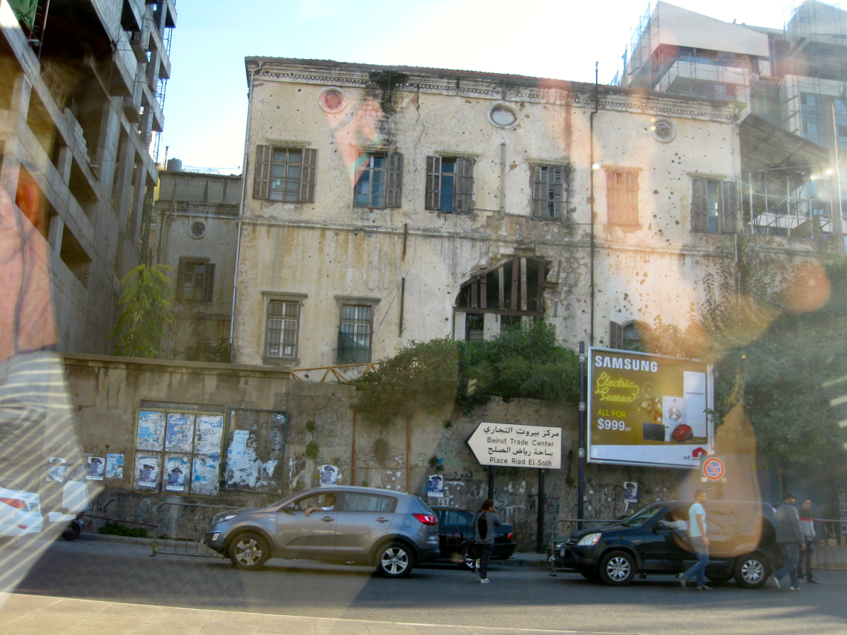
Lebanon (Legacy of conflict)
Notes:
Billboard with multiple photos can be seen on Beirut boulevards, highways, and city streets all over Lebanon. They are stark reminders of the people killed by political violence in the last few decades who. They come from all walks of life and religious backgrounds.

Slide 10
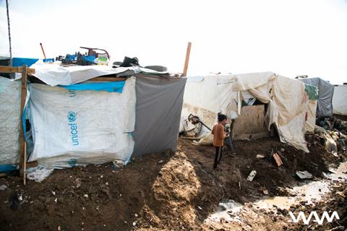
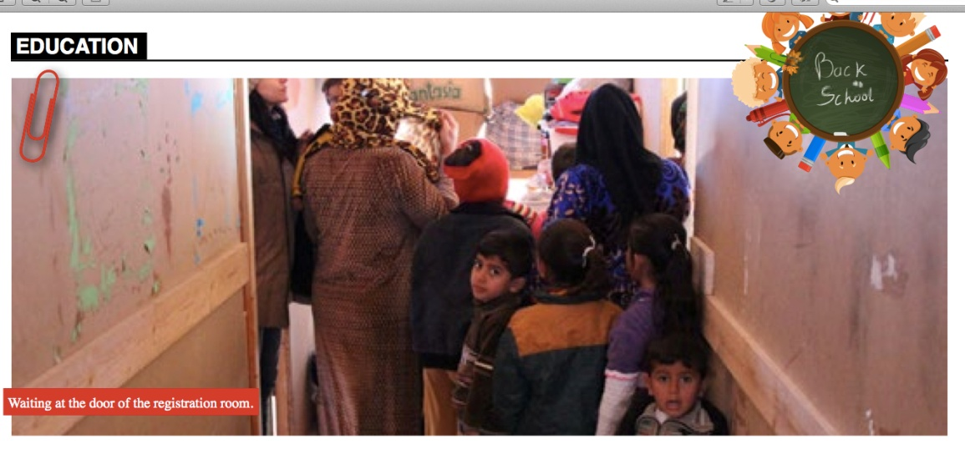
Lebanon
Visiting newly arrived refugees
A makeshift refugee camp in the Becca Valley
Lines for school registration in a new TM camp

Slide 11
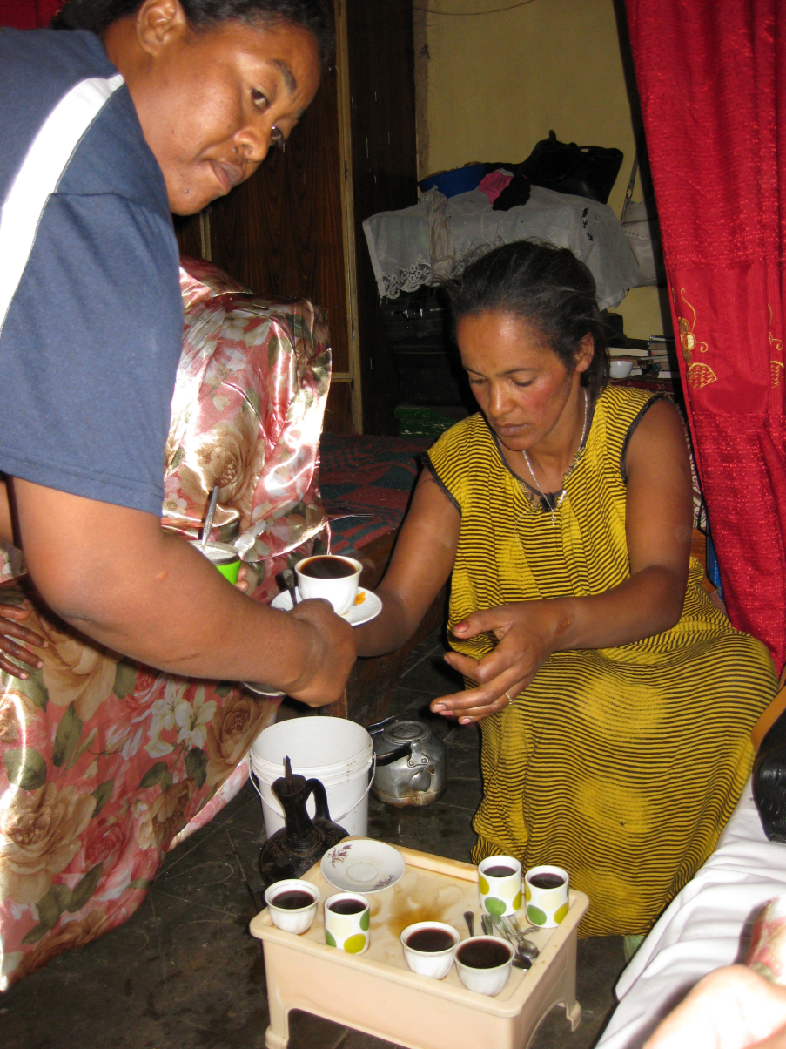
Ethiopia Delivering Hope International
Doulas working in their neighborhood—a slum beside a landfill—reaching out with compassion & support to “improve maternal, newborn and child health, and promote family preservation and the prevention of orphans.”
Notes:
Compelled by Christ’s love, we improve maternal, newborn and child health, and promote family preservation and the prevention of orphans.
STATS: 90% of Ethiopian women deliver without the aid of a skilled birth attendant.
MOMS: one of the highest Maternal Mortality Rates in the world, at 350 deaths/100,000. For comparison, the US has 24 maternal deaths per 100,000 live births.
CHILDREN:1 in 11 under 5 yrs (30x greater than western Europe). The deaths of these children account for 46% of total recorded deaths in all of Ethiopia.
DHI – solution is to train doulas in communities, improving maternal health and nutrition during pregnancy through antenatal care, ensuring safe and clean delivery, and providing immediate postnatal care, it is estimated we could prevent nearly 75% of neonatal deaths, more than 50% of deaths in the first year of life, and 99% of maternal deaths.
.

Slide 12
Evangelicals a Liberal Can Love
"In parts of Africa where bandits and warlords shoot or rape anything that moves, you often find that the only groups still operating are Doctors Without Borders and religious aid workers: crazy doctors and crazy Christians. In the town of Rutshuru in war-ravaged Congo, I found starving children, raped widows and shellshocked survivors. And there was a determined Catholic nun from Poland, serenely running a church clinic. Unlike the religious right windbags, she was passionately “pro-life” even for those already born — and brave souls like her are increasingly representative of religious conservatives. We can disagree sharply with their politics, but to mock them underscores our own ignorance and prejudice.“
Evangelicals a Liberal Can Love. Nicholas Kristof, New York Times (3 February 2008)
See also: Some Myths about Faith-Based Humanitarian Aid. Wilfred Mlay, Humanitarian Exchange 27 (July 2004, pp. 48-51)

Slide 13
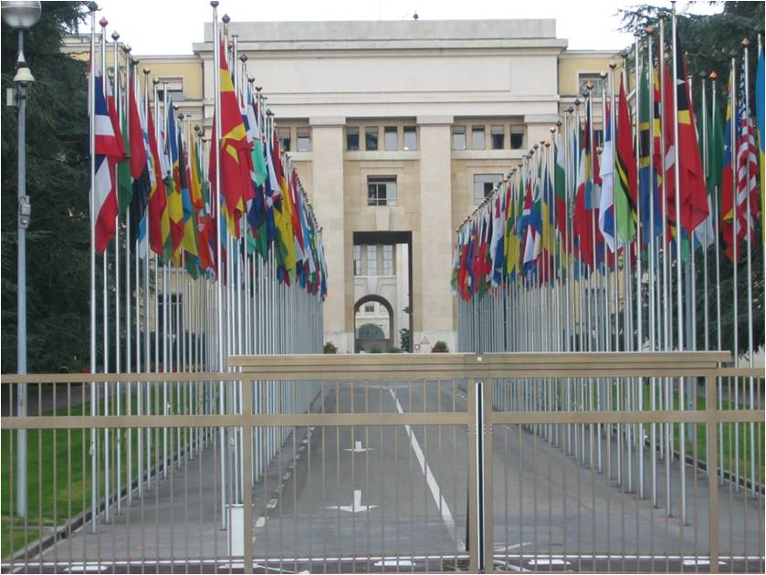
.
GI Update December 2015
Staying Current–Navigating the News
Things We Need to Know

Slide 14
.
Notes:
GMH work in and from Geneva

Slide 15
Trio Gathering Leadership in an Age of Turmoil https://sites.google.com/site/virtrios/ O’Donnells’ house in France March 2015

Slide 16
Video overview-promo: http://webtv.un.org/watch/adoption-of-the-sustainable-development-goals/4513425361001 .
Notes:
People, Prosperity, Peace, Planet, Partnerships
Social Economic Environment

Slide 17
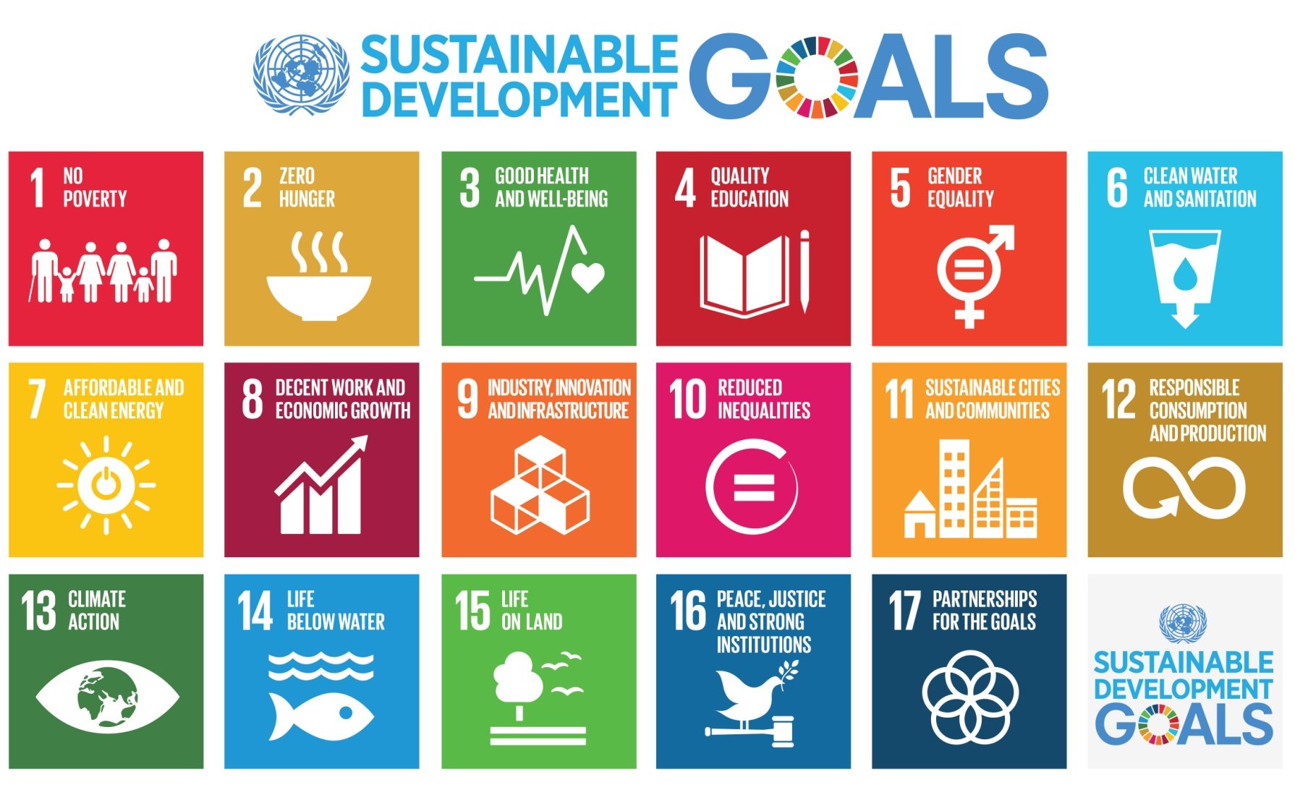
Transforming Our World: The 2030 Agenda for Sustainable Development United Nations, 25 September 2015, paragraph 50
"Today we are also taking a decision of great historic significance. We resolve to build a better future for all people, including the millions who have been denied the chance to lead decent, dignified and rewarding lives and to achieve their full human potential. We can be the first generation to succeed in ending poverty; just as we may be the last to have a chance of saving the planet…"
Notes:
Definitely a sense of urgency….

Slide 18
SDGs
Goal 1 End poverty in all its forms everywhere
Goal 2 End hunger, achieve food security and improved nutrition and promote sustainable agriculture
Goal 3 Ensure healthy lives and promote well-being for all at all ages
Goal 4 Ensure inclusive and equitable quality education and promote lifelong learning opportunities for all
Goal 5 Achieve gender equality and empower all women and girls
Goal 6 Ensure availability and sustainable management of water and sanitation for all
Goal 7 Ensure access to affordable, reliable, sustainable and modern energy for all
Goal 8 Promote sustained, inclusive and sustainable economic growth, full and productive employment and decent work for all
Goal 9 Build resilient infrastructure, promote inclusive and sustainable industrialization and foster innovation
Goal 10 Reduce inequality within and among countries
Goal 11 Make cities and human settlements inclusive, safe, resilient and sustainable
Goal 12 Ensure sustainable consumption and production patterns
Goal 13 Take urgent action to combat climate change and its impacts
Goal 14 Conserve and sustainably use the oceans, seas and marine resources for sustainable development
Goal 15 Protect, restore and promote sustainable use of terrestrial ecosystems, sustainably manage forests, combat desertification, and halt and reverse land degradation and halt biodiversity loss
Goal 16 Promote peaceful and inclusive societies for sustainable development, provide access to justice for all and build effective, accountable and inclusive institutions at all levels
Goal 17 Strengthen the means of implementation and revitalize the global partnership for sustainable development

Slide 19
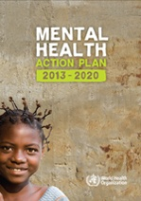
Mental Health Action Plan 2013-2020

Slide 20
.
According to the World Health Organization (WHO), mental, neurological, and substance use disorders “are common in all regions of the world, affecting every community and age group across all income countries. While 14% of the global burden of disease is attributed to these disorders, most of the people affected—75% in many low-income countries—do not have access to the treatment they need.” (WHO, 2008, launch of the mhGAP program)
http://www.who.int/mental_health/mhgap/en/index.html
WHO estimates:
• over 150 million have depression
• 25 million have schizophrenia
• 50 million have epilepsy
• over 100 million have drug or alcohol use disorders
• over 800 thousand suicides/year.
In addition, “people with these disorders are often subjected to social isolation, poor quality of life and increased mortality. These disorders are the cause of staggering economic and social costs.” (WHO Department of Mental Health, The Bare Facts).

Slide 21
Overview: Mental Health Action Plan 2013-2020
Vision A world in which mental health is valued, promoted, and protected, mental disorders are prevented and persons affected by these disorders are able to exercise the full range of human rights and to access high-quality, culturally appropriate health and social care in a timely way to promote recovery, all in order to attain the highest possible level of health and participate fully in society and at work free from stigmatization and discrimination.
Cross-cutting Principles
Universal health coverage Regardless of age, sex, socioeconomic status, race, ethnicity or sexual orientation, and following the principle of equity, persons with mental disorders should be able to access, without the risk of impoverishing themselves, essential health and social services that enable them to achieve recovery and the highest attainable standard of health. | Human rights Mental health strategies, actions and interventions for treatment, prevention and promotion must be compliant with the Convention on the Rights of Persons with Disabilities and other international and regional human rights instruments. |  | Evidence-based practice Mental health strategies and interventions for treatment, prevention and promotion need to be based on scientific evidence and/or best practice, taking cultural considerations into account. | Life course approach Policies, plans, and services for mental health need to take account of health and social needs at all stages of the life course, including infancy, childhood, adolescence, adulthood and older age. | Multisectoral approach A comprehensive and coordinated response for mental health requires partnership with multiple public sectors such as health, education, employment, judicial, housing, social and other relevant sectors as well as the private sector, as appropriate to the country situation. |  | Empowerment of persons with mental disorders and psychosocial disabilities Persons with mental disorders and psychosocial disabilities should be empowered and involved in mental health advocacy, policy, planning, legislation, service provision, monitoring, research and evaluation.
Goal To promote mental well-being, prevent mental disorders, provide care, enhance recovery, promote human rights and reduce the mortality, morbidity and disability for persons with mental disorders
Objectives and Targets
1. To strengthen effective leadership and governance for mental health Global target 1.1: 80% of countries will have developed or updated their policy/plan for mental health in line with international and regional human rights instruments (by the year 2020). Global target 1.2: 50% of countries will have developed or updated their law for mental health in line with international and regional human rights instruments (by the year 2020). |  | 2. To provide comprehensive, integrated and responsive mental health and social care services in community-based settings Global target 2: Service coverage for severe mental disorders will have increased by 20% (by the year 2020). |  | 3. To implement strategies for promotion and prevention in mental health Global target 3.1: 80% of countries will have at least two functioning national, multisectoral mental health promotion and prevention programmes (by the year 2020). Global target 3.2: The rate of suicide in countries will be reduced by 10% (by the year 2020). |  | 4. To strengthen information systems, evidence and research for mental health Global target 4: 80% of countries will be routinely collecting and reporting at least a core set of mental health indicators every two years through their national health and social information systems (by the year 2020).

Slide 22
WHS See GI Update Feb 2016 http://us10.campaign-archive2.com/?u=e83a5528fb81b78be71f78079&id=685aadf4a6

Slide 23
One Humanity
Core Responsibilities 1. Political leadership to prevent and end conflict
2. Uphold the norms that safeguard humanity
3. Leave no one behind
4. Change people’s lives—from delivering aid to ending need
5. Invest in humanity

Slide 24
One Humanity
“As a boy I grew up in war. I was six years old when I was forced to flee my home and village in Korea with only what I could carry in my arms. The schools destroyed, my home abandoned, I was filled with fear and uncertainty. I could not have known that my darkest hour would so profoundly shape my destiny. With shelter, schoolbooks and relief items, a young United Nations offered hope and protection and inspired me to pursue a career in public service. Seven decades after the founding of the United Nations, I believe its blue flag still remains a banner of hope for all humanity.” (Ban Ki-moon, opening paragraph)
One Humanity: Shared Responsibility Report of the Secretary-General for the World Humanitarian Summit (Feb 2016)

Slide 25
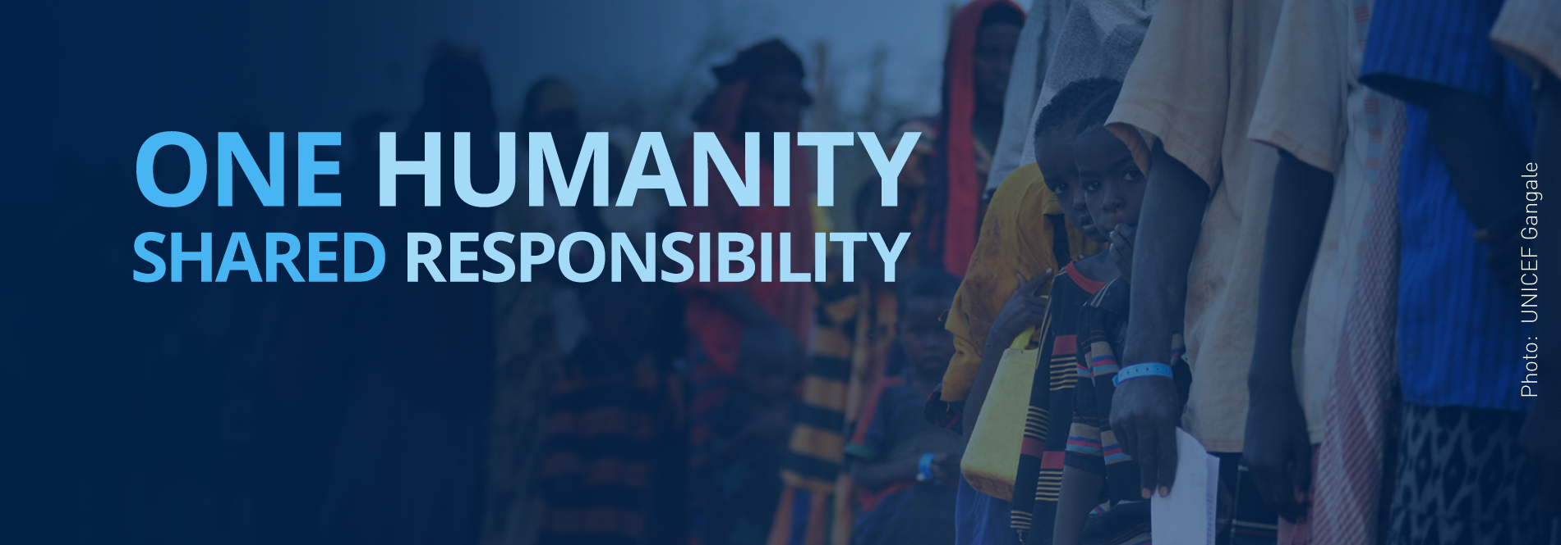
World Humanitarian Summit Istanbul 24-26 May https://www.worldhumanitariansummit.org
Global Religious Forum for the World Humanitarian Summit http://jliflc.com/wpcontent/uploads/2015/10/GlobalReligiousForum-1pger.pdf

Slide 26
Part Two
Global Context
World Development Report: Mind, Society, and Behavior World Bank (2015)
Disasters Report: Focus on Culture and Risk
International Federation of Red Cross and Red Crescent Societies (2014)
White Paper on Peacebuilding Geneva Peacebuilding Platform (2015)

Slide 27
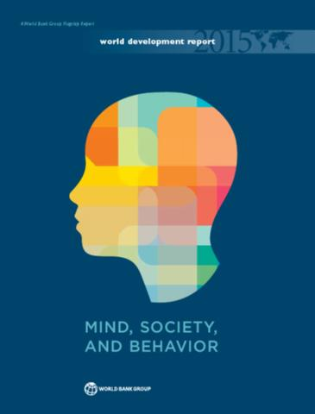
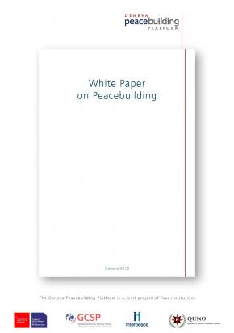
.

Slide 28
World Development Report: Mind, Society, and Behavior World Bank (2015)
“The Report aims to integrate recent findings on the psychological and social underpinnings of behavior to make them available for more systematic use by both researchers and practitioners in development communities. The Report draws on findings from many disciplines, including neuroscience, cognitive science, psychology, behavioral economics, sociology, political science, and anthropology. In ongoing research, these findings help explain decisions that individuals make in many aspects of development, including savings, investment, energy consumption, health, and child rearing. The findings also enhance the understanding of how collective behaviors—such as widespread trust or widespread corruption—develop and become entrenched in a society. The findings apply not only to individuals in developing countries but also to development professionals, who are themselves prone to error when decision-making contexts are complex.” (pp. 2-3)

Slide 29
;
Disasters Report: Focus on Culture and Risk International Federation of Red Cross and Red Crescent Societies (2014)
“This year, the World Disasters Report takes on a challenging theme that looks at different aspects of how culture affects disaster risk reduction (DRR) and how disasters and risk influence culture. The report asks, for example, what should be done when people blame a flood on an angry goddess (River Kosi, India, in 2008) or a volcanic eruption on the mountain god (Mount Merapi). After the tsunami in 2004, many people in Aceh (Indonesia) believed that Allah had punished them for allowing tourism or drilling for oil, and similar beliefs were widespread in the United States regarding Hurricane Katrina, showing God’s displeasure with aspects of the behaviour of the people who live in or visit New Orleans.
Most people who live in places that are exposed to serious hazards are aware of the risks they face, including earthquakes, tropical cyclones, tsunami, volcanic eruptions, floods, landslides and droughts. Yet they still live there because, to earn their living, they need to or have no alternative. Coasts and rivers are good for fishing and farming; valley and volcanic soils are very fertile; drought alternates with good farming or herding. Culture and beliefs, for example, in spirits or gods, or simple fatalism, enable people to live with risks and make sense of their lives in dangerous places. Sometimes, though, unequal power relations are also part of culture, and those who have little influence must inevitably cope with threatening environments. ….Sometimes there is also an institutional reluctance to deal with the issues of inequality and power that make people vulnerable in the places where they make a living. The one thing that is certain is that we will have less sustained impact if we do not adequately take account of people’s cultures, beliefs and attitudes in relation to risk” (P.8)

Slide 30
White Paper on Peacebuilding Geneva Peacebuilding Platform (2015)
“The White Paper…reflects a 12-month collaborative multi-stakeholder initiative with [100+] peacebuilding professionals from all regions coordinated by the Geneva Peacebuilding Platform. The aim of this exercise is…[to broaden] the discussion about how countries and societies can move towards sustainable peace, and about the assistance the UN and other international and local actors can bring to such processes.” peace (Geneva Peacebuilding Platform website)
“Why is such a broader conversation necessary? First, the next decade will see more pressures on states and societies – and likely more conflict. These pressures can emerge, for instance, from demographic trends (population growth, increasing urbanization), economic trends (more inequality and unemployment), power shifts (changing constellations, diffusion of power, less control by states), climate change (more natural disasters and climatic fluctuations) and new conflict dynamics (geo-political tension, more chronic violence, new threats).2 Rising pressures will likely increase the risk of conflict. In some regions, this conflict could be violent. In order to face these challenges, peacebuilding and prevention capacities need to be developed further and rendered more effective. “ (p. 6)
The findings are presented in four sections:
The global context of the peacebuilding field
Challenges for peacebuilding practice
Opportunities for peacebuilding practice
Future perspectives for building

Slide 31
Faith-Based Resources-Efforts 10+ Recent Materials-Milestones
Religions for Peace: Working towards the MDGS: A Toolkit for Religious Leaders and Communtiies http://www.worldvolunteerweb.org/fileadmin/docdb/mdg_faith_toolkit.pdf
A Common Word 2007 http://www.acommonword.com/
Development and Faith: When Mind, Hear, and Soul Work Together 2007, Katherine Marshall and Marisa van Saanen
Building from Common Foundations; The World Health Organization and Faith-Based Organizations in Primary Care Geneva Global and World Health Organization (2008) http://apps.who.int/iris/handle/10665/43884
World Interfaith Faith Harmony Week 2011--current http://www.un.org/en/events/interfaithharmonyweek/
UN Resolution for Interfaith Harmony Week (2010) http://daccess-dds-ny.un.org/doc/UNDOC/GEN/N10/512/84/PDF/N1051284.pdf?OpenElement
Christian Witness in a Multi-Religious World: Recommendations for Conduct, 2011 (WCC, Vatican, WEA) http://www.worldea.org/news/3985
Joint Learning Initiative on Faith an Local Communities *date?) http://jliflc.com/
Religion, Security, and Global Uncertainties Project (2014) http://www.paccsresearch.org.uk/wp-content/uploads/2014/12/Religion-Security-Global-Uncertainties.pdf
Ending Extereme poverty: A Moral and Religious Imperative 2015
https://www.rebelmouse.com/Faith2EndPoverty/ending-extreme-poverty-a-moral-and-spiritual-imperative-1081333677.html
Laudato Si: Caring for Our Common Home, 2015, Pope Francis http://w2.vatican.va/content/dam/francesco/pdf/encyclicals/documents/papa-francesco_20150524_enciclica-laudato-si_en.pdf
Notes: Faith-based event at WB July 2015, UN Interagency Task Force on Faith and Development
Local and national initiatives—in the trenches: Video of women in Nigeria and West Africa: Muslim and Cx women uniting for peace

Slide 32
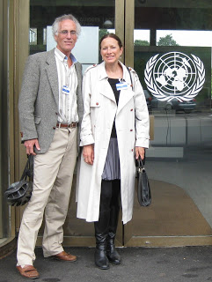
FBOs
“This Update focuses on the transformational role of the faith-based sector within Global Integration (GI). Religion and faith, as we know, have a central place for most people in our world—including many “persons and communities of concern,” staff, organizations, governments, and donors. Faith-based people are thus often mainstream contributors and partners--and not marginal players-- when it comes to the efforts to transform the world. The emphasis on personal transformation (including virtue and moral integrity) is often an important added contribution from the faith-based sector.”
Global Integration Update (August 2015) Faith-Based Partners in Transformation http://us4.campaign-archive1.com/?u=f34fc856e7776d7b69dafd3b3&id=f2d61d15f5

Slide 33
Global Integration Update (August 2015) Faith-Based Partners in Transformation http://us4.campaign-archive1.com/?u=f34fc856e7776d7b69dafd3b3&id=f2d61d15f5
`“We believe that a variety of people must be at the “global tables” in order to help shape and influence agendas, policies, and action in the “global trenches.” That includes people from all countries, sectors, and faith backgrounds, who are informed and skilled, and dedicated to the common good. The UN’s 2030 Agenda for Sustainable Development(Transforming Our World) explicitly encourages such diverse and competent involvement and encapsulates it in Sustainable Development Goal 17: “Strengthen the means of implementation and revitalize the global partnership for sustainable development.” (see also the partnership examples and updates at Partnerships Engagement for the Sustainable Development Goals)

Slide 34
Joint Learning Initiative Six Hubs
HIV & Maternal Health
Immunization
Resilience
Capacity Building
Peace & Conflict
Gender Based Vi

Slide 35
.

Slide 36
Building from Common Foundations; The World Health Organization and Faith-Based Organizations in Primary Care Geneva Global and World Health Organization (2008)
“The World Health Organization (WHO) worked with faith-based organizations (FBOs) in preparing for the Alma-Ata Declaration of 1978. Together they gained a clearer picture of healthcare in the developing world, and then established the concept of primary healthcare. This report is intended to assist in the process of rejuvenating dialogue and partnership with FBOs in the face of widespread health challenges in communities around the world, not least of which is HIV/AIDS. The revival of the primary healthcare model within WHO underscores that if this framework is to be promoted as a more sustainable system of health servicing and delivery, then the inclusion of FBOs will add greater potential for breadth and effectiveness.”

Slide 37
Christian Witness in a Multi-Religious World: Recommendations for Conduct. World Council of Churches, Pontifical Council for Interreligious Dialogue, World Evangelical Alliance (2011)
“The purpose of this document is to encourage churches, church councils and mission agencies to reflect on their current practices and to use the recommendations in this document to prepare, where appropriate, their own guidelines for their witness and mission among those of different religions and among those who do not profess any particular religion. It is hoped that Christians across the world will study this document in the light of their own practices in witnessing to their faith in Christ, both by word and deed.” (quoted from the Prologue) . For some perspectives on this document, see the article Top Evangelical, Catholic, and Mainline Bodies Issue Evangelism Rules, Chris Norton, the Christianity Today (June 29, 2011) “Missiologists applaud unity effort, but note what's missing and what will raise eyebrows.”

Slide 38
Interfaith Harmony Week UN Resolution (2010, excerpts)
…Recognizing the imperative need for dialogue among different faiths and religions to enhance mutual understanding, harmony and cooperation among people….
Encourages all States to support, on a voluntary basis, the spread of the message of interfaith harmony and goodwill in the world’s churches, mosques, synagogues, temples and other places of worship during that week, based on love of God and love of one’s neighbour or on love of the good and love of one’s neighbour, each according to their own religious traditions or convictions…

Slide 39
.
"World Interfaith Harmony Week celebrates the principles of tolerance and respect for the other that are deeply rooted in the world’s major religions. The observance is also a summons to solidarity in the face of those who spread misunderstanding and mistrust."
Secretary-General Ban Ki-moon Message for World Interfaith Harmony Week

Slide 40
Part Three
Global Mental Health
Newsletters
Training
Texts-Journals

Slide 41
Global Mental Health
"GMH is an international, culturally-sensitive, interdisciplinary, and multi-sectoral domain which promotes human well-being, the right to health, and equity in health for all. It encourages healthy behaviours and lifestyles; is committed to preventing and treating mental, neurological, and substance use conditions; and seeks to improve policies and programs, professional practices and research, advocacy and awareness, and social and environmental factors that affect health and well-being.“
Based on definition from:
GMH--Finding Your Niches and Networks, Psychology International, March 2012

Slide 42
Hidden Pictures A Personal Journey into GMH (trailer of the film by Delaney Ruston)
https://www.youtube.com/watch?v=Y8Tbiciyzq0

Slide 43
Convention on the Rights of Persons with Disabilities (UN, 2006)
Article 1 - Purpose
The purpose of the present Convention is to promote, protect and ensure the full and equal enjoyment of all human rights and fundamental freedoms by all persons with disabilities, and to promote respect for their inherent dignity.
Persons with disabilities include those who have long-term physical, mental, intellectual or sensory impairments which in interaction with various barriers may hinder their full and effective participation in society on an equal basis with others.

Slide 44
GMH-Map a global map for a global movement https://sites.google.com/site/gmhmap/

Slide 45
GMH: Newsletters-Updates
Mental Health Innovation Network (monthly)
Movement for Global Mental Health (monthly)
mhGAP, World Health Organization (twice a year)
Bulletin, World Federation for Mental Health (quarterly)
Psychology International, Office of International Affairs, American Psychological Association (4-6 times/year). Also as of April 2015 there is a biweekly news bulletin with information about opportunities for international involvement in mental health.
Gulbenkian Global Mental Health Platform (monthly)
See more here: https://sites.google.com/site/gmhmap/home/gmh-updates

Slide 46
GMH Training
Doctoral Programs
Chicago School of Professional Psychology, International Psychology, online with concentrations in Organizations/Systems or Trauma Services.
Masters Programs
MSc Global Mental Health, London-based course taught jointly between the London School of Hygiene and Tropical Medicine and King's College London Institute of Psychiatry. Click here for the online prospectus.
MSc Global Mental Health: University of Glasgow, College of Medical, Veterinary, and Life Sciences. Click here for theprogramme brochure.
International Masters in Mental Health Policies and Services, Universidade Nova de Lisboa, Faculdade de Ciências Médicas.Click here for the program brochure.
Master of Arts in Counseling Psychology and Global Mental Health: William James College (formerly Massachusetts School of Professional Psychology). Click here for the program brochure.
Courses
GMH: Trauma and Recovery Certificate Program, Harvard Program in Refugee Trauma (on-site learning in Italy, and web-based learning). Certificates of completion are awarded by HPRT and the Harvard Medical School Department of Continuing Education.
Leadership in Mental Health Course, Sangath Centre and London School of Hygiene and Tropical Medicine(Goa, India).
See more here: https://sites.google.com/site/gmhmap/home/gmh-training-programmes

Slide 47
GMH Texts and Journals
Texts
Global Mental Health: Trauma and Recovery (2011, edited by Richard Mollica)
21st Century Global Mental Health (2012, edited by Eliot Sorel)
Global Mental Health: Principles and Practice (2013, edited by Vikram Patel et al.)
Journals
Global Mental Health (open access journal on GMH, first issue in 2014)
Transcultural Psychiatry (December 2014); special issue on GMH
The Lancet (October 2011 and September 2007); special issues on GMH
See more here: https://sites.google.com/site/gmhmap/home/gmh-texts-journals

Slide 48
World Mental Health Day (1992-2014, 10 October)
2015: Mental Health and Dignity
2014: Living with Schizophrenia
2013: Mental Health and Older Adults--Note: Hidden Pictures (feature film)
2012: Depression--Note: I Had a Black Dog (self-help animation, five minutes)
2011: The Great Push: Investing in Mental Health
2010: Mental Health and Chronic Physical Illnesses
2009: Mental Health in Primary Care
2008: Making Mental Health a Global Priority: Advocacy/Action
2007: Mental Health in a Changing World: Culture and Diversity
2006: Building Awareness–Reducing Risk: Mental Illness/Suicide
2005: Mental and Physical Health Across the Life Span
2004: The Relationship between Physical and Mental Health
2003: Emotional/Behavioral Disorders of Children/Adolescents
2002: The Effects of Trauma/Violence on Children /Adolescents
2001: Mental Health and Work
2000: Mental Health and Work
1999: Mental Health and Ageing
1998: Mental Health and Human Rights?
1997: Children and Mental Health
1996: Women and Mental Health
1995: Mental Health and Youth
1994: Improving Mental Health Services throughout the World
1992-1993 (general themes)

Slide 49
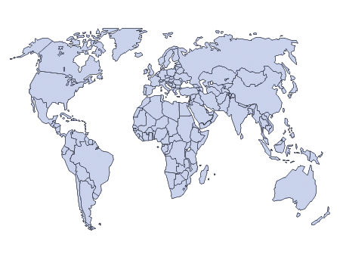
Hindrances to GMH 10 “flaws” that affect GMH “flows" and sustainable development
Different concepts of “mental” health
Conflicts of interest, agendas, “psychiatrization” of MH
Stigma and discrimination
Lack of resources: finances, health practitioners
Political will and status quo
Turf wars and relationship conflicts
Lifestyle inconveniences and cognitive dissonance
War and major catastrophes
Corruption and moral “ill health”
“Problems without passports”
Etc.—add your own thoughts here:

Slide 50
GMH and the FB Sector
Mental Health AS Mission

Slide 51
Part Four
Strategies for Crossing Sectors
Interests
Involvements
Influences

Slide 52
Sectors
Specialized groupings of people that provide different types of services and products to people. Each sector is comprised of a wide array of people who are part of different organizations; influenced by various disciplines, practices, and goals; and intertwined with many related networks. A sector fundamentally, is a human entity.”
Crossing Sectors for Serving Humanity, pp. 5-6

Slide 53
.

Slide 54
Relevance…
“The relevance of crossing sectors is…seen in the research by Johnson et al (2010) which advocates for greater interactions between the major religious blocs, especially Christians and non-Christians, in the service of humanity.”
What percentage of non-Christians personally know a Christian?…The [research] results are startling in the sense that Christians and non-Christians appear to be living in quite separate worlds. This distance has implications for Christian missions but is also problematic when it comes to dialogue, peace initiatives, environmental and health challenges, and many other areas of human interaction. Our hope is that highlighting the problem will help in planning solutions for the future. (p.29)
Crossing Sectors for Serving Humanity, chapter 2, pp. 9-10

Slide 55
5 Applications Crossing Sectors for Serving Humanity
• Support mission/aid workers in their well-being and effectiveness
• Support colleagues in other sectors via materials in the member
care field
• Equip mission/aid workers with tools and opportunities for their
work with others
• Equip member caregivers who directly work with vulnerable
populations and others
• Stay informed as global citizens about current and crucial issues
facing humanity

Slide 56
Crossing sectors: Issues Pursue your passions
--What issues matter to you the most? --What are you passionate about? --What are you motivated to learn more about?

Slide 57
Crossing sectors: Involvements Till the terrain
--What types and levels of involvement are realistic for you?
--With whom?
--How to sustain your involvements?
Continuum of Involvement
Informed----------Included----------Immersed

Slide 58
Crossing sectors: Influences Get a grid
What has influenced your desire and ability to cross sectors? List 3-5 items for each of the six categories below.
Principles/Beliefs
Documents/Materials
Organizations/Groups
People/Models
Milestones/Gravestones
→Charting a Future Course

Slide 59
Sharing One’s Faith?
“In general, being faith-based is respected within these sectors, provided that the following two caveats are embraced: do not make assistance/services contingent on the recipients' religious or political affiliations/beliefs--especially vulnerable people/populations; and do not use experiences like conflicts/calamities as opportunities to "proselytize" or otherwise "share one's spiritual/religious beliefs" with vulnerable people/populations (often viewed as being exploitative and unethical). Not everyone agrees fully with the latter caveat--in which faith-based efforts can be viewed as faith-biased affronts--and there are many views on the appropriateness of including spiritual/religious matters in humanitarian/developmental work. ”
K and M O’Donnell
Member Care Update (May 2013) Faith-Based Perspectives http://us4.campaign-archive1.com/?u=f34fc856e7776d7b69dafd3b3&id=f2d61d15f5

Slide 60
Universal Declaration of Human Rights Articles 18 and 19
Everyone has the right to freedom of thought, conscience and religion; this right includes freedom to change his religion or belief, and freedom, either alone or in community with others and in public or private, to manifest his religion or belief in teaching, practice, worship and observance.
Everyone has the right to freedom of opinion and expression; this right includes freedom to hold opinions without interference and to seek, receive and impart information and ideas through any media and regardless of frontiers.

Slide 61
Code of Conduct for The International Red Cross and Red Crescent Movement and NGOs in Disaster Relief (1994)
Principle 3 of the 10 Principles:
Aid will not be used to further a particular political or religious standpoint.
“Humanitarian aid will be given according to the need of individuals, families and communities. Notwithstanding the right of NGHAs to espouse particular political or religious opinions, we affirm that assistance will not be dependent on the adherence of the recipients to those opinions. We will not tie the promise, delivery or distribution of assistance to the embracing or acceptance of a particular political or religious creed." . To review some comments on this principle and the other 10 principles: A Living Document? Code of Conduct... Disaster Relief (20 September 2004).

Slide 62
Proselytism Policy Statement Micah Network (2007)
“1. While longing to see people coming to a personal faith in Jesus Christ we reject manipulative or coercive proselytism as a way of propagating the Christian faith 2. It is absolutely abhorrent to us to exploit people’s vulnerability in order to put pressure on them to convert to our religion. Conversions gained in this way are often superficial and bring no credit to the converts or the Christian faith in general. 3. There is a crucial difference between using aid in order to put pressure on needy people to convert and dispensing aid while hoping and praying that those who receive it come to believe in Jesus Christ. “ (excerpts)

Slide 63
Seven Directional Commitments F-B MHPs as Global Integrators Adapted from “The Missional Heart of Member Care” International Bulletin of Mission Research, April 2015, Volume 39 See also: Global Integrators (CORE MC weblog 2015)
1. We commit to diligently pursue our own journeys of personal and professional growth—to grow deeply as we go broadly.
2. We commit to integrate the inseparable areas of our character (resilient virtue) and competency (relevant skills) with compassion (resonant love).
3. We commit to follow God into new areas of learning and work: crossing sectors, cultures, disciplines, and comfort zones.
4. We commit to embrace our duty to enter difficult settings, including those permeated by conflict, calamity, and corruption, as those in great need are often in places of great risk."
5. We commit to have clear ethical commitments and standards that guide our work in global integration, respecting the dignity and worth of all people.
6. We commit to pursue common ground for the common good, working with others to promote wellbeing and sustainable development.
7. We commit to base our work upon the trans-everything practice of fervently loving one another—agape. Our love is the ultimate measure of our global integration.

Slide 64
Core Resources
Global Integration: Addressing the Pressing Issues Facing Our World
Christian Psychology Around the World, April 2016 http://emcapp.ignis.de/
Global Member Care: Crossing Sectors for Serving Humanity (2013 ) Chapter Two: Charting Your Course through the Sectors
https://sites.google.com/site/globalmca/home/volume-2-preview
Note: chapter two is available to read on the Amazon ebook preview http://www.amazon.com/Global-Member-Care-Crossing-Humanity-ebook/dp/B00HX6WZLQ
Transforming Our World: The 2030 Agenda for Sustainable Development
United Nations, 2015 https://sustainabledevelopment.un.org/post2015/transformingourworld
See also: One Humanity: Shared Responsibility (United Nations, February 2016) http://sgreport.worldhumanitariansummit.org/
See also: Core Humanitarian Standard on Quality and Accountability (CHS Alliance, 2014) http://www.corehumanitarianstandard.org/the-standard
Mental Health Action Plan 2013-2020
World Health Organization, 2013 http://www.who.int/mental_health/publications/action_plan/en/
See also: MHPSS advocacy paper for the World Humanitarian Summit (IASC, July 2015) https://interagencystandingcommittee.org/iasc-and-world-humanitarian-summit/content/whs-advocacy-paper-mental-health-and-psychosocial-support
GMH: Tracking and Trekking Across Sectors
Psychology International, (K and M O’Donnell, June 2015) http://www.apa.org/international/pi/2015/06/mental-health-tracking.aspx
Note: the full version is available on the GMH-Map website: https://sites.google.com/site/gmhmap/home/gmh-track-trek

Slide 65
FOI for our GI-Journey
Framework to guide
Outils (tools) to resource
Integrity to permeate
la foi is French for faith

Slide 66
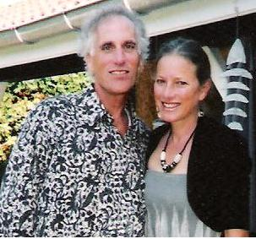
.
Thank you!
Kelly and Michèle Member Care Associates, Inc.
mcaresources@gmail.com www.membercareassociates.org
Global Integration is a framework for: actively integrating our lives with global realities by connecting relationally and contributing relevantly, on behalf of human wellbeing and the issues facing humanity, in light of our integrity and core values (e.g., ethical, humanitarian, faith-based)
ad majorem Dei gloriam.

Slide 67
Appendix: United Nations
“We are at a historic crossroads, and the direction we take will determine whether we will succeed or fail in fulfilling our promises....Transformation is our watchword....I urge Governments and people everywhere to fulfil their political and moral responsibilities.”
Synthesis Report on Sustainable Development
Ban Ki-Moon, 4 December 2014 (Paragraphs 2, 4, 25)
“We can be the first generation to succeed in ending poverty; just as we may be the last to have a chance at saving the planet.”
Transforming Our World: The 2030 Agenda for Sustainable Development United Nations, 1 August 2015 (Paragraph 60)

Slide 68
Perspectives: The United Nations
But the world is not so happy a place. Billions of people suffer impoverishment, many until the end of their miserable lives…
Can we really offer justice and freedom from want to a mid-twenty-first-century earth of perhaps nine billion people, one-third of whom may live in squalor and desperation?...
[Surprises and setbacks] should not deter us from responding as best we can, using our talents to improve this always mixed record of trying “to save generations from the scourge of war,” “to reaffirm faith in fundamental human rights,” and “to promote social progress and better standards of life in larger freedom.”
The original Preamble to the Charter of the United Nations had it right. The question is, can we do it?
(Paul Kennedy, The Parliament of Man: The Past, Present, and Future of the United Nations, 2006, 279, 289)

Slide 69
UN Charter, 1945
We the peoples of the United Nations determined:
to save succeeding generations from the scourge of war, which twice in our lifetime has brought untold sorrow to mankind,
and to reaffirm faith in fundamental human rights, in the dignity and worth of the human person, in the equal rights of men and women and of nations large and small,
and to establish conditions under which justice and respect for the obligations arising from treaties and other sources of international law can be maintained,
and to promote social progress and better standards of life in larger freedom…

Slide 70
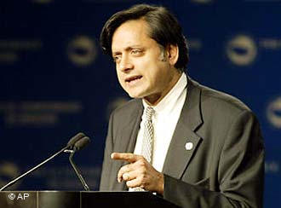
The United Nations is a 20th-century organization facing a 21st-century challenge as an institution with impressive achievements but also haunting failures, one that mirrors not just the world’s hopes but its inequalities and disagreements, and most important, one that has changed but needs to change further….
The single greatest problem facing the United Nations is that there is no single greatest problem; rather there are a dozen different ones each day clamoring for attention. Some, like the crisis in Lebanon, the Palestinian situation and the nuclear programs in Iran and North Korea, are obvious and trying.
Others we call “problems without passports”— issues that cross all frontiers uninvited, like climate change, drug trafficking, human rights, terrorism, epidemic diseases, and refugee movements.
Their solutions, too, can recognize no frontiers because no one country or group of countries, however rich or powerful, can tackle them alone.
Shashi Tharoor, The Good for Something United Nations, Newsweek, September 4, 2006

