Slide 1
Bearing Witness to 20th and 21st Century Genocides: Literature and the Arts
prepared by Jane M. Gangi, PhD
November 2020

Slide 2
The Armenian Genocide

Slide 3
The Armenian Genocide
I have read this book at least five times and it breaks my heart every time. It is impossible not to love Veron who endured so much yet continued to love family and friends without ceasing.
You might also enjoy this video by David Kherdian, Veron’s son, on how he wrote this book:
https://www.youtube.com/watch?v=fK0QjjfYkEU&ab_channel=FacingHistoryandOurselves

Slide 4
Veron did not lose her faith in God and her love of Armenian culture. This passage by Rose Wilder Lane (Laura Ingalls Wilder’s daughter) points to another way of dealing with genocide—through the arts.
The crochet stitch itself must be nearly as old as fingers, which seem mysteriously impelled to pull a loop through a loop. I say mysteriously, remembering how this impulse baffled the American Near East Relief workers who went into Caucasian Armenia [in 1918]…Every hut in every village was totally destroyed. In the ruins and in the miles of wild grasses the Americans found 25,000 orphaned children hiding, lost, sick, starving and dying.

Slide 5
Rose Wilder Lane, continued
They were three to ten years old and knew nothing but hunger and fear. The Americans gathered them…cleaned, deloused, fed, healed and saved most of them alive. But it was impossible to keep bandages on their sores. Untaught, and constantly admonished not to, they couldn’t resist pulling ravellings from the gauze and with their tiny fingers looping them into crude Armenian lace. (as cited in Armenian Relief Cross of Lebanon, p. 18).
Here Ellis Barowsky and I write about how literature and the arts help in the healing process after experiencing atrocity:
https://www.thefreelibrary.com/Listening+to+children%27s+voices%3a+literature+and+the+arts+as+means+of...-a0206851504

Slide 6
Isabel Bayrakdarian always touches me emotionally. Here she sings Komitas Vardapet’s Andouni (Homeless) at the annual April 24th memorial march in Yerevan, Armenia. (Open with hyperlink).

Slide 7
The Holocaust

Slide 8
Another song by Bayrakdaraian: "O Mamo nie płacz nie—Niebios Przeczysta Królowo Ty zawsze wspieraj mnie" (Oh Mamma do not cry—Immaculate Queen of Heaven support me always). (Open with hyperlink).
Message by an 18 year old girl on concentration camp wall during World War II: “No, Mother, do not weep,
Most chaste Queen of Heaven
Support me always.
‘Zdrowaś Mario.’”

Slide 9
Marie Uchytilová and Jiří Hampl’s Monument to the Child Victims of War in Lidice

Slide 10
This a true story of an infant whose parents threw her out of the train carrying them to certain death. A German woman adopted and cared for “Erika.”

Slide 11
Another incredible story of “the helpers.”

Slide 12
The Cambodian Genocide

Slide 13
This is a gripping biography by Philip Short.

Slide 14
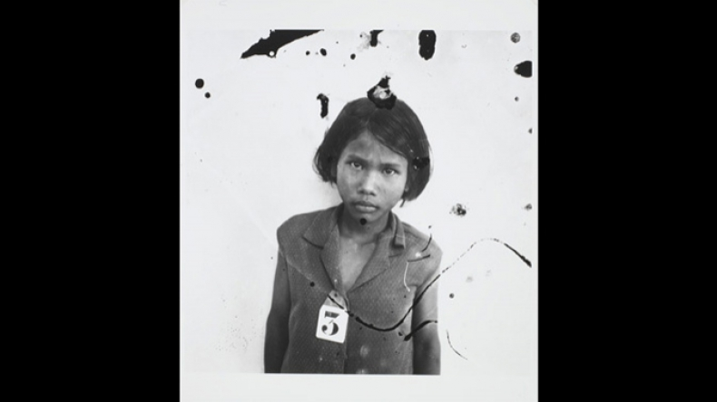
Amnesty International’s Cambodia Photo Exhibit, which evoked Lee Ann Fujii to study genocide (open with hyperlink)

Slide 15
The Killing Fields, directed by Roland Joffé

Slide 16
The Guatemalan Genocide

Slide 17
(Open with hyperlink).

Slide 18
(Open with hyperlink).

Slide 19
The Genocide of Iraqi Kurds

Slide 20
Memorials to the Victims of the Kurdish genocide in Halabja

Slide 21
A well-researched document helpful in understanding what happened.
Human Rights Watch/Middle East. Iraq's Crime of Genocide: The Anfal Campaign against the Kurds. New Haven: Yale UP, 1995.

Slide 22
The Bosnian Genocide

Slide 23
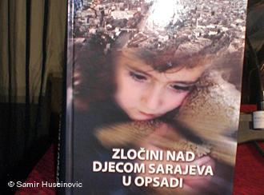
Crimes against Children in the Siege of Sarajevo (2010)documents every child killed in the Serbian siege of Sarajevo

Slide 24
Slobodan Milosevic and the Destruction of Yugoslavia by Louis Sell

Slide 25
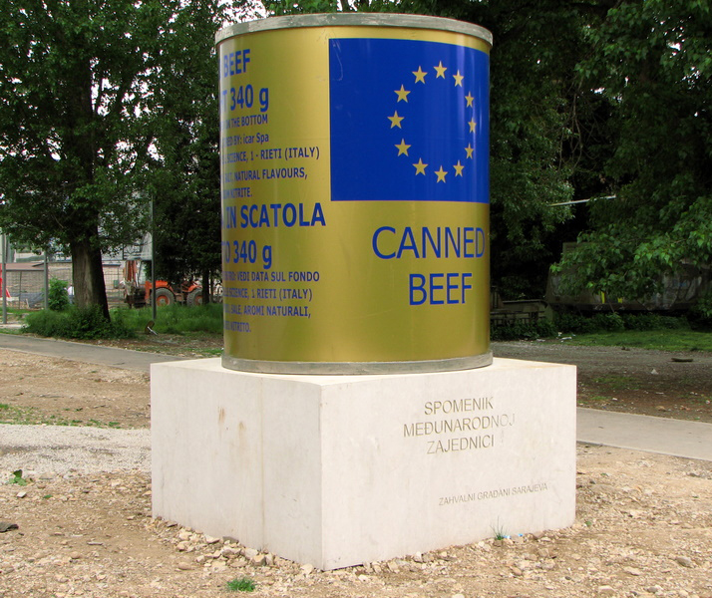
Monument to the International Community, From the Grateful Citizens of Sarajevo

Slide 26
The Genocide in Kosovo

Slide 28
The Rwandan Genocide

Slide 31
Dallaire still feels that, if he could have had 5,000 peacekeepers, he could have stopped the genocide.

Slide 32
The Genocide in Darfur

Slide 34
With her science fiction novel, Okorafor expands the genres in which genocide can be described.

Slide 35
Darfur Drawn: The Confrfur Through Children’s Eyes (Human Rights Watch, 2005)
Dr. Jerry Ehrlich smuggled these children’s drawings out of Darfur.

Slide 37
Music
Julia Bloom’s (2004) Darfur Moon:
https://cabinoflove.bandcamp.com/track/darfur-moon

Slide 38
Although the United Nations has not yet called al-Assad’s attacks on Syrian citizens, surely genocidal attacks have occurred.

Slide 39
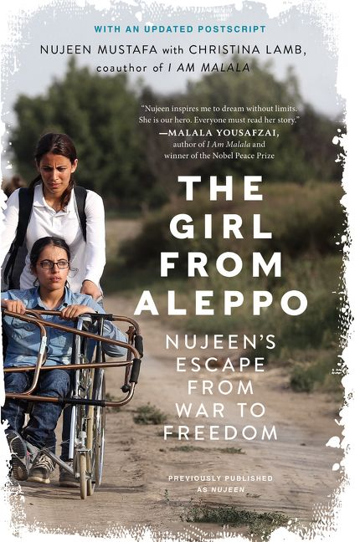

Slide 41
al-Assad deliberately attacks Syrian hospitals.

Slide 42
Although the United Nations has not declared genocide in North Korea, that day may come. Genocidal acts have occurred.

Slide 45
The first book written for young adults on atrocity in North Korea.

Slide 46
The Rohingya of Myanmar

Slide 47
Rohingya Refugees: Why I Fled. (Open with hyperlink).

Slide 49
Genocide Watch issues emergencies for countries around the world, including Yemen:
https://www.genocidewatch.com/countries-at-risk

