Slide 1
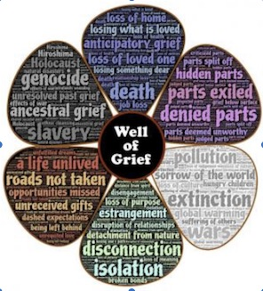
Waterford Public Library Talk October 6, 2020 GOOD GRIEF: HEALING AFTER LOSS
Michèle Lewis O’Donnell, PsyD
with
Jane Gangi, PhD
Tom Miyashiro, MA
See additional information in the Notes under the slides.
© Michele Lewis O’Donnell, 2020
Notes:
Special thanks to Jill Adams, Head of Adult Services, for organizing this Library Talk webinar.
Waterford Public Library, Waterford, Connecticut USA
Michele Lewis O’Donnell, PsyD
Member Care Associates, Inc.
michele.lewis.odonnell@gmail.com

Slide 2
Disclaimer
The information in this Library Talk on Grief is for educational purposes only and should not be construed as professional mental health advice, nor is the information a substitute for professional mental health expertise or treatment. If you have a mental health concern, you should consult with your licensed mental health care provider or seek other professional mental health treatment. If you think you may have a mental health emergency, such as feeling suicidal, call your doctor, mental health professional or emergency services immediately.

Slide 3
What is Psychosocial Support?
Actions that help individuals, families, & communities draw upon their psychological, social, and spiritual resources to deal with needs and life’s challenges:
The psychological domain includes feelings, emotions, thoughts, beliefs, perceptions, and behaviors
The social domain includes traditions, values, upbringing, roles/relationships, family, and community networks
The spiritual domain includes spiritual/faith identity, worldview, spiritual practices, faith and community networks
The three domains intersect and overlap. Our well-being in one domain affects our well-being in the others
Notes:
One of the lessons I have learned anew during Covid is that we need each other. I have been touched personally by the compassion and generosity of many. I’ve been inspired at the courage, commitment, and sacrifice of countless essential workers. We can all in some way participate in supporting others during this pandemic. In discussing loss and how to grieve, I hope we can be inspired to be “Grief Leaders” (Washington Post: When the world’s in crisis, we need ‘grief leaders.’ Here’s how to be one). We can lead in our homes and communities, modeling that it is normal and smart to face our feelings and grief and give others that permission too. We can all give “psychosocial support” where we are.
There is evidence that governments around the world are recognizing in their pandemic recovery plans that they need to include mental health psychosocial support.
Notice included here is the spiritual and faith dimensions of human well-being (WB). I want to pause and underscore this because so often the resources, the practices, traditions, and resilience represented in spiritual and faith domains is overlooked or ignored. There is for instance, a body of research on Religion and Resilience, examining faith practices that enhance facing and living through adversity and crises.
I work in the mission/humanitarian/development sectors globally and when it comes to well-being the trend for the last several years has been toward faith-sensitive prorgaming (in addition to “trauma-sensitive”)programing among the people of concern.

Slide 4
Outcomes: Better understanding...
How Grief in response to loss is:
Normal, Healthy, Necessary
How to identify & grieve:
“Hidden or “Ambiguous” Losses
How grief can keep teaching us if we are open
to its lessons
Notes:
The outcomes I hope for as a result of our discussions today.

Slide 5
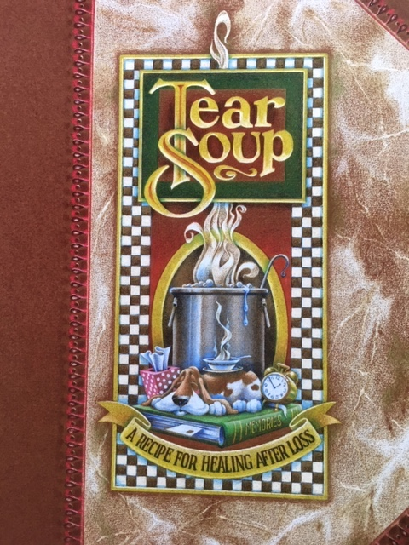
Story by
Pat Schwiebert and
Chuck DeKlyen
Illustrated by
Taylor Bills
Sopa de Lágrimas
GriefWatch.com
1999, 2013 11th ed.

Slide 6
Grief defined:
“Grief is the process
you go through as you adjust
to the loss of
anything or anyone
important in your life.”
Tear Soup, p 47
Notes:
Grief is universal and at the same time, it is very personal.

Slide 7
Questions
What is one loss you have experienced during Covid?
How did it affect you?
How did it affect those around you?
Notes:
During Covid we have all become more aware of the issue of loss because we see it everywhere, at multiple levels simultaneously.
Uncertainties about everything, unemployment, anxiety, food insecurity, isolation, domestic violence, substance use, depression - even the most resilient of us are experiencing some of theses things.
One of my losses….

Slide 8
Poem
6 Feet Didn’t Seem That Far
by
Jennarose Colucci
2020
Notes:
Brief Intro by Jane Gangi –A poem about loss during Covid
+ READING: 2 minutes

Slide 9
“6 feet doesn’t seem that far,”
I thought to myself on the first day of quarantine.
“This will be easy.”
It doesn’t seem that far ….
until your mom comes home from a long day at work
and can’t sit at the dining room table with us for dinner
because two of her coworkers just tested positive.
It doesn’t seem that far….
until your parents haven’t hugged in almost two months
because she’s an essential worker
and he’s high risk because he had a kidney transplant.

Slide 10
It doesn’t seem that far ….
until your grandma is standing on her porch
alone
on her 80th birthday
as her seven kids and 16 grandkids
wave from the car.
It doesn’t seem that far….
until you are at a funeral and you can’t even
hug your cousins as their father
is lowered
6 feet away from them
forever.
Stay home and save lives because I was wrong.
Six feet feels like a world away when all you need
is a hand
to hold.

Slide 11
Video
3 minute Introduction to Tear Soup
Notes:
Keeping in mind your loss during Covid, let’s watch a three minute clip from the beginning of TEAR SOUP https://www.youtube.com/watch?v=USN8GGbC4Ck

Slide 12
Losses big, small, hidden
What size pot does your loss need?
Notes:
What other titles would you add to the library of losses?
Losses require different size pots to make tear soup: What size pot does your loss need? [from “not fair” to “serious heartache” to “profound loss” to “more than I can bear”]
TIMING: 2 minutes

Slide 13
Tear Soup Helpful ingredients to consider
A pot full of tears One heart willing to be broken open A dash of bitters A bunch of good friends Many handfuls of comfort food A lot of patience
Buckets of water to replace the tears
Plenty of exercise
A variety of helpful reading material
Enough self care
Season with memories
Optional: one good therapist and/or support group
From Tear Soup
Is there anything you would add to these ingredients?
Notes:
Anything you might add to the ingredients of your soup? I would add all the diverse feelings—maybe those are in the “pot full of tears”.

Slide 14
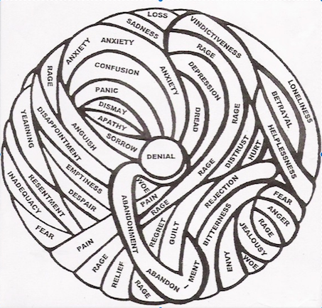
GRIEF...
A TANGLED
“BALL” OF
EMOTIONS
Norm Wright, PhD,
Experiencing Grief,
2004, p. 57
Notes:
As Dr. Wright illustrates, grief is a jumbled, tangled assortment of feelings. Initially shock and numbness may keep you from consciously experiencing your emotions. Some days it may feel like all the emotions apply to you, other days one or two dominate. This is not unusual but rather normal in grief. What are some of these feelings? Pain, emptiness, sadness, fear, anger, rage, betrayal, regret, resentment, relief (the emotion people are reluctant to discuss), guilt, anxiety, panic, confusion, apathy, envy, jealousy, helplessness, loneliness, despair, yearning, dread,....
Helpful exercise from the book: Each day be aware of your ball of grief and observe/acknowledge your feelings. Share your ball with others so they can understand. It may also help them with their grief. When you are aware and acknowledge your feelings (not try to “fix” them or deny them) you will be more likely to control them vs having them control you.

Slide 15
Panelists Share
Tom Miyashiro, MA
-- Personal story of loss
Jane Gangi, PhD
-- Review of Tear Soup
Notes:
Tom, you have a personal story of unbearable loss as a young adult in your late 20s. Learning to make Tear Soup was a part of your story. Tell us more.
Jane, as an educator of teachers and author of a landmark textbook on children’s literature and articles and books on children’s and young adult literature on genocide, what are some of your impressions after reviewing Tear Soup? How is it a “mirror” and/or “window” book?

Slide 16
Ambiguous Loss Pauline Boss, PhD Learning to Cope with Unresolved Grief
Defined:
A loss that occurs without closure or clear understanding, which can halt or freeze the grief process and lead to unresolved grief.
“Incomprehensible” “The irresolvable context is pathological, not the individual or family.” (Boss)
Signs that a loss is ambiguous:
*fluctuating, ambivalent or contradictory emotions (love/anger)
*leads to anxiety, which if not managed can lead to
traumatizing stress
Notes:
Ambiguous loss is an uncertain loss without clear boundaries or resolution. It is incomprehensible, irrational.
In ambiguous loss, the uncertainty of how or what to grieve can freeze the normal grieving process.
The term was first used in the 1970s by Pauline Boss, a researcher who studied families of soldiers who went missing in action and coined the term in the late 1970s. These loved ones were physically absent, but psychologically present, making, “closure” difficult. Later she applied it to psychological absence coupled with physical presence, as with dementia and Alzheimer's.

Slide 17
Ambiguous loss (continued)
Examples:
Physical – Missing in Action, miscarriage, no funerals (Covid)
Psychological – dementia, divorce, mental ill health
Can be the most stressful type of loss
Six Goals for Resilience despite Ambiguous Loss:
finding meaning (continuing rituals/celebrations)
letting go of need for control
normalizing ambivalence
reconstructing identity (roles, rules, rituals)
discovering new hope (arts more than sciences help)
Notes:
Examples: 1)”CATASTROPHIC” – (MIAs, murders unsolved). NORMATIVE”--“empty nest” grief, divorce, miscarriages, chronic mental ill health.
Covid losses: death alone/separated, postponed funerals, cancelled graduations, weddings, reunions, etc.

Slide 18
UNRESOLVED GRIEF From the lack of awareness of many “hidden”, intangible, or “ambiguous losses
Loss of a familiar world
Loss of sense of security
Loss of a dream
Loss of status
Loss of lifestyle
Loss of sense of belonging
or “system identity”
Covid cancellations
“
“
Loss of a job
Loss of relationships
Loss of possessions
Loss of personal space
Loss of the past that never was
Loss of role models
Loss of the past that was
Loss of health or mental health
Losses during COVID are often:
multiple, simultaneous, intense, and unresolved
Notes:
Loss during covid is often hidden and ambiguous. PAST THAT NEVER WAS: children and youth who miss important experiences or, for instance in school, sports teams, music/dance, etc. Syrians in Syria: : 8+ years of civil war, children who have never gone to school due to danger/fear; E + hockey stick, children who miss knowing parents or grandparents.
THE PAST THAT WAS: In war, genocide, migration, climate change, natural catastrophes, homes/places ,communities, and cultures may disappear which are tied to a sense of belonging, significance, understanding—all of which are psychologically present but physically absent.
There are no accepted rituals for grieving hidden losses, we often don’t even recognize that our discomfort related to these losses is GRIEF. Especially when the hidden losses are embedded in something good (like move to a new home, a new marriage, a new country of opportunity/safety).

Slide 19
Keys to Good Grief:
Permission to Grieve
People to Comfort
Difference between comfort and encouragement
Time to Process
Notes:
Permission includes the internal permission we give ourselves and external permission from others to express our feelings w/o being judged. Embracing our losses and grieving helps us move on and be more engaged in life in general. Grief validates the good and meaningful in our lives!
To understand why unresolved grief occurs we need to ask ourselves, do we deny, discount or compare our grief to others or a higher good?
Comfort validates grief, gives message ‘I care and understand’. Encouragement, in contrast, attempts to change the other person’s perspective, to see the positive or optimistic side. When encouragement is given when comfort is needed, we take away the permission to grieve.
We also need people who will support us and help us move through our grief by actively listening, expressing empathy, and being available to help in practical ways.
In addition to permission and comfort, we also need time to process and work through many conflicting emotions. The time it takes varies among individuals and is an uneven process (forward and back). Rushing the normal grief process leads to unresolved grief.

Slide 20
Panelists Share
Tom Miyashiro, MA
--Perspective working with youth and at risk kids
--challenges/concerns related to Covid
Jane Gangi, PhD
-- “Check-ins” and teaching during Covid
-- Questions from participants
Notes:
Tom, in your ongoing commitment to youth in our community through work in schools with at risk kids (LifeFAQs.org , New London High School, etc.) and a youth ministry (Faith2Faith), what are some of the needs you have seen during Covid or pre Covid you would like to share?
Jane, as a professor of of teachers what have you been learning during this pandemic about both teachers’ and students’ needs during Covid and how to meet some of those needs in the virtual classroom?
Are there books for children and youth that have been particularly relevant to their concerns and worries?

Slide 21
Focusing on the Positive
What have you gained during this pandemic? For what are you grateful?
Are there things that you have you learned that you could live without?

Slide 22
Helping Children/Youth with grief and death a loved one
1. Children model what they see in adults
--how you grieve as a parent/adult matters
2. Children usually want to be included
--belonging>respect>significance>security
3. Children need to be prepared
--plans, reactions they may witness, questions
Notes:
Children’s resilience grows when they are sensitively included in family rituals of grief and respectfully prepared to participate if they choose (according to their developmental stage); when their losses are validated and questions are welcomed.
Story: A child at age eight, excluded from private viewing of grandfather, although she wanted to go. As a teen she wanted to understand why she was “left out”.
Death of pets is an opportunity to learn good grief, tear soup making—how we did it as a family with four hamsters!

Slide 23
Video animation 6 minutes
Guide for Parents and Carers:
Telling Children about the Death of a Relative
Dr Louise Dalton, Dr Elizabeth Rapa, Helena Channon-Wells, Dr Virginia Davies and Prof Alan Stein louise.dalton@psych.ox.ac.uk | March 2020 | thelancet.com/series/communicating-with-children
Notes:
Optional 6 minute video
Written guidelines to accompany video in multiple languages. Also, similar animations and guidelines for Healthcare Professionals and Carers.

Slide 24
Department of Psychiatry, Oxford University, 03/2020
Notes:
Booklet on SUPPORTING FAMILIES TO COMMUNICATE THE DEATH OF A RELATIVE to accompany Video

Slide 25
Tear Soup
Suggestions for use of video
Video introductory clip (3 minutes):
You Tube
https://www.youtube.com/watch?v=USN8GGbC4Ck
Full version (YouTube link) on Library Resource Sheet
--When you want to work on your grief, invite a friend to watch with you
--Families can watch together
--Teachers and students
SEE GriefWatch.com “Downloads” > Tear Soup DVD Viewer's Guide
Viewer’s Guide also available in Spanish
WHAT RESOURCES CAN YOU SHARE?
Notes:
NOTE: Tear Soup Viewer guides in Spanish

Slide 26
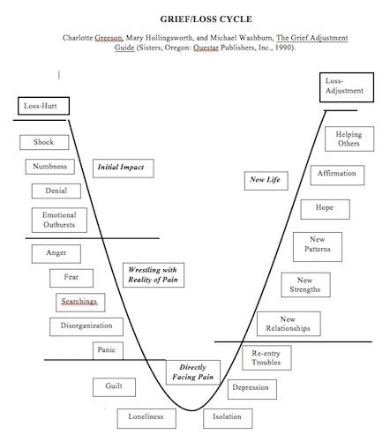
Initial Impact
New Life
Wrestling with Reality of the Pain
****
Directly
facing the Pain
****
Notes:
Optional slide: Stage approaches can be confusing as there are various models. This one I consider the best depiction of general reactions in the grief cycle, U-shaped curve or “Valley of Sorrow”.
Note: Things can get worse before they get better and fluctuate back and forth, but this is actually progress as one moves through the “valley” and the emotions of “directly facing the pain”. If one tries to jump across to “new life” prematurely and avoid the depths of the valley (denial), one truncates the grief adjustment process, which usually leads to a variety of relational and maladjustment problems.

Slide 27
Thank you
For joining the conversation on LOSS and GRIEF
during Covid!
Waterford Public Library
Connercticut ,USA

