Slide 1
Good Grief: Healing After Loss
Tuesday, October 6, 6:30 pm
Waterford Public Library, Waterford, CT (online via Zoom)
Jane M. Gangi, PhD

Slide 2
6 Feet Didn’t Seem That Far by Jennarose Colucci an Education student at Mount Saint Mary College, Newburgh, NY May 2020
“6 feet doesn’t seem that far,”
I thought to myself on the first day of quarantine.
“This will be easy.”
It doesn’t seem that far ….
until your mom comes home from a long day at work
and can’t sit at the dining room table with us for dinner because
two of her coworkers just tested positive.
It doesn’t seem that far….
until your parents haven’t hugged in almost two months because she’s an
essential worker
and he’s high risk because he had a kidney transplant.
It doesn’t seem that far ….
until your grandma is standing on her porch
Alone on her 80th birthday
as her seven kids and 16 grandkids
wave from the car.
It doesn’t seem that far….
until you are at a funeral and you can’t even
hug your cousins as their father
is lowered
6 feet away from them
forever.
Stay home and save lives because I was wrong.
Six feet feels like a world away when all you need
is a hand
to hold.

Slide 3
“Making things makes my head feel better”—a child in Newark, NJ (2015)
As suggested in Tear Soup:
Writing
Psychologist Ellis Barowsky and I found that young people who have experienced trauma can gain healing, sometimes more quickly than with “talk therapy,” through the arts:
-storytelling -dance -music -multimodal representation
-the visual arts -film -theater and radio -animoto, vimeo, podcast
Also, consider handcrafts: woodworking, knitting, needlepoint, crochet
Gangi, J. M., & Barowsky, E. (2009). Listening to children's voices: Literature and the arts as means of responding to the effects of war, terrorism, and disaster. Childhood Education, 85(6), 357-363.

Slide 4
Rose Wilder Lane (Laura Ingalls Wilder’s daughter)
The crochet stitch itself must be nearly as old as fingers, which seem mysteriously impelled to pull a loop through a loop. I say mysteriously, remembering how this impulse baffled the American Near East Relief workers who went into Caucasian Armenia [in 1918]…Every hut in every village was totally destroyed. In the ruins and in the miles of wild grasses the Americans found 25,000 orphaned children hiding, lost, sick, starving and dying.

Slide 5
Rose Wilder Lane, continued
They were three to ten years old and knew nothing but hunger and fear. The Americans gathered them…cleaned, deloused, fed, healed and saved most of them alive. But it was impossible to keep bandages on their sores. Untaught, and constantly admonished not to, they couldn’t resist pulling ravellings from the gauze and with their tiny fingers looping them into crude Armenian lace. (as cited in Armenian Relief Cross of Lebanon, p. 18)

Slide 6
Rudine Sims Bishop (1990): Children must have books that are mirrors—where they see themselves—and windows—books that open to them new worlds.

Slide 7
Not all of these possible “mirror” books would be appropriate, which is why we will always need adults sensitive to individual children.

Slide 8
Death: Connor must come to terms with his dying mother. Novel—probably 6th grade and up.

Slide 9
In Tokyo, three friends who have never witnessed death decide to “stalk” an old man who looks like he is about to die. Their eventual friendship changes things. Middle grade novel.

Slide 10
Upper elementary +

Slide 11
After a beloved grandmother passes away, spring brings her favorite purple flowers. Picture book.

Slide 12
Would we really want to live forever? Fantasy novel. Upper elementary—middle school.

Slide 13
To come to terms with the death of her mother, Phoebe takes a trip with her grandparents. Middle grade novel.

Slide 14
An Iranian and Iraqi boy end up in the same hospital, at first as enemies and, later, as friends. Picture book.

Slide 15
Two children lose their mother during the Dust Bowl. Picture book.

Slide 16
Also, the loss of a mother during the Dust Bowl. Novel in verse.

Slide 17
Escaping from Haiti, a boy loses his parents to a drowning accident. The love of his uncle and his drum help him grieve. Picture book.

Slide 18
A boy who has witnessed death in Somalia begins to find his way through art and a caring teacher. Picture book.

Slide 19
After the death of their parents, an older brother tries to keep his younger brothers together. Novel.

Slide 20
During the Holocaust, a German woman rescues a baby, Erika, whose parents have thrown her from the train taking them to certain death in a concentration camp. Picture book (upper elementary and higher).

Slide 21
In Afghanistan, after her mother dies, her father seeks to remarry. The new stepmother doesn’t want her so her father abandons Jameela in a marketplace. Novel, based on a true story.

Slide 22
During World War I, Sterling North loses his mother. His laid back father and a pet racoon help relieve his sadness. Novel.

Slide 23
Animal death. Novel.

Slide 24
Divorce and separation: Lee and an author communicate through letters after his parents divorce. Novel.

Slide 25
A boy receives a letter from his father who has left the family. Picture book.

Slide 26
Loss and separation from family: Abandoned children find each other in a foster home. Novel (as also been adapted to a play by Aurand Harris).

Slide 27
Jacqueline Woodson and James Ransome, both of whom have relatives in prison, wrote this so that those affected know there could be joy in a prison visit. Picture book.

Slide 28
Loss of home: Yasmin and her family must move after a typhoon destroys their home.

Slide 29
After a Pakistan soldier shoots her for going to school, Malala emigrates to the U. K. Picture book and chapter book biography.

Slide 30
Tomás and his family, because they are migrants do not have library cards so a librarian loans him one. True story of Tomás Rivera who became a chancellor of the U of California. Picture book.

Slide 31
When the British separate two aboriginal Australian girls from their people, the two girls make a trip of extraordinary danger to return to home. Based on a true store. Chapter book biography and there is also a film.

Slide 32
When the Canadian government separates children from their families to send them to boarding school, Shi-shi-etko takes a walk of memories with her grandmother. Picture book.

Slide 33
A family from Kosovo escapes genocide to a family in Vermont. Novel.

Slide 34
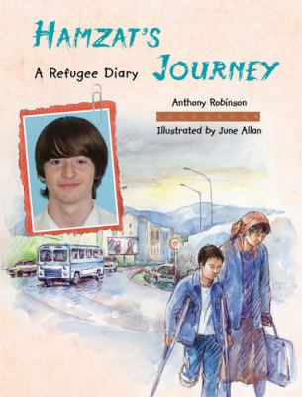
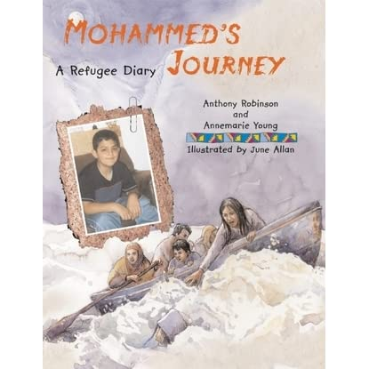
Three picture books.

Slide 35
Based on a true story. After the American invasion of Afghanistan, an Afghani family flees to Canada. Ziba remembers all she loved about her home. Picture book.

Slide 36
The Hmong embroidery of their flight from one country to another. Picture book.

Slide 37
A man must leave his family for another country to find work. Wordless picture book.

Slide 38
Teens who meet to discuss all kinds of problems. Novel.

Slide 39
Really, anything by Jacqueline Woodson who has won every major award there is including, today, the MacArthur genius grant.
After Tupac and D Foster (foster children)
Behind You (after wrongful death)
Beneath a Meth Moon (drugs)
Between Madison and Palmetto (friendship)
The Book Chase (aspiring writer)
Brown Girl Dreaming (memoir)
From the Notebooks of Melanin Sun (nontraditional families)
The House You Pass on the Way (biracial)
Hush (a policeman’s family who must change identities)
I Hadn’t Meant to Tell You This (sexual abuse)
If You Come Softly (cross-racial love and wrongful death)
Last Summer with Maizon (death and endings)
Lena (escaping sexual abuse)
Locomotion (foster children)
Maizon at Blue Hill (being African American in an exclusive private school)
Miracle’s Boys (a teen who keeps his family together after his parents’ death; correctional center)
Peace, Locomotion (siblings in separate foster homes)

Slide 40
In I Hadn’t Meant to Tell You This, Woodson tells the story of a rich, Black girl who befriends a “whitetrash” girl, Lena, who has experienced sexual abuse:
We stared at each other silently. I wanted to shake all that sadness and steel out of her. I wanted to know everything about her right then; what had she been like as a little girl, what did she believe in, who did she love. I wanted to throw my arms around her and shout, “Welcome home.”
“Welcome home”—our continuing message to those who grieve.

Slide 41
Resources Collaborative for Equity in Literacy Learning at Mount Saint Mary College: https://www.msmc.edu/about/centers-institutes/the-collaborative-for-equity-in-literacy-learning/resources/children-s-and-young-adult-literature/

