Slide 1
Working Globally Across Sectors Reflections and Resources for Global Mental Health Michèle Lewis O’Donnell, PsyD and Kelly O’Donnell, PsyD Member Care Associates, Inc. Regent University, School of Psychology and Counseling MHPS 691—Indigenous Mental Health Care I, 11 July 2020 MCAresources@gmail.com http://membercareassociates.org ©2020 Kelly and Michèle O’Donnell—see the notes under the slides too
Notes:
Note: We speak regularly on the topics of global integration, global mental health, member care, and integrity/anti-corruption, in person and remotely. We have found that a 90 minute lecture at a graduate school, for example, is good to give an overview, perhaps even inspire folks, yet understandably it can usually only go so far and thus an overall strategy by graduate schools is needed for including “global” perspectives and material throughout the curriculum/training. This might require an intentional, informed, consensual shift. Key to this shift is cultivating a more “global” mentality and mentors/models with not just ‘international” (different nations) experience but multi-sectoral, global experience (with issues that transcend geo-political borders—problems without passports). Note for instance, within the multi-disciplinary field of psychology, the American Psychological Association’s recent Strategic Plan (2019) which explicitly calls the organization and its members to “Embrace a global mentality.”
--Image: Detail from the cover of Global Member Care: Crossing Sectors for Serving Humanity (2013) William Carey Library.

Slide 2
.
Member Care Associates Inc. (MCA) is a Christian non-profit organisation working internationally and across sectors (mission, health, humanitarian, development, peace, human rights). We focus on wellbeing and effectiveness (WE) for staff and their organizations, global mental health, and integrity/anti-corruption. Our services include consultation, training, research, developing resources, and publications. We (Kelly and Michèle) did our doctoral training in clinical psychology and theology at Rosemead School of Psychology, Biola University USA. We are representatives for the World Federation for Mental Health at the United Nations.

Slide 3
Global Integration
A framework for actively and responsibly engaging in our world —locally through globally—for God’s glory:
by connecting relationally and contributing relevantly
on behalf of human wellbeing and the issues facing humanity,
in light of our integrity, commitments, and core values (e.g., ethical, humanitarian, human rights, faith-based).
Following Jesus Globally: Engaging the World through Global Integration Lausanne Global Analysis (January 2020–English, Spanish, Portuguese, French) Link HERE for a copy of the article with a basic translation tool into 50 languages.
Notes:
People, Platforms, Presentations, Publications, Partnerships, Probity…

Slide 4
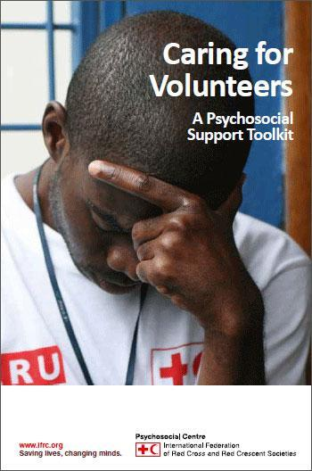
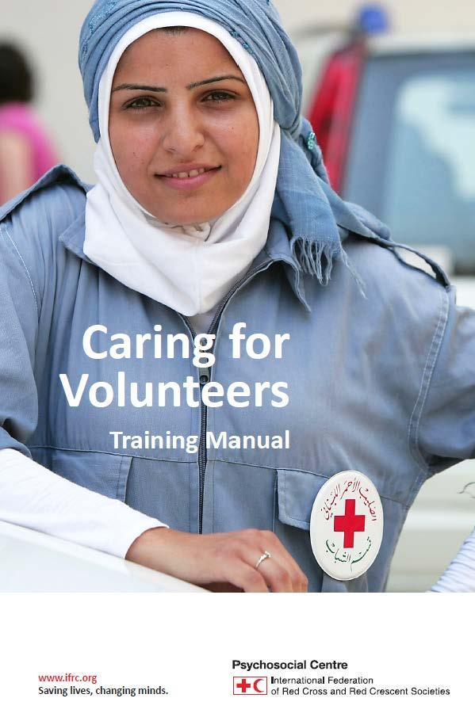
1. Wellbeing and Effectiveness (WE) Member Care

Slide 5
Wellbeing and Effectiveness (WE) Member Care
Engaging in Humanity Care: Stress, Trauma, and Humanitarian Work Christian Psychology Around the World–Special Focus: Coping with Stress in Theory and Practice (Issue 14, May 2020, pp. 153-167)
Multi-Sectoral Member Care: Engaging Our World as Global Integrators Journal of Psychology and Theology (December 2016)

Slide 6
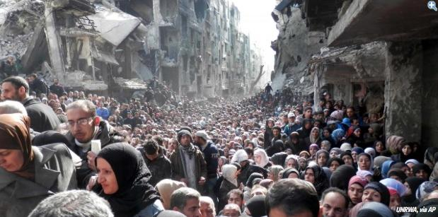
.
2. Global Mental Health
Mental Health as Mision
Notes:
-- Palestinian refugees residing in Syria--forcibly displaced again--refugees twice over.
Yarmouk refugee camp, February 2014. Current estimates of forcibly displaced people worldwide: 70+ million people (UNHCR)
130M+people in need of humanitarian assistance. 65M+ people internally or internationally displaced. --And the list of “globe-ails” goes on and on...
“Globe-ails” is a term we use to encapsulate the many major problems--ails--affecting the people-planet nexus, including our yearnings-groanings for the full restoration of creation. --See: --Doomsday: Next Stop, Global Dis-Integration? (Global Integration Update, June 2017)
Syria (and Lebanon) – complex recent history of civil war: the Palestinians given refuge are twice refugees in the current Syrian civil war.
Article: The Palestinians Fleeing Syria Are Among the Most Vulnerable Refugees (Dec. 4, 2015, thenation.com)
Their special legal status leaves them stateless, even after decades of exile, and without the same rights as other refugees.
By Mai Abu Moghli and Nael Bitarie link:https://www.thenation.com/article/the-palestinians-fleeing-syria-are-among-the-most-vulnerable-refugees/
History in Syria: several waves of Palestinian refugees since 1948 (by 2011, more than 560,000 refugees living in Syria). Also, there is a large Iraqi refugee population.

Slide 7
Global Mental Health Defined
“Global Mental Health (GMH) is an emerging domain of research and practice that promotes equitable mental health and well-being for all.
GMH is international, interdisciplinary, culturally relevant and multi-sectoral.
GMH emphasizes the right to equity in health and encourages healthy behaviors and lifestyles.
GMH is committed to preventing and treating mental, neurological, and substance use conditions (MNS) especially for vulnerable populations such as poverty, conflict, and trauma and in low- and middle-income countries.
GMH seeks to improve policies and programs, professional practices and research, advocacy and awareness, and social and environmental factors that affect mental health and well-being.”
(O’Donnell and Lewis O’Donnell, 2016 and O’Donnell and Eaton, 2017).
Notes:
--GMH shaped by public health, human rights, clinical science, and cultural anthropology.
--It is not simply something that concerns specialists--“psychology-psychiatry, psychotherapy, and psychopharmacology.”
--Note: personally, 2009 is the year we began to intentionally connect with the young GMH movement. It would be accurate to say that the initial GMH “movement” was significantly shaped via the launching of: The Lancet’s GMH Special Issue (2007), the formation of the Movement for Global Mental Health (2008), and the mhGAP Program by the World Health Organization (2008). There were plenty of precursors and other influences as well. And the were concerns and detractors from the start about a perceived over emphasis on Western concepts for mental ill health, psychiatry, and pharmacology. --For a helpful critique of GMH, see Kirmayer and Peterson’s introductory article in the special issue on GMH in the Journal of Trans-Cultural Psychiatry (December 2014, this article is open access).

Slide 8
GMH Mental Health as Mission (mhM)
No Turning Back for the World Community…Mental Health and Psychosocial Support in Crisis Situations. Global Insights, Office of International Affairs, American Psychological Association (January 2020)
Global Mental Health: What’s Up? Recent Developments and Directions Global Insights, Office of International Affairs, American Psychological Association (June 2019). Click HERE for the full version. Click HERE for the overview version.

Slide 9
Global Mental Health: What’s Up? Recent Developments and Directions "The GMH markers represent many advances on behalf of “mental health and wellbeing for all.” They point to what we sense is a tangible shift into a new phase for GMH: a collective game changer with serious positive implications for on the ground, community-based improvements in mental health.
Some of the many areas impacted—the advances and shifts—include greater awareness, acceptance, advocacy, collaboration, and action for: health budgets, policies, and laws; scaling up, task shifting, and the central roles of people with lived experience; parity, primary health care, and universal health coverage; humanitarian action, trauma-informed care, and peacebuilding; health, mental health, and social work training programs in academic, organizational, and community settings; implementation science, indigenous psychologies, and culturally-appropriate and faith-sensitive services; and social and commercial determinants of health, stigma, and human rights. We are seeing a convergence of many efforts, the fruit of the labor of thousands of civil society, lived-experience, local and faith-based, business, academic, and government colleagues around the world.
This next GMH phase--Generation 2.0--is increasingly “human.” It is about investing in our common humanity, our human family. It is people committed to people in order to resolutely make healthy lives—including mental health--and wellbeing for all a reality. It is everyone’s responsibility.”
Notes:
Global Mental Health: What’s Up? Recent Developments and Directions Global Insights, Office of International Affairs, American Psychological Association (June 2019) Click HERE for the full version.

Slide 10
Lancet Commission on GMH and Sustainable Development (October 2018)
Summary of Key Recommendations
Address mental health across all the Sustainable Development Goals
Include mental health in the essential package of services for Universal Health Coverage
Take a public health approach to prevention and promotion
Ensure inclusion of people with mental health conditions
Increase investment in mental health
Harness learning from research to help drive change
Measure progress against existing commitments
Source: MHIN Policy Brief October 2018
Notes:
Question: how is trauma included and represented in this Report? Causes and consequences, sources and symptoms, prevention and treatment, contributing to the global burden of health?

Slide 11
Cape Town Declaration (2011) Pan African Network of People with Psychosocial Disabilities
“We recognise that people with psychosocial disabilities have been viewed in bad ways, with derogatory words being used to describe us such as mentally disturbed, having unsound minds, idiots, lunatics, imbeciles and many other hurtful labels We are people first!
We have potentials, abilities, talents and each of us can make a great contribution to the world. We in the past, presently and in the future, have, do and will continue to make great contributions if barriers are removed….
For as long as others decide for us, we do not have rights. No one can speak for us. We want to speak for ourselves.
We want to be embraced with respect and love….
We wish for a better world in which all people are treated equally, a world where human rights belong to everyone. We invite you to walk beside us. We know where we want to go”.

Slide 12
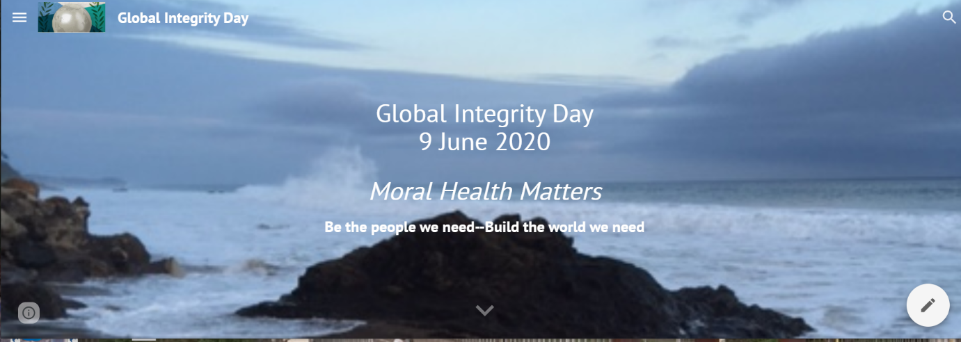
https://sites.google.com/view/global-integrity-day/
3. Pro-Integrity and Anti-Corruption Moral Health

Slide 13
Pro-Integrity and Anti-Corruption Moral Health
Global Integrity Day, 9 June 2020–Moral Lives Matter ‘A positive and solemn day for cultivating lifestyles of integrity throughout the year.’
Integrity and Anti-Corruption Resource List (March 2020)
A Summons to a Global Integrity Movement: Fighting Self-Deception and Corruption Lausanne Global Analysis (March 2018) Link to a copy with a translation tool for 50 languages HERE.

Slide 14
4. United Nations etc.

Slide 15
United Nations and COVID etc.
GMH-Map website:
COVID-19 resources from various sources --GI Update June 2020: Managing Stress and COVID-Distress: Faith-Inclusive Resources --GI Update May 2020: Staying Sane during COVID-19: Mental Health Resources for Ourselves, Others, and the World --GI Update April 2020: Confronting COVID-19: "Be safe. Be smart. Be kind.“
--Resources for MHPSS during the COIVD-19 Pandemic, MHIN (ongoing)
--United Nation Comprehensive Response to COVID-19 (June 2020)
--IASC Guidance: Operational Considerations for Multi-Sectoral MHPSS in COVID (June 2020)
--IASC Guidance on Basic Psychosocial Skills: A Guide for COVID-19 Responders (June 2020)
--WHO Resolution on the COVID-19 Response (19 May 2020)
--COVID-19 and the Need for Action on Mental Health. UN Policy Brief, 13 May 2020.

Slide 16
More Resources
"The world must change the way mental health challenges are addressed." Dainius Puras, Remarks 6 July 2020 to the UNCHR, presenting his annual report as the UN Special Rapporteur on the Right to Physical and Mental Health.
Mental Health for Sustainable Development: A Topic Guide for Development Professionals Ryan, Iemmi, Hanna, Loryman, Eaton; K4D Emerging Issues Report (January 2020)
See also: Blue Print Group, United for GMH
Mental Health Innovation Network
Movement for Global Mental Health
UN IASC MHPSS Reference Group
MHPSS Network
WHO, Mental Health

Slide 17
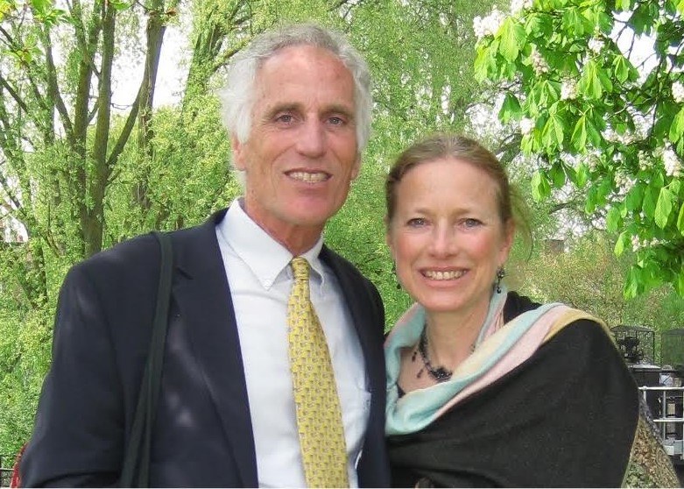
.
Thank you!
Kelly and Michele O’Donnell, Member Care Associates, Inc. mcaresources@gmail.com www.membercareassociates.org
Notes:
--Dr. Michèle Lewis O’Donnell and Dr. Kelly O’Donnell are consulting psychologists living/working internationally for 30+ years.. Respectively they are the COO and CEO of Member Care Associates, Inc (MCA), an NGO focusing on the wellbeing and effectiveness of staff and their organizations. Their multi-sectoral emphases for consultation, training, and writing include: personnel development, Global Mental Health, and integrity/anti-corruption. Kelly and Michèle are International Affiliates of the American Psychological Association and Representatives of the World Federation for Mental Health to the United Nations. Their publications include over 70 articles and five books in the member care and mental health fields (see recent publications) as well as ongoing Member Care Updates and Global Integration Updates (archived on the MCA website). They did their doctoral training in clinical psychology and theology at Rosemead School of Psychology, Biola University, USA and have two wonderful adult daughters, Erin and Ashling, raised in five countries. MCAresources@gmail.com

Slide 18
PS More things we want to share with you….
Wellbeing for All Global Mental Health Developments and Directions
Presentations Payap University and Cornerstone Counseling Center
Chiang Mai, Thailand
6, 7 February 2020
(some of the slides)

Slide 19
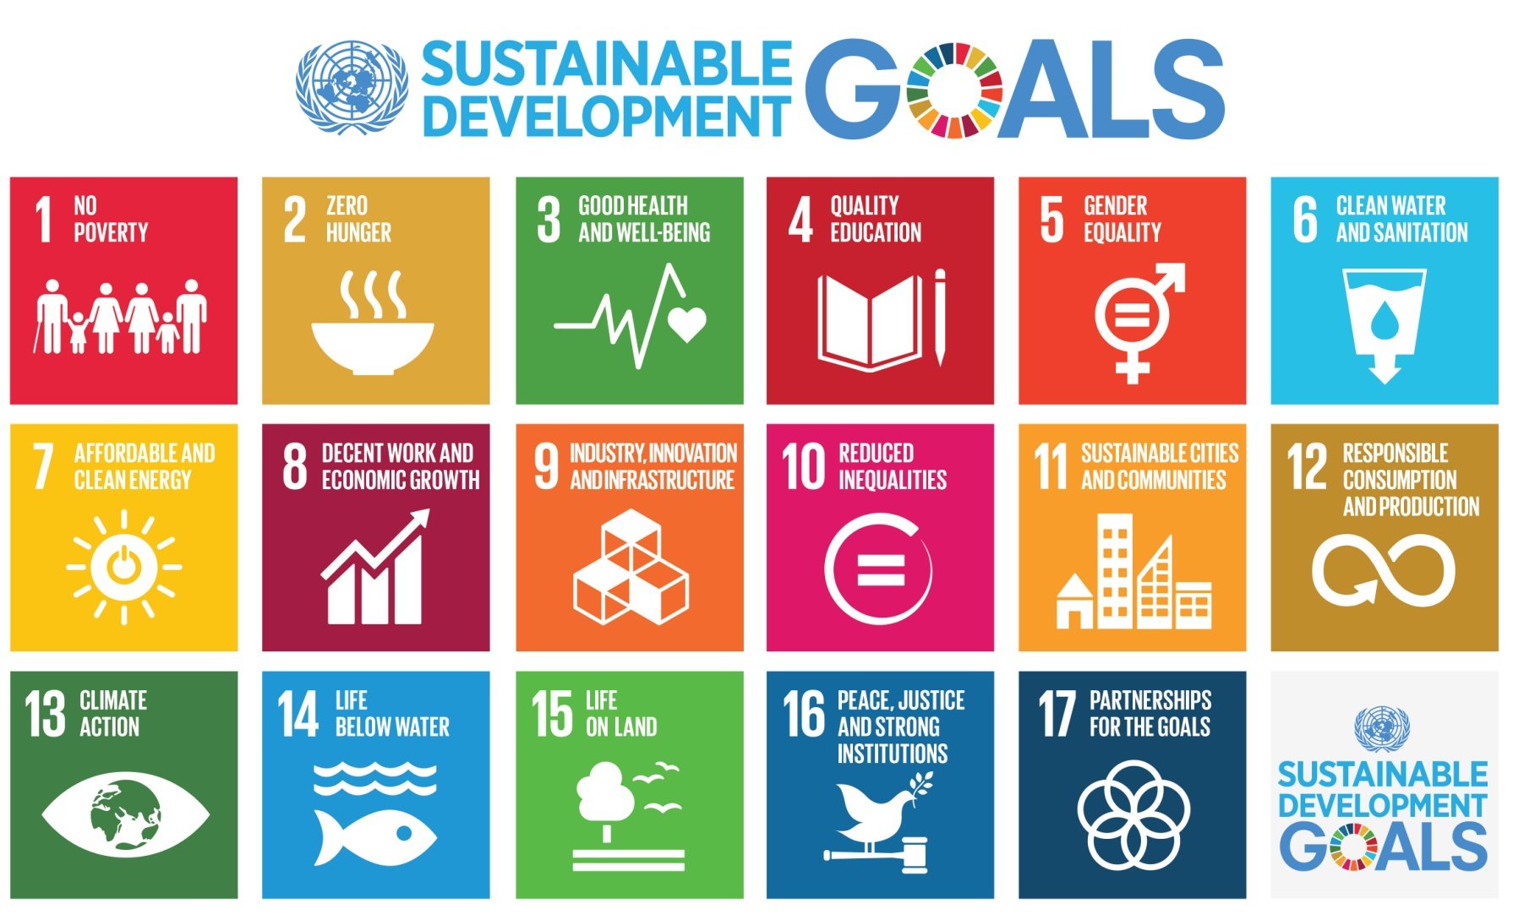
There is no sustainable development without mental health Transforming Our World: The 2030 Agenda for Sustainable Development (Sept. 2015)
.
"Today we are also taking a decision of great historic significance. We resolve to build a better future for all people, including the millions who have been denied the chance to lead decent, dignified and rewarding lives and to achieve their full human potential. We can be the first generation to succeed in ending poverty; just as we may be the last to have a chance of saving the planet…” (paragraph 50)
The five overlapping themes in the SDGs: People-Peace-Prosperity-Planet-Partnership
Notes:
We are aware that there are different perspectives about the United Nations. It has many strengths and weaknesses, accomplishments and failures. In spite of its shortcomings, we are convinced of its critical importance in our world along with the huge opportunities--and moral responsibilities--that are before us all via the sustainable development Agenda. We encourage you to carefully review the Agenda, noting especially its core which consists of 17 goals and 169 targets. It is a plan of action that involves five overlapping areas: People, Planet, Prosperity, Peace, and Partnerships.
--How are we connecting and contributing to the SDGs? --How can the SDGs support the purpose and work of the church-mission community?
--Will the SDGs morph into the Sustainable Survival Goals? See: Global Integration Updates (Member Care Associates) Doomsday? Next Stop, Global Dis-Integration (June 2017) and Faith-Based Partners in Transformation (August 2015)

Slide 20
Overview: Mental Health Action Plan 2013-2020
Vision A world in which mental health is valued, promoted, and protected, mental disorders are prevented and persons affected by these disorders are able to exercise the full range of human rights and to access high-quality, culturally appropriate health and social care in a timely way to promote recovery, all in order to attain the highest possible level of health and participate fully in society and at work free from stigmatization and discrimination.
Cross-cutting Principles
Universal health coverage Regardless of age, sex, socioeconomic status, race, ethnicity or sexual orientation, and following the principle of equity, persons with mental disorders should be able to access, without the risk of impoverishing themselves, essential health and social services that enable them to achieve recovery and the highest attainable standard of health. | Human rights Mental health strategies, actions and interventions for treatment, prevention and promotion must be compliant with the Convention on the Rights of Persons with Disabilities and other international and regional human rights instruments. |  | Evidence-based practice Mental health strategies and interventions for treatment, prevention and promotion need to be based on scientific evidence and/or best practice, taking cultural considerations into account. | Life course approach Policies, plans, and services for mental health need to take account of health and social needs at all stages of the life course, including infancy, childhood, adolescence, adulthood and older age. | Multisectoral approach A comprehensive and coordinated response for mental health requires partnership with multiple public sectors such as health, education, employment, judicial, housing, social and other relevant sectors as well as the private sector, as appropriate to the country situation. |  | Empowerment of persons with mental disorders and psychosocial disabilities Persons with mental disorders and psychosocial disabilities should be empowered and involved in mental health advocacy, policy, planning, legislation, service provision, monitoring, research and evaluation.
Goal To promote mental well-being, prevent mental disorders, provide care, enhance recovery, promote human rights and reduce the mortality, morbidity and disability for persons with mental disorders
Objectives and Targets
1. To strengthen effective leadership and governance for mental health Global target 1.1: 80% of countries will have developed or updated their policy/plan for mental health in line with international and regional human rights instruments (by the year 2020). Global target 1.2: 50% of countries will have developed or updated their law for mental health in line with international and regional human rights instruments (by the year 2020). |  | 2. To provide comprehensive, integrated and responsive mental health and social care services in community-based settings Global target 2: Service coverage for severe mental disorders will have increased by 20% (by the year 2020). |  | 3. To implement strategies for promotion and prevention in mental health Global target 3.1: 80% of countries will have at least two functioning national, multisectoral mental health promotion and prevention programmes (by the year 2020). Global target 3.2: The rate of suicide in countries will be reduced by 10% (by the year 2020). |  | 4. To strengthen information systems, evidence and research for mental health Global target 4: 80% of countries will be routinely collecting and reporting at least a core set of mental health indicators every two years through their national health and social information systems (by the year 2020).

Slide 21
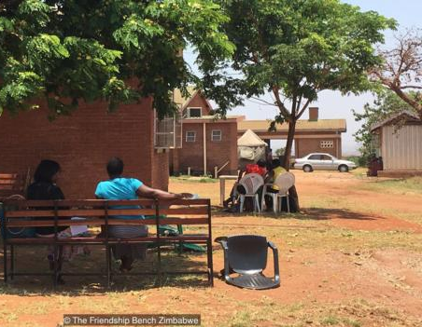
The Friendship Bench
“The Friendship Bench project is an evidence-based intervention developed in Zimbabwe to bridge the mental health treatment gap. Their mission is to enhance mental well-being and improve quality of life through the use of problem solving therapy delivered by trained lay health workers. The Friendship Bench focuses on people who are suffering from common mental disorders, such as anxiety and depression. Produced by: Nicky Wimble, United For Global Mental Health”
Video: https://www.youtube.com/watch?v=Th77mCuL5GY

Slide 22
.
“Evidence-based psychological interventions commonly used in high-resource settings can be effective in low-resource contexts, including when they are delivered by trained and supervised non-specialists. These interventions have proved helpful in the treatment of common mental health problems, such as depression, anxiety and traumatic and chronic stress, as well as other difficulties, such as harmful alcohol use. Cultural and contextual adaptations can increase the effectiveness of psychological interventions, and make them more accessible to people affected by crises. Treatments are best delivered in local languages, using recognisable terminology and case examples, and implemented in ways that do not exacerbate stigma or exclusion. Humanitarian settings demand psychological interventions that are as brief and as low-cost as possible, and which optimise limited human resources.”
Scalable psychological interventions for people affected by adversity, Schaefer et al (July 2018) Mental Health and Psychological Support in Humanitarian Crises, Humanitarian Exchange/HPN, ODI

Slide 23
Social Determinants of Health
“Because mental disorders are so strongly socially determined, the global burden of these disorders is unlikely to be relieved by improved access to mental health treatments alone. In the words of the final report of the WHO Commission on the social determinants of health in 2008: “Why treat people only to send them back to the conditions that made them sick in the first place?”
Social determinants of mental disorders and sustainable development goals: A systematic review of reviews. Lund at al (1 April 2018) Lancet
Idioms of Distress-- the socio-cultural understanding of mental ill health
Diagnostic shifts—continuum of severity (distress, disability, duration) vs being a “disorder or a disease”, and the socio-cultural context for mental ill health
Notes:
Note from CORE Member Care weblog, 16 December 2015 http://coremembercare.blogspot.com
--We also want to mention the need to address global injustices and global inequities related to the current global governance systems--a central issue which relates to but is not sufficiently addressed by SDG 10: "Reduce inequality within and between countries." For example with regards to health, consider this perspective: "Power asymmetry and global social norms limit the range of choice and constrain action on health inequity; these limitations are reinforced by systemic global governance dysfunctions and require vigilance across all policy arenas....Global governance for health must be rooted in commitments to global solidarity and shared responsibility; sustainable and healthy development for all requires a global economic and political system that serves a global community of healthy people on a healthy planet. " (The Lancet-University of Oslo Commission on Global Governance for Health, The Lancet, Feb. 2014, p. 5)

Slide 24
Be Global Citizens Embracing our common identity, belonging, and responsibilities as humans (not global homogeneity, cultural conformity, national non-sovereignty…)
Gyeongju Action Plan (2016) “Education for Global Citizenship: Achieving the SDGs Together”
“In addition to literacy and numeracy, education must advance the cause of global citizenship which: promotes integrated development of the whole person emotionally, ethically, intellectually, physically, socially, and spiritually; imbued with an understanding of our roles, rights and responsibilities for the common good in service to humanity and the advancement of a culture of peace, non-violence, freedom, justice, and equality…“empowers learners to assume active roles to face and resolve global challenges and to become proactive contributors to a more peaceful, tolerant, inclusive, and secure world” [UNESCO 2014]; nurtures a sense of solidarity and empathy in order to end poverty, protect the planet, ensure human rights, and foster prosperous and fulfilling lives for all….We commit to…An education that teaches conflict resolution, a deep appreciation for diversity, ethical reasoning, gender equality, human rights and responsibilities, interdependence, multilingual and multicultural competence, social justice, sustainable development, and values.” (pages 1,2) [bold font added for emphasis]

