Slide 1
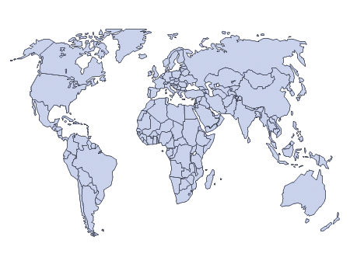
Global Integration Lessons from our Journey Global Member Care, Global Mental Health, and Sustainable Development Global Christianity and World Evangelization Gordon-Conwell Seminary 14 January 2015 Kelly O’Donnell, PsyD and Michèle Lewis O’Donnell, PsyD Consulting Psychologists, Member Care Associates, Inc. (c) 2015 Kelly and Michele O’Donnell

Slide 2
GI Topics
Define GI
United Nations (perspectives)
Sustainable Development (proposed goals)
Crossing Sectors –a GI bridge for UN/SD--GMC/GMH
Member Care (global model, history, directions)
Global Mental Health (current issues, agendas)
concepts, stories, resources, videos, good practice →applications for you
Notes:
1. The Introduction (Growing Broadly in Mission/Aid--and Beyond) and Chapter 2 (Charting Your Course Through the Sectors) in our edited book, Global Member Care (vol 2): Crossing Sectors for Serving Humanity. You can access these materials via the Amazon ebook preview (click on the book cover that you see): http://www.amazon.com/Global-Member-Care-Crossing-Humanity-ebook/dp/B00HX6WZLQ
2. Review the list of the Sustainable Development Goals in our November 2014 MCA Resource Update:
http://us4.campaign-archive2.com/?u=f34fc856e7776d7b69dafd3b3&id=d73606536a
See also the UN Secretary General’s Synthesis Report on the Post 2015 Development Agenda (December 2015) on the UN Sustainable Development Knowledge Platform: https://sustainabledevelopment.un.org/

Slide 3
Main sources for materials:
1. The Introduction (Growing Broadly in Mission/Aid--and Beyond) and Chapter 2 (Charting Your Course Through the Sectors) in our edited book, Global Member Care (vol 2): Crossing Sectors for Serving Humanity. You can access these materials via the Amazon ebook preview (click on the book cover that you see): http://www.amazon.com/Global-Member-Care-Crossing-Humanity-ebook/dp/B00HX6WZLQ
2. Review the list of the Sustainable Development Goals in our November 2014 MCA Resource Update: http://us4.campaign-archive2.com/?u=f34fc856e7776d7b69dafd3b3&id=d73606536a
See also the UN Secretary General’s Synthesis Report on the Post 2015 Development Agenda (December 2014) on the UN Sustainable Development Knowledge Platform: https://sustainabledevelopment.un.org/

Slide 4
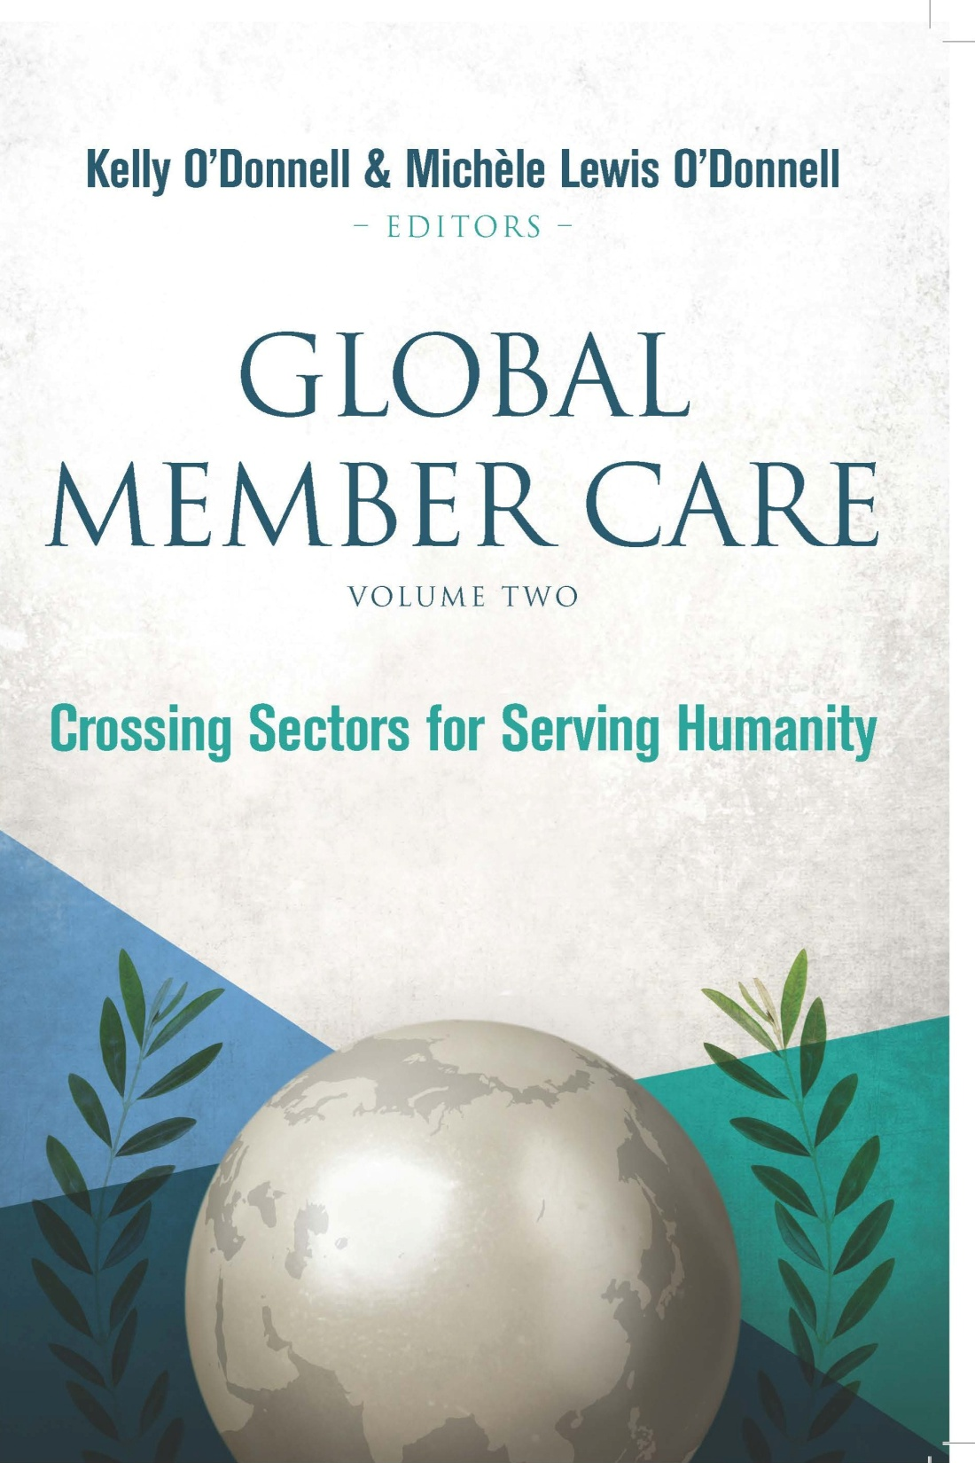
Notes:
Review the Table of Contents—35 chapters organized in Four Parts: Overview, Humanitarian Sector, Health Sector, and Human Resources Sector.
Find a few chapters that interest you! Note the core resources and references listed at the end of each chapter. Also note the updates for additional resources which are on the website for the GMC book series (Global MCA). https://sites.google.com/site/globalmca/. For example, if you are interested in staff safety, see chapter 10 which is an excerpt from Operational Security Management, see the list of core resources at the end of this chapter including the link to the online full version, and for additional resources go the Update section on the book website (url is above).

Slide 5
.

Slide 6
Review and Reflect
Review the Table of Contents—35 chapters organized in Four Parts: Overview, Humanitarian Sector, Health Sector, and Human Resources Sector.
Find a few chapters that interest you.
Note the core resources and references listed at the end of each chapter.
Also note that there are updates for additional resources on the website for the GMC book series (Global MCA). https://sites.google.com/site/globalmca/.
For example, if you are interested in staff safety, see chapter 8 which is an excerpt from Operational Security Management, see the list of core resources at the end of this chapter including the link to the online full version, and for additional resources go the Update section on the book website (url is above).

Slide 7
Part 1 Global Integration (GI)
Connecting relationally and contributing relevantly on behalf of the core issues facing humanity and in light of our core values.
4core

Slide 8
GI
GI is a framework for actively integrating our lives (connecting and contributing) with global realities (addressing the major issues facing humanity and promoting wellbeing) in light of our core values (e.g., ethical imperatives, commitment to humanity, God’s glory).
It involves mentalities, skills, and commitments
for working in the broad range of GI areas:
from the towers, to the tearooms, to the trenches.

Slide 9
GI
GI is especially important in view of the major global efforts to develop and implement the United Nation’s Post 2015 Development Agenda.
Some of the main emphases and resources we offer to support GI are via:
--global member care (e.g., the Member Care Associates website and the recent book Crossing Sectors for Serving Humanity) and
--global mental health (e.g., the GMH-Map website and the recent article on GMH: Strategies for Staying Updated in Psychology International).

Slide 10
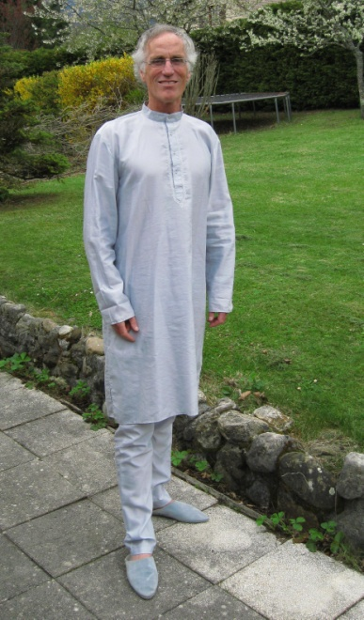
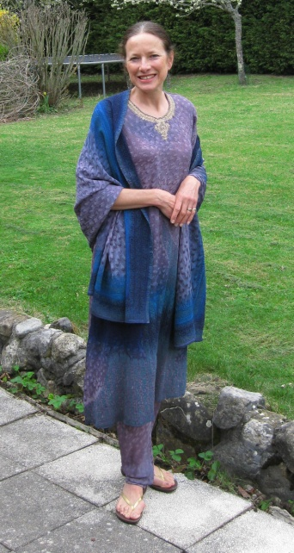
GI Joe and GI Jane ☺ ☺
Our international work as psychologists is based in Geneva. It includes regular interactions with personnel/events in the United Nations, World Health Organization, and international NGOs—and hence materials, perspectives, and cutting edge news that we can share with colleagues.
We think that one of the greatest opportunities currently for further developing GI is organizing a new coalition(s) of colleagues/organizations committed to/involved in GI (global integrators).

Slide 11
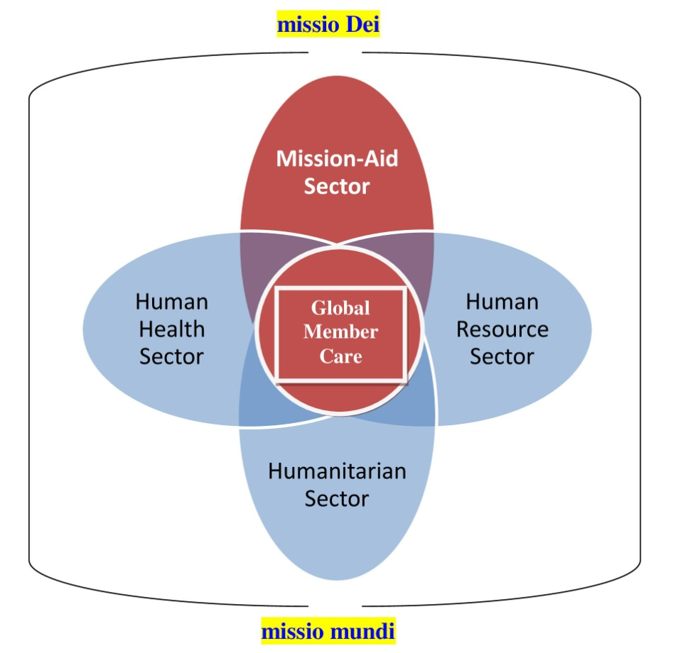
Mt. 13: 52 GI Gems
“Therefore every scribe that has become a disciple of the kingdom of heaven is like the owner of the house that brings from his treasure new things and old things”
Our application: Every learned/influential person who is a serious follower of God and God’s ways, is a steward of important resources—she/he is aware of and utilizes foundational (old) and new resources that are special/crucial: perspectives, practices, tools, relationships , directions, etc. ad majorem Dei gloriam. ☺

Slide 12
Global Integration Updates
See GI archives at:
www.membercareassociates.org

Slide 13
Why can’t Grace go to school?
. http://exposedcampaign.com/video

Slide 14
Part 2 United Nations A global context for navigating GI

Slide 15
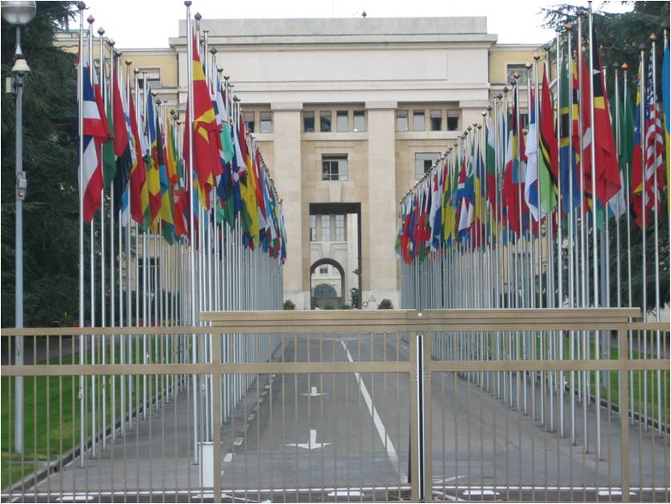
Notes:
First stop: The United Nations

Slide 16
.
One of the organizations with which we work
The NGO Forum for Health is a Geneva-based consortium of 30 health organizations--promoting human rights and quality care in global health.
Our origins lie in the 1978 Alma Ata Conference on Primary Health Care.
2008: Mental Health and Psychosocial Working Group
Our mission is to contribute to making health for all a reality:
-- advocating for protection and realization of the right to health;
--promoting equity and justice in access to health for all persons at all stages of their life;
--promoting and encouraging healthy life choices.
The next slides illustrate some areas of GMH consultation
to “educate and advocate” for health and mental health

Slide 17
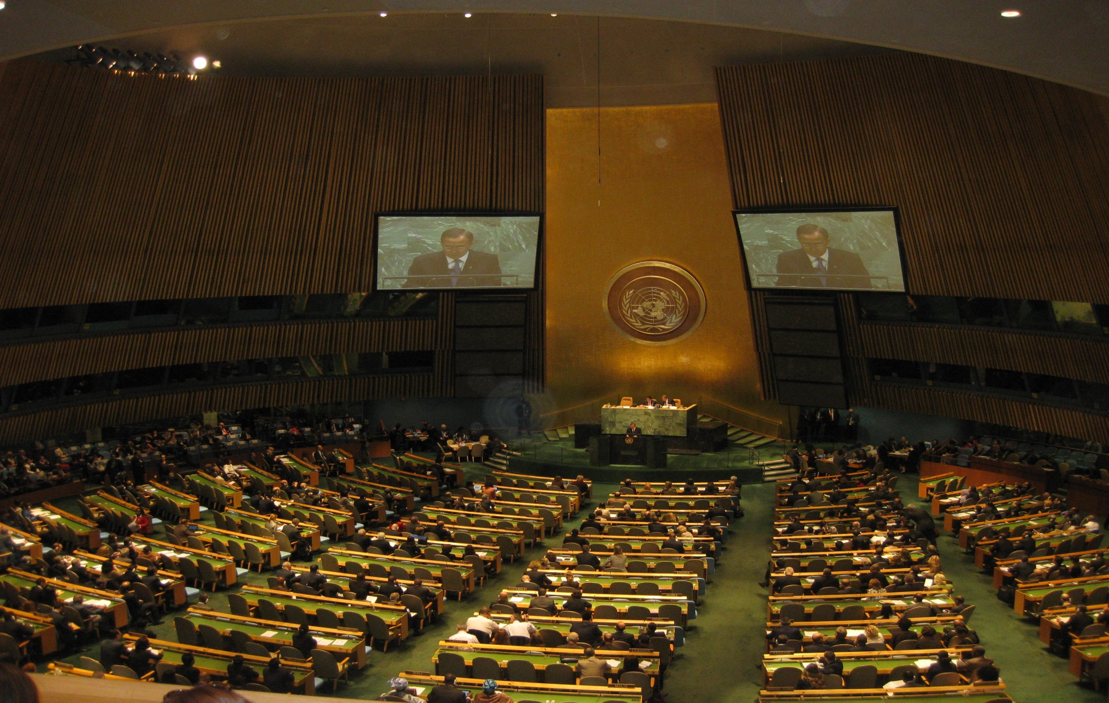
Involvement in putting MH on the NCD agenda (e.g., four joint statements) leading up to the UN General Assembly High level Meeting on NCDs, Sept 2011
Notes:
The UN is not enough nor was it ever meant to be enough….
We the peoples (plural) vs we the governments

Slide 18
,
Notes:
1.5 billion people live in places where there is a serious threat to their physical integrity due to violence. An example of a conference we helped organize and spoke at. The conference is a good example of work in GI:
Connecting relationally
Contributing relevantly
Core issues
Core values.

Slide 19
World Health Organization
.

Slide 20
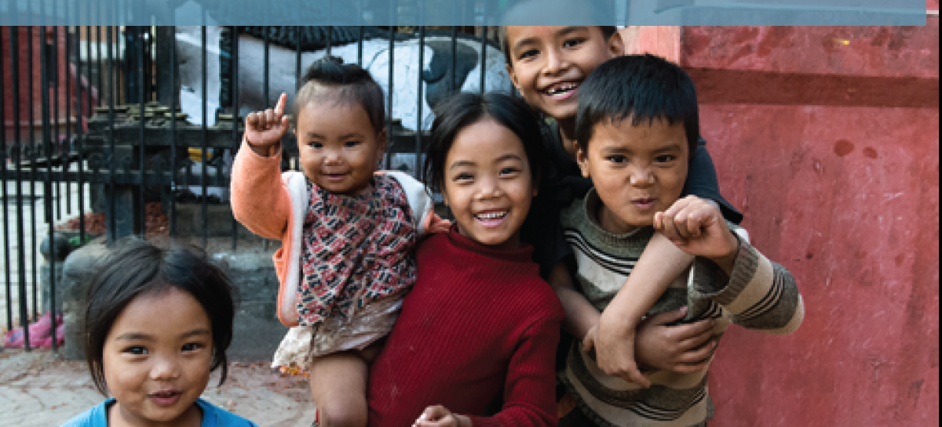
GMH and NGOs Working Together Well! Mental helse som global utfordring. Hva kan vi bidra med?
Kelly O’Donnell, PsyD
NGO Forum For Health
7 March 2014—Oslo

Slide 21
Global Mental Health
Evidence-Based Practice
in Low Resource Countries
WHO Collaborating Centre on Mental Health
of the University of Geneva, Department of Psychiatry

Slide 22
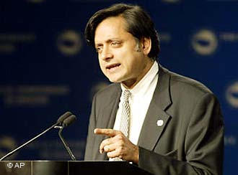
The United Nations is a 20th-century organization facing a 21st-century challenge as an institution with impressive achievements but also haunting failures, one that mirrors not just the world’s hopes but its inequalities and disagreements, and most important, one that has changed but needs to change further….
The single greatest problem facing the United Nations is that there is no single greatest problem; rather there are a dozen different ones each day clamoring for attention. Some, like the crisis in Lebanon, the Palestinian situation and the nuclear programs in Iran and North Korea, are obvious and trying.
Others we call “problems without passports”— issues that cross all frontiers uninvited, like climate change, drug trafficking, human rights, terrorism, epidemic diseases, and refugee movements.
Their solutions, too, can recognize no frontiers because no one country or group of countries, however rich or powerful, can tackle them alone.
Shashi Tharoor, The Good for Something United Nations, Newsweek, September 4, 2006

Slide 23
UN Charter, 1945
We the peoples of the United Nations determined:
to save succeeding generations from the scourge of war, which twice in our lifetime has brought untold sorrow to mankind,
and to reaffirm faith in fundamental human rights, in the dignity and worth of the human person, in the equal rights of men and women and of nations large and small,
and to establish conditions under which justice and respect for the obligations arising from treaties and other sources of international law can be maintained,
and to promote social progress and better standards of life in larger freedom…

Slide 24
What is the source?
“All human beings are born free and equal in dignity and rights. They are endowed with reason and conscience and should act towards one another in a spirit of brotherhood.”
Universal Declaration of Human Rights
What was the year it was ratified and by whom?
1948, UN General Assembly

Slide 25
More Perspectives: The United Nations
But the world is not so happy a place. Billions of people suffer impoverishment, many until the end of their miserable lives…
Can we really offer justice and freedom from want to a mid-twenty-first-century earth of perhaps nine billion people, one-third of whom may live in squalor and desperation?...
[Surprises and setbacks] should not deter us from responding as best we can, using our talents to improve this always mixed record of trying “to save generations from the scourge of war,” “to reaffirm faith in fundamental human rights,” and “to promote social progress and better standards of life in larger freedom.”
The original Preamble to the Charter of the United Nations had it right. The question is, can we do it?
(Paul Kennedy, The Parliament of Man: The Past, Present, and Future of the United Nations, 2006, 279, 289)

Slide 26
UN Year in Review 2014
https://www.youtube.com/watch?v=WdpwkmsxcIE

Slide 27
Part 3 Sustainable Development Building the future we want
We are right in the middle, as the world community and spearheaded by the United Nations, of formalizing the Post 2015 Agenda for sustainable development. What will be the goals, targets, and indicators that will be agreed upon in late 2015 and which will take us to 2030? The recent Open Working Groups Outcome Document from July 2014 and the UN Secretary General’s Synthesis Report for the Post 2015 Development Agenda are currently the main reference points for the Sustainable Development Goals (SDGs) that are emerging. These important documents build upon many previous efforts, especially the lessons learned from the Millennium Development Goals (2002-current) and the commitments made in the Rio +20 Declaration on Sustainable Development: The Future We Want (June 2012, available in six languages).

Slide 28
Millennium Development Goals (MDGs)
“In September 2000, building upon a decade of major United Nations conferences and summits, world leaders came together at United Nations Headquarters in New York to adopt the United Nations Millennium Declaration, committing their nations to a new global partnership to reduce extreme poverty and setting out a series of time-bound targets - with a deadline of 2015 - that have become known as the Millennium Development Goals.” www.un.org/millenniumgoals
Question: What are the eight MDGs?
End Poverty and Hunger
Universal Education
Gender Equality
Child Health
Maternal Health
Combat HIV/AIDS
Environmental Sustainability
Global Partnership

Slide 29
Sustainable Development Goals
Central to the upcoming SDGs is the need for a coordinated, massive effort to eradicate poverty in all its forms, prioritizing both people and the planet, and doing so by integrating the SDG’s social, economic, and environmental dimensions (see also the Executive Summary in State of the Least Developed Countries 2014, focusing on poverty eradication and the SDGs).
How the world community agrees upon and accomplishes the upcoming SDGs (underpinned by the desire for justice and equity for all) is still being negotiated and debated.
Review the short overview on the UN's Sustainable Development Knowledge Platform.
Review the 17 proposed SDGs and the 169 targets in the Open Working Groups Outcome Document.

Slide 30
UN Secretary General’s Synthesis Report on the Post 2015 Development Agenda (Dec. 2014)
“1. The year 2015 offers a unique opportunity for global leaders and people to end poverty, transform the world to better meet human needs and the necessities of economic transformation, while protecting our environment, ensuring peace and realizing human rights.
2. We are at a historic crossroads, and the directions we take will determine whether we will succeed or fail on our promises. With our globalized economy and sophisticated technology, we can decide to end the age-old ills of extreme poverty and hunger. Or we can continue to degrade our planet and allow intolerable inequalities to sow bitterness and despair. Our ambition is to achieve sustainable development for all. Transformation is our watchword….
4. At this moment in time, we are called to lead and act with courage….
11. Our globalized world is marked by extraordinary progress alongside unacceptable – and unsustainable – levels of want, fear, discrimination, exploitation, injustice and environmental folly at all levels….
25...I urge Governments and people everywhere to fulfil their political and moral responsibilities. This is my call to dignity, and we must respond with all our vision and strength.”

Slide 31
Six Essential Elements for SD Synthesis Report Dec. 2014
Dignity: to end poverty and fight inequalities;
Justice: to promote safe and peaceful societies, and strong institutions;
People: to ensure healthy lives, knowledge, and the inclusion of women and children;
Prosperity: to grow a strong, inclusive, and transformative economy;
Planet: to protect our ecosystems for all societies and our children;
Partnership: to catalyse global solidarity for sustainable development….

Slide 32
Proposed SDGs
Goal 1 End poverty in all its forms everywhere
Goal 2 End hunger, achieve food security and improved nutrition and promote sustainable agriculture
Goal 3 Ensure healthy lives and promote well-being for all at all ages
Goal 4 Ensure inclusive and equitable quality education and promote lifelong learning opportunities for all
Goal 5 Achieve gender equality and empower all women and girls
Goal 6 Ensure availability and sustainable management of water and sanitation for all
Goal 7 Ensure access to affordable, reliable, sustainable and modern energy for all
Goal 8 Promote sustained, inclusive and sustainable economic growth, full and productive employment and decent work for all
Goal 9 Build resilient infrastructure, promote inclusive and sustainable industrialization and foster innovation
Goal 10 Reduce inequality within and among countries
Goal 11 Make cities and human settlements inclusive, safe, resilient and sustainable
Goal 12 Ensure sustainable consumption and production patterns
Goal 13 Take urgent action to combat climate change and its impacts
Goal 14 Conserve and sustainably use the oceans, seas and marine resources for sustainable development
Goal 15 Protect, restore and promote sustainable use of terrestrial ecosystems, sustainably manage forests, combat desertification, and halt and reverse land degradation and halt biodiversity loss
Goal 16 Promote peaceful and inclusive societies for sustainable development, provide access to justice for all and build effective, accountable and inclusive institutions at all levels
Goal 17 Strengthen the means of implementation and revitalize the global partnership for sustainable development

Slide 33
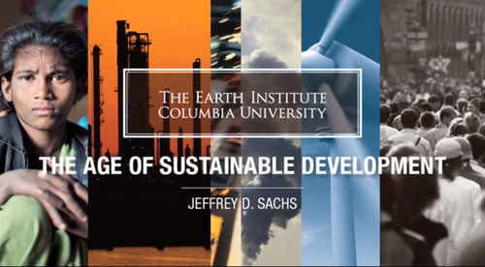
The Age of Sustainable Development Earth Institute, Columbia University
Click here to access the five minute overview
of the course by Jefferey Sachs.

Slide 34
Part 4 Crossing Sectors Going broadly and growing deeply
“Mathematically, a sector is the area of a circle bounded by any two radii. (Think of a sector as being a triangular piece of pie cut from the midpoint of a round pie.)
From this geometric definition emerges the concept of human sectors, or specialized groupings of people. For our purposes a sector is a distinct part of society (analogous to the area between two radii in a circle or a piece of pie) with a special albeit broad purpose. It is a large, amorphous yet recognizable block within the international community that provides different types of services and products to people.
Each one is comprised of a wide array of people who are part of different organizations; influenced by various disciplines, practices, and goals; and intertwined with many related networks. A sector fundamentally, is a human entity.”
Crossing Sectors for Serving Humanity, p.p. 5-6

Slide 35
Example: The Humanitarian Sector
“The humanitarian sector includes thousands of non-governmental organizations, government and intergovernmental agencies, and groups from civil society including faith-based groups. These entities provide a myriad of worthwhile services such as medical care, military and civilian peacekeeping in conflict zones, relief response in natural disasters, human rights advocacy, HIV/AIDS prevention, childhood education, maternal health care, water purification, and so many other areas. Collectively they represent much of humanity’s concerted effort to alleviate human misery and promote human wellbeing.“
Crossing Sectors for Serving Humanity, p. 6
Notes:
“Being psychologists with international experience helped us to enter into [Global Heallth] GH, of course. Yet coming from the faith-based mission sector with involvement in the humanitarian sector did not guarantee it would be easy to find our way into the mainstream of GH. Entering into different sectors is a dynamic process, not simply a static concept. It felt like a cross-cultural experience, exhilarating yet at times unnerving as we were stretched by our encounters with a variety of highly experienced people, challenging ideas, and new areas of learning. This diverse sector though, like learning a new culture or language, started to make more sense over time. We attended conferences, workshops, and webinars; learned about projects and research studies; read materials and watched videos; served on committees and task forces; asked lots of questions; and above all met and talked with people from many NGOs, countries, and disciplines within the sector. We built relationships and saw how much we all had to offer each other, highlighting our mutual emphases and goals. “ Crossing Sectors book, pp. 6-7

Slide 36
Relevance…
“The relevance of crossing sectors is clearly seen in the research by Johnson et al (2010) which advocates for greater interactions between the major religious blocs, especially Christians and non-Christians, in the service of humanity. [Quote:]
What percentage of non-Christians personally know a Christian?…The [research] results are startling in the sense that Christians and non-Christians appear to be living in quite separate worlds. This distance has implications for Christian missions but is also problematic when it comes to dialogue, peace initiatives, environmental and health challenges, and many other areas of human interaction. Our hope is that highlighting the problem will help in planning solutions for the future. (p.29)”
Crossing Sectors, pp. 9-10

Slide 37
Relevance…
“We think that intentionally crossing sectors is the next developmental phase for the member care field.
[and for the church-mission community].
What are some resources/practices and challenges/problems within these sectors?
What can we learn from each other?
How can our experiences in these sectors help us improve our member care efforts for supporting and managing mission/aid staff?
We are entering into some new terrain while at the same time solidly building on the field’s foundations and core focus on mission/aid workers. In so doing we seek to broaden and further shape the contours of good practice in member care. “
Crossing Sectors for Serving Humanity

Slide 38
Like A Death Sentence Human Rights Watch
.
http://www.hrw.org/reports/2012/10/02/death-sentence-0

Slide 39
Crossing sectors: a. Issues Pursue your passions (and delight in YHWH--Psalm 37:4)
What issues matter to you the most? What are you passionate about? What are you naturally motivated to learn more about?
Take it further by exploring what is happening in these areas within other sectors. Be prepared to expand your “experiential boundaries,” knowing that it can be a bit uncomfortable but also rewarding. It may take time and effort to significantly connect and contribute. Don’t go alone but get involved with others. Find compatible colleagues with similar interests and key groups and networks in which you can be part.

Slide 40
Crossing sectors: b. Involvements Till the terrain (and cultivate faithfulness--Psalm 37:3)
What types and levels of involvement are realistic for you?
Crossing sectors can be understood as a “continuum of involvement.”
Informed----------Included----------Immersed
The continuum begins with more minor involvement in a sector, such as reading the quarterly magazines from a human resources organization about things like staff selection and people management (informed).
It then proceeds to a midpoint and the inclusion of a sector or parts of a sector in one’s work such as travel health resources for preventing road traffic accidents and malarial infections (included).
The end of the continuum could involve becoming a recognized part of another sector such as working part time as a human rights advocate in a nongovernmental organization or developing culturally relevant psychosocial support for victims of gender violence (immersed).

Slide 41
Crossing sectors: c. Influences Get a grid (and commit your way to YHWH–Psalm 37:5)
What has influenced your desire and ability to cross sectors? List 3-5 items for each of the six categories below.
Principles/Beliefs
Documents/Materials
Organizations/Groups
People/Models
Milestones/Gravestones
→Charting a Future Course

Slide 42
Crossing Sectors: Personal Influences
Principles/ Beliefs
1. The “unity of truth” across time and subjects 2. The imago Dei as a basis for loving truth and peace 3. Moral duty and “blessed to be a blessing” 4. Resilient virtue is stronger than resilient evil 5. Human history has a direction and purpose
Documents/ Materials
1. Universal Declaration of Human Rights (United Nations, 1948) 2. Doing Member Care Well (2002).
Organizations/ Groups
People/Models
Milestones/ gravestones
Spanish classes and Latin America (1970–83) 2. Integration of psychology and theology doctorate (1978–84) 3. Perspectives on the World Christian Movement course (1981) 4. “We must develop a macro model for member care” (1990).
→
Crossing sectors: Charting a future Course
1. Greater involvement in global mental health and with mental health as mission…3. Greater involvement in international affairs/international relations.

Slide 43
Crossing sectors: d. More strategies
See the website for the Global Member Care book series (see the section with suggestions for using volume 2):
https://sites.google.com/site/globalmca/

Slide 44
Crossing Sectors Examples from the Humanitarian Sector
Five foundational resources that are relevant for member care and Christian mission/aid/development
See pages 12-14 in Global Member Care (vol. 2)—10 examples of lessons learned

Slide 45
.

Slide 46
IFRC
In the aftermath of a number of disasters in the early 1990s, the necessity and importance of addressing the psychological needs of victims were amply demonstrated. This led to the establishment of the psychological support programme (PSP) of the International Federation in May 1991….
However, a series of conflict situations brought to light another category of people psychologically affected by disasters: relief workers. Many Red Cross and Red Crescent delegates who had worked in relief operations (Rwanda and Somalia, for example) came back feeling lost, isolated, depressed and completely exhausted and suffering from nightmares and flashbacks. They often found it difficult to talk about their feelings of helplessness and horror to family, friends and colleagues who could not fully understand what they had been through or were not interested.
It became increasingly apparent, therefore, that delegates needed specialized psychological debriefings. (Psychological Support Programme for Delegates, Psychological Support: Best Practices from Red Cross and Red Crescent Programmes, 2001, p. 18).

Slide 47
.

Slide 48
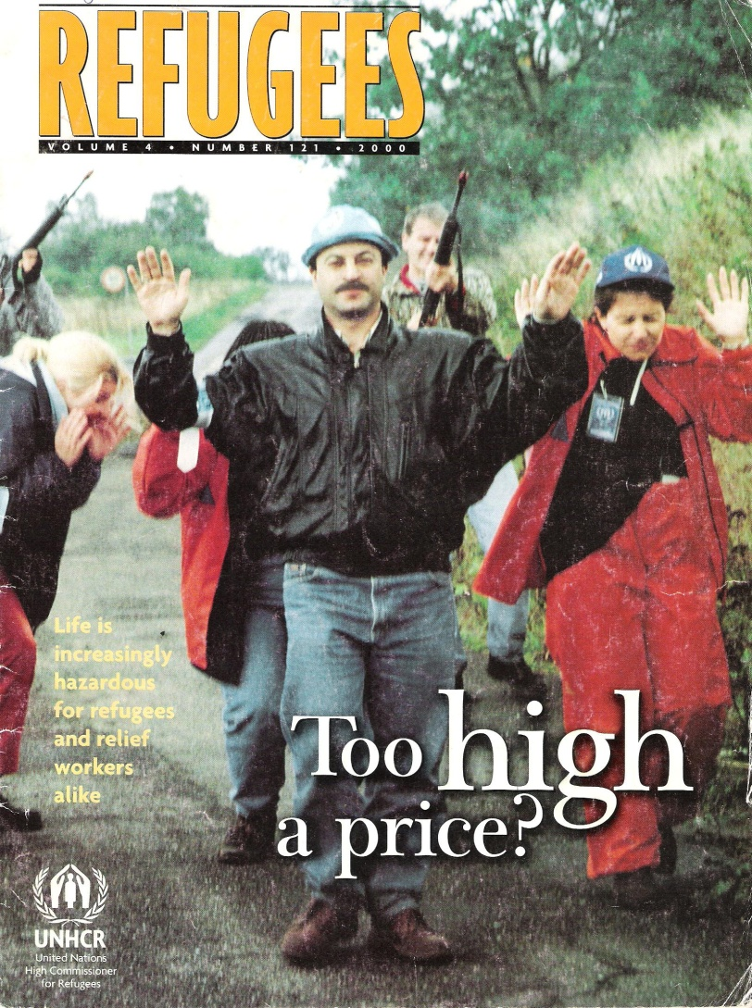
The ‘invisible shield’ of protection disappears
“…the world community looked forward to an era of greater personal freedom and social progress [post-cold war].
…[but] superpower stalemate was replaced by a series of nasty ethnic, religious and other conflicts.
…Civilians became deliberate targets of terror or human pawns in the political endgame
….safety was not a ‘luxury’ but a necessary part of continuing the business of saving lives
…Refugees are most in need of assistance at the very same moment when relief officials are most exposed to personal danger.”

Slide 49
.

Slide 50
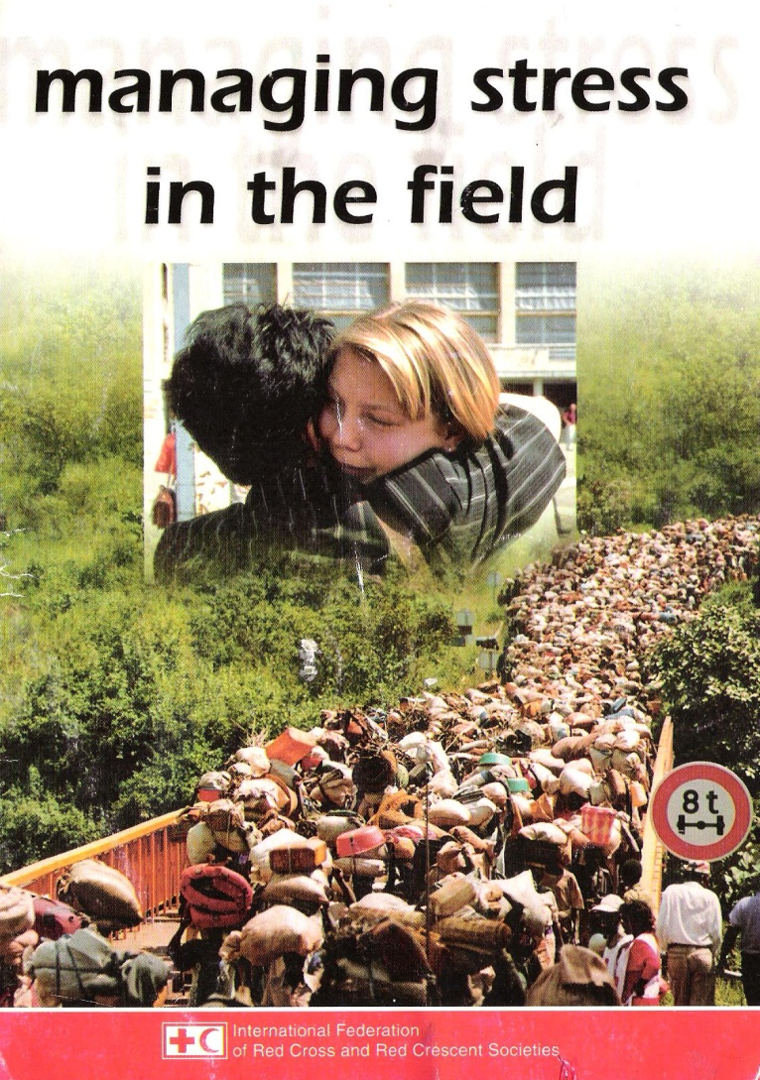
Short Questionnaire on Stress Based on: “Relief Worker Burnout Questionnaire” in Coping with Disaster (1999) by John H. Ehrenreich
Instructions: Rate the following items in terms of how much the symptom was true of you the last month.
0 = Never 1 = Occasionally 2 = Somewhat often 3 = Frequently 4 = Almost always
*****
___1. Do you tire easily? Do you feel fatigued a lot of the time, even when you have gotten enough sleep?
___2. Are people annoying you by their demands and stories about their daily activities? Do minor inconveniences make you irritable or impatient?
___3. Do you feel increasingly critical, cynical or disenchanted?
___4. Are you affected by sadness you can’t explain? Are you crying more than usual?
___5. Are you forgetting appointments, deadlines, personal possessions? Have you become absent-minded?
___6. Are you seeing close friends and family members less frequently? Do you find yourself wanting to be alone and avoiding even your close friends?
___7. Does doing even routine things seem like an effort?
___8. Are you suffering from physical complaints such as stomach aches, headaches, lingering colds, general aches and pains?
___9. Do you feel confused or disoriented when the activity of the day stops?
___10. Have you lost interest in activities that you previously were interested in or even enjoyed?
___11. Do you have little enthusiasm for your work? Do you feel negative, futile, or depressed about your work?
___12. Are you less efficient than you think you should be?
___13. Are you eating more (or less), smoking more cigarettes, using more alcohol or drugs to cope with your work?
Total Score: (Add up scores for items 1-13)

Slide 52
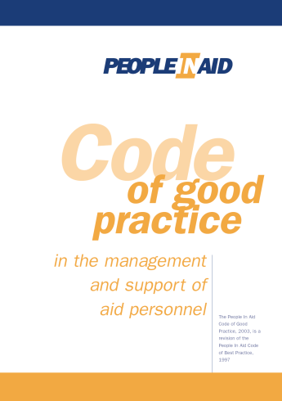
People are central to the achievement of our mission. (Guiding Principle, PIA )
Principle 7: Health, Safety and Security.
The security, good health, and safety of our staff
are a prime responsibility of our organization.
Written policies are available to staff on security, individual health, care and support, health and safety. Program plans include written assessment of security, travel and health risks specific to the country or region, reviewed at appropriate intervals.
Before an international assignment, all staff receive health clearance. In addition, they and accompanying dependents receive verbal and written briefing on all risks relevant to the role to be undertaken, and the measures in place to mitigate those risks, including insurance… Briefings are updated when new equipment, procedures, or risks are identified. All staff have a debriefing or exit interview at the end of any contract or assignment. Health checks, personal counseling, and careers advice are available. Managers are trained to ensure these services are provided.

Slide 53
.

Slide 54
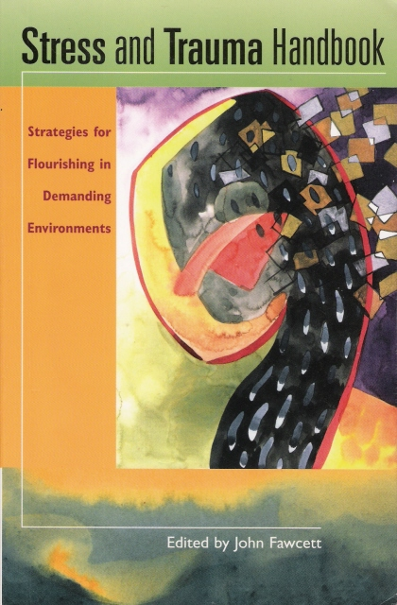
.
“…the most stressful events in humanitarian work have to do with the organisational culture, management style and operational objectives of an NGO or agency rather than external security risks or poor environmental factors. Aid workers, basically, have a pretty shrewd idea what they are getting into when they enter this career, and dirty clothes, gunshots at night and lack of electricity do not surprise them. Intra-and inter-agency politics, inconsistent management styles, lack of team work and unclear or conflicting organizational objectives, however, combine to create a background of chronic stress and pressure that over time wears people down and can lead to burnout and even physical collapse.”
John Fawcett, Stress and Trauma Handbook: Strategies for Flourishing in Demanding Environments (2003, World Vision, p. 6).

Slide 55
Part 5 Global Member Care
An interdisciplinary, international, and mult-sectoral field that focuses on:
supporting the diversity of mission/aid workers and sending groups
providing and developing quality resources to promote wellbeing, resiliency, and effectiveness
Examples: Pre-field training, field coaching, personnel departments, pastoral counselors, crisis support, and reentry preparation.

Slide 56
회복력 기르기 Developing Resilience
인간의 회복력은 현실에 직면하는 중요한 능력이다:
내적인 힘, 사회적 도움, 그리고 탁월한 가치를 통한
삶의 어려움과 도전을 통해 참여하며 성장하는 것.
The ability to face reality:
grow through life’s challenges and adversities
inner strength (character), coping skills (competencies), social support (community), and transcendent values (core commitments) .

Slide 57
Some materials to help orient students and colleagues to member care consultation. Access these materials here: https://sites.google.com/site/membercaravan/training-for-mc
1. Field Counseling: Sifting the Wheat from the Chaff (Cerny and Smith, 2002) includes five principles for ethical field care, a sample confidentiality statement, and eight case vignettes/analyses.
2. Training and Using Member Care Workers (Gardner and Gardner, 1992) offers suggestions for mental health professionals who provide services to mission agencies/mission settings.
3. What Mission CEOs Want from Mental Health Professionals (McKaughan, 2002) is in Enhancing Missionary Vitality: Mental Health Professions Serving Global Mission (56 articles). Two of the main suggestions from CEOs (based on a survey) were understandable language and thinking corporately.
4. Highlights from a One-Week Field Consult —This is a day by day brief description of a member care trip to work with mission staff in an organization/Asian country: leadership consultation, brief counseling, debriefing, conference speaking, training...and avoiding malaria.

Slide 58
Network
Specialist
Sender
Self/Mutual
Master
Connections
Caregivers
Commitment
Core/Community
Christ

Slide 59
Five Good Practice Flows
Sphere 1. Master Care: Good Practice Principle 1—Flow of Christ
Our relationship with Christ is fundamental to our well-being and work effectiveness. Member care resources strengthen our relationship to the Lord and help us to encourage others in the Lord.
Sphere 2. Self and Mutual Care: Good Practice Principle 2—Flow of Community
Self care is basic to good health. Self-awareness, monitoring one’s needs, a commitment to personal development, and seeking help when needed are signs of maturity. Likewise quality relationships with family and friends are necessary…with those in one’s home and host cultures.
Sphere 3. Sender Care: Good Practice Principle 3—Flow of Commitment
An organisation’s staff is its most important resource. As such, sending groups—both churches and agencies—are committed to work together to support and develop their personnel throughout the worker life cycle. They demonstrate this commitment by the way they invest themselves…
Sphere 4. Specialist Care: Good Practice Principle 4—Flow of Caregivers
Specialist care is to be done by properly qualified people, usually in conjunction with sending groups. The goal is not just care, but empowerment—to help personnel develop the resiliency and capacities needed to sacrifice and minister to others.
Sphere 5. Network Care: Good Practice Principle 5—Flow of Connections
Member care providers are committed to relate and work together, stay updated on events and developments, and share consolidated learning from their member care practice. They are involved in not just providing their services, but in actively “knitting a net” to link resources with areas of need.

Slide 60
.

Slide 61
Add new model

Slide 62
Relevance of Sectors Sphere 6 for MC
Humanitarian Sector: relevant in the common commitment for supporting and managing international and local staff, in maintaining effective organizations, and in offering a variety of relief and development services to vulnerable populations.
Human Health Sector: relevant in the common commitment to promote human wellness through research, resources, advocacy, and policies at all levels of society, and applicable to staff and those with whom staff work.
Human Resource Sector: relevant in the common commitment to fulfill organizational objectives by developing and managing human resource systems and by promoting staff/volunteer well-being and effectiveness (with some emphasis on organizational development).

Slide 63
Sector Care: Good Practice Principle 6: Flow of Common Ground
People with member care responsibility in mission/aid stay in touch with sectors that are relevant for their work. They are willing to cross into new areas—emphases, projects, disciplines, and fields within related sectors—for mutual learning, exchanging resources, and developing skills. Crossing sectors includes a continuum of involvement which is carefully considered in view of one’s primary focus in member care: being informed by, integrating with, and/or immersing in a given sector or part of a sector.

Slide 64
Applications:
To support mission/aid workers in their well-being and effectiveness
• To support colleagues in other sectors via materials in the member care field
• To equip mission/aid workers with tools and opportunities for their work with others
• To equip member caregivers who directly work with vulnerable populations and others
• To stay informed as global citizens about current and crucial issues facing humanity

Slide 65
Global MC Course
See the MCA Resource Update, September 2014, for the syllabus of the Global Member Care Course. The course now includes chapters from the Crossing Sectors book along with the missio Dei theological perspective
In the Resource Updates section at:
www.membercareassociates.org

Slide 66
100 + Books for a MC Library
See the list at:
www.membercareassociates.org

Slide 67
Part 6 Global Mental Health
GMH is an international, interdisciplinary, and multi-sectoral domain which promotes human well-being, the right to health, and equity in health for all. It encourages healthy behaviours and lifestyles; is committed to preventing and treating mental, neurological, and substance use conditions; and seeks to improve policies and programs, professional practices and research, advocacy and awareness, and social and environmental factors that affect health and well-being." (GMH--Finding Your Niches and Networks, Psychology International, March 2012)
See also our GMH-Map website:
Global Mental Health: A Global Map for a Global Movement

Slide 68
Health and Mental Health
Health
A state of complete physical, mental and social well-being and not merely the absence of disease or infirmity.
Mental Health
A state of well-being in which every individual realizes his or her own potential, can cope with the normal stresses of life, can work productively and fruitfully, and is able to make a contribution to her or his community.
World Health Organization

Slide 69
Vikram Patel and Martin Prince. Global Mental Health: A New Global Health Field Comes of Age, JAMA 2010; 303(19): page 1976
“The most striking inequity concerns the disparities in provision of care and respect for human rights of persons living with mental disorders between rich and poor countries. Low- and middle-income countries are home to more than 80% of the global population but command less than 20% of the share of the mental health resources. The consequent “treatment gap” is a contravention of basic human rights—more than 75% of those identified with serious anxiety, mood, impulse control, or substance use disorders in the World Mental Health surveys in low- and middle-income countries received no care at all, despite substantial role disability.”

Slide 70
.
According to the World Health Organization (WHO), mental, neurological, and substance use disorders “are common in all regions of the world, affecting every community and age group across all income countries. While 14% of the global burden of disease is attributed to these disorders, most of the people affected—75% in many low-income countries—do not have access to the treatment they need.” (WHO, 2008, launch of the mhGAP program)
http://www.who.int/mental_health/mhgap/en/index.html WHO estimates:
• over 150 million have depression
• 25 million have schizophrenia
• 50 million have epilepsy
• over 100 million have drug or alcohol use disorders
• over 800 thousand suicides/year.
In addition, “people with these disorders are often subjected to social isolation, poor quality of life and increased mortality. These disorders are the cause of staggering economic and social costs.” (WHO Department of Mental Health, The Bare Facts).
*For a brief overview on global mental health issues, watch the 2009 WHO video (five minutes). http://www.youtube.com/watch?v=L8iRjEOH41c

Slide 71
World Mental Health Day (1992-2014, 10 October)
2014: Living with Schizophrenia
2013: Mental Health and Older Adults--Note: Hidden Pictures (feature film)
2012: Depression--Note: I Had a Black Dog (self-help animation, five minutes)
2011: The Great Push: Investing in Mental Health
2010: Mental Health and Chronic Physical Illnesses
2009: Mental Health in Primary Care
2008: Making Mental Health a Global Priority: Advocacy/Action
2007: Mental Health in a Changing World: Culture and Diversity
2006: Building Awareness–Reducing Risk: Mental Illness/Suicide
2005: Mental and Physical Health Across the Life Span
2004: The Relationship between Physical and Mental Health
2003: Emotional/Behavioral Disorders of Children/Adolescents
2002: The Effects of Trauma/Violence on Children /Adolescents
2001: Mental Health and Work
2000: Mental Health and Work
1999: Mental Health and Ageing
1998: Mental Health and Human Rights
1997: Children and Mental Health
1996: Women and Mental Health
1995: Mental Health and Youth
1994: Improving Mental Health Services throughout the World
1992-1993 (general themes)

Slide 72
Hidden Pictures A personal journey into GMH (film trailer)
http://www.hiddenpicturesfilm.com/
Reflections on the video:
Who is hiding, hurting, helping?

Slide 73
1991
All persons have the right to the best available mental health care, which shall be part of the health and social care system.
All persons with a mental illness…shall be treated with humanity and respect for the inherent dignity of the human person.
UN GA 1991 Resolution (Article 1 excerpts)
Protection of Persons with Mental Illness
and the Improvement of MH Care
.

Slide 74
Convention on the Rights of Persons with Disabilities (UN, 2006)
Article 1 - Purpose
The purpose of the present Convention is to promote, protect and ensure the full and equal enjoyment of all human rights and fundamental freedoms by all persons with disabilities, and to promote respect for their inherent dignity.
Persons with disabilities include those who have long-term physical, mental, intellectual or sensory impairments which in interaction with various barriers may hinder their full and effective participation in society on an equal basis with others.

Slide 75
2003

Slide 76
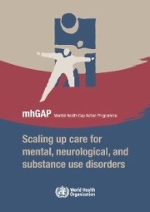
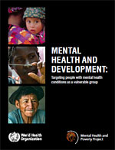
WHO GMH Publications 2008, 2010

Slide 77
mhGA report and program
.

Slide 78
mh GAP
Mental health is fundamental to health. This is reflected by the definition of health in the WHO Constitution as “a state of complete physical, mental, and social well-being and not merely the absence of disease or infirmity”. Research conducted in recent years has brought to our attention that mental health inherently affects physical health and physical health affects mental health. The two are inseparable in terms of achieving a more complete state of wellness.
Dr. Ala Alwan, WHO

Slide 79
GMH Briefing

Slide 80
mh GAP
Mental, neurological, and substance use (MNS) disorders are prevalent in all regions of the world and are major contributors to morbidity and premature mortality. 14% of the global burden of disease, measured in disability-adjusted life years (DALYs), can be attributed to MNS disorders. The stigma and violations of human rights directed towards people with these disorders compounds the problem. The resources that have been provided to tackle the huge burden of MNS disorders are insufficient, inequitably distributed, and inefficiently used, which leads to a treatment gap of more than 75% in many countries with low and lower middle incomes.
In order to reduce the gap and to enhance the capacity of Member States to respond to the growing challenge, the World Health Organization (WHO) presents the Mental Health Gap Action Programme (mhGAP). mhGAP provides health planners, policy-makers, and donors with a set of clear and coherent activities and programmes for scaling up care for MNS disorders.

Slide 81
WHO (2010) Mental Health And Development
This WHO report on mental health and development is a call to action to all development stakeholders - governments, civil society, multilateral agencies, bilateral agencies, global partnerships, private foundations, academic and research institutions - to focus their attention on mental health.
The report presents compelling evidence that persons with mental and psychosocial disabilities are a vulnerable group but continue to be marginalized in terms of development aid and government attention. It makes the case for reaching out to this group through the design and implementation of appropriate policies and programmes and through the inclusion of mental health interventions into broader poverty reduction and development strategies. The report also describes a number of key interventions which can provide a starting point for these efforts. By investing in persons with mental and psychosocial disabilities, development outcomes can be improved.

Slide 82
MH and Development
People with mental health conditions meet the major criteria
for vulnerability as identified by an analysis of major development stakeholders’ projects and publications:
They are subjected to stigma and discrimination on a daily basis
They experience extremely high rates of physical and sexual victimization.
Frequently, people with mental health conditions encounter restrictions in the exercise of their political and civil rights, and in their ability to participate in public affairs.
They also are restricted in their ability to access essential health and social care, including emergency relief services.
Most people with mental health conditions face disproportionate barriers in attending school and finding employment.
As a result of all these factors, people with mental health conditions are much more likely to experience disability and die prematurely, compared with the general population.

Slide 83
GMH Briefing

Slide 84
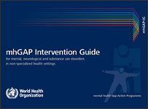
Intervention Guide
The mhGAP Intervention Guide (mhGAP-IG) for mental, neurological and substance use disorders for non-specialist health settings, is a technical tool developed by WHO to assist in implementation of mhGAP. The Intervention Guide has been developed through a systematic review of evidence followed by an international consultative and participatory process.
The mhGAP-IG presents integrated management of priority conditions using protocols for clinical decision-making. The priority conditions included are: depression, psychosis, bipolar disorders, epilepsy, developmental and behavioural disorders in children and adolescents, dementia, alcohol use disorders, drug use disorders, self-harm/suicide and other significant emotional or medically unexplained complaints.
The mhGAP-IG is a model guide and has been developed for use by health-care providers working in non-specialized health-care settings after adaptation for national and local needs.
.

Slide 85
Mental Health Action Plan 2013-2020
.

Slide 86
Overview: Mental Health Action Plan 2013-2020
Vision A world in which mental health is valued, promoted, and protected, mental disorders are prevented and persons affected by these disorders are able to exercise the full range of human rights and to access high-quality, culturally appropriate health and social care in a timely way to promote recovery, all in order to attain the highest possible level of health and participate fully in society and at work free from stigmatization and discrimination.
Cross-cutting Principles
Universal health coverage Regardless of age, sex, socioeconomic status, race, ethnicity or sexual orientation, and following the principle of equity, persons with mental disorders should be able to access, without the risk of impoverishing themselves, essential health and social services that enable them to achieve recovery and the highest attainable standard of health. | Human rights Mental health strategies, actions and interventions for treatment, prevention and promotion must be compliant with the Convention on the Rights of Persons with Disabilities and other international and regional human rights instruments. |  | Evidence-based practice Mental health strategies and interventions for treatment, prevention and promotion need to be based on scientific evidence and/or best practice, taking cultural considerations into account. | Life course approach Policies, plans, and services for mental health need to take account of health and social needs at all stages of the life course, including infancy, childhood, adolescence, adulthood and older age. | Multisectoral approach A comprehensive and coordinated response for mental health requires partnership with multiple public sectors such as health, education, employment, judicial, housing, social and other relevant sectors as well as the private sector, as appropriate to the country situation. |  | Empowerment of persons with mental disorders and psychosocial disabilities Persons with mental disorders and psychosocial disabilities should be empowered and involved in mental health advocacy, policy, planning, legislation, service provision, monitoring, research and evaluation.
Goal To promote mental well-being, prevent mental disorders, provide care, enhance recovery, promote human rights and reduce the mortality, morbidity and disability for persons with mental disorders
Objectives and Targets
1. To strengthen effective leadership and governance for mental health Global target 1.1: 80% of countries will have developed or updated their policy/plan for mental health in line with international and regional human rights instruments (by the year 2020). Global target 1.2: 50% of countries will have developed or updated their law for mental health in line with international and regional human rights instruments (by the year 2020). |  | 2. To provide comprehensive, integrated and responsive mental health and social care services in community-based settings Global target 2: Service coverage for severe mental disorders will have increased by 20% (by the year 2020). |  | 3. To implement strategies for promotion and prevention in mental health Global target 3.1: 80% of countries will have at least two functioning national, multisectoral mental health promotion and prevention programmes (by the year 2020). Global target 3.2: The rate of suicide in countries will be reduced by 10% (by the year 2020). |  | 4. To strengthen information systems, evidence and research for mental health Global target 4: 80% of countries will be routinely collecting and reporting at least a core set of mental health indicators every two years through their national health and social information systems (by the year 2020).
Notes:
Download this Action Plan—this page is the core summary of it.
Study it and refer to it! We see it as one of the best efforts so far to consensually agree on the way forward for mental health globally.
http://www.who.int/mental_health/publications/action_plan/en/

Slide 87
Some core resources to orient students and colleagues to GMH
Transforming Lives, Enhancing Communities: Innovations in GMH by Vikram Patel and Shekhar Saxena (New England Journal of Medicine, 01/2014) http://www.nejm.org/doi/full/10.1056/NEJMp1315214
Global Mental Health: A Resource Map for Connecting and Contributing (Psychology International, July 2011, Kelly). Links to 10 core resources. http://www.apa.org/international/pi/2011/07/global-health.aspx
Global Mental Health: Strategies for Staying Updated (TBA/linked--(Psychology International, April 2014, Kelly). Describes seven “GMH flows” and their inclusion in different sectors and health/development agendas. http://www.apa.org/international/index.aspx
WHO: Mental Health Action Plan 2013-2020 is a foundational document for the global and national development of MH; MINDbank is an online platform with resources for MH, substance abuse, disability.

Slide 88
Some Final Thoughts Global Integration (GI)
Connecting relationally and contributing relevantly on behalf of the core issues facing humanity and in light of our core values.
4core

Slide 89
Seven Directional Commitments Recommendations for Member Care Workers [and Global Integrators] Excerpted from “The Missional Heart of Member Care” International Bulletin of Missionary Research, April 2015, Volume 39 (used by permission)
“1. We commit to diligently pursue our own journeys of personal and professional growth—to grow deeply as we go broadly.
2. We commit to integrate the inseparable areas of our character (resilient virtue) and competency (relevant skills) with compassion (resonant love).
3. We commit to follow God into new areas of learning and work: crossing sectors, cultures, disciplines, and comfort zones.
4. We commit to embrace our duty to enter difficult settings, including those permeated by conflict, calamity, and corruption, as those in great need are often in places of great risk."
5. We commit to have clear ethical commitments and standards that guide our provision of quality services to a diversity of workers and senders in mission. [and to humanity in general in view of the SDGs]
6. We commit to develop quality member care workers [and quality global integrators] from all peoples, mutually learning from those who work within their own cultures and those who serve cross-culturally.
7. We commit to base our work upon the trans-everything practice of fervently loving one another—agape. Our love is the ultimate measure of our member care.”

Slide 90
Global Integration: Developing Fluency
I cdnuolt blveiee taht I cluod aulaclty uesdnatnrd waht I was raednig abuot GI thnigs. WOW—golbla itnergaiton and golbla itnegratros! The phaonmneal pweor of the hmuan mnid! Aoccdrnig to rscheearch at Grdono-Cownlel, it deosn't mttaer in waht oredr the ltteers in a wrod are, the olny iprmoatnt tihng is taht the frsit and lsat ltteer be motsly in the rghit pclae. The rset can be a taotl mses and you can still raed it wouthit a porbelm. This is bcuseae the huamn mnid deos not raed ervey lteter by istlef, but the wrod as a wlohe. Amzanig huh? So evne thuohg I do’tn udnresatnd it all, I can sitll undresatdn the ovrella picetur...Hurary!

Slide 91
Global Integrators
"Persevere as you pursue areas that you are passionate about and stretch yourself into new areas of interest as part of life-long learning. As in most human enterprises, there can be political agendas, power dynamics, territoriality, and dysfunctional behaviors to navigate” (O’Donnell, 2012, p. 201). Keep in the forefront the opportunities for “selfless moral struggle” in partnering with others (Patel et al. 2011, p. 90) and the “duty and choice to risk your own rights and well-being” on behalf of fellow humans (O’Donnell, 2011, p. 187). “Embrace lifestyles that reflect commitments to equality, justice, and wellbeing for all” (O’Donnell, 2012, p. 201). Develop your personal character and professional competence as a responsible global citizen committed to “seeing reality clearly… [including] physical and mental suffering due to human cruelty… [without giving up] our dream for a more loving and peaceful humanity” (Mollica, 2013, p.15). Connect with a supportive caravan of colleagues for your Global Integration journey in the service of humanity. “Your task is to be true, not popular” (Luke 6:26, The Message).
CORE Member Care, weblog , Global lntegrators-1, 15 January 2015
www.COREmembercare.blogspot.com

Slide 92
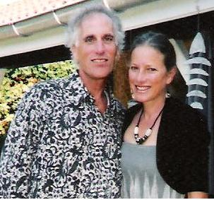
.
Thank you!
Kelly and Michéle
Member Care Associates, Inc.
mcaresources@gmail.com
www.membercare.org

