Slide 1
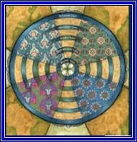
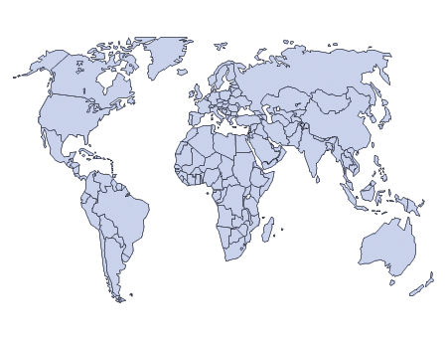
Global Integration Charting Your Course in the Service of Humanity
Rosemead School of Psychology
16 April 2013
Kelly O’Donnell, PsyD Member Care Associates, Inc.

Slide 2
Global Integration
Actively integrating our lives
(connecting and contributing)
with global realities
(the major issues facing humanity)
for God’s glory.

Slide 3
Glen Moriarty (Regent University) Spring 2012 JPT
“If we want integration to be a credible and relevant voice in all corners of our world,
then we need to be proactive about learning, engaging and collaborating with Christian mental health professionals outside of North America.
Soon the mental health professions will also scale up.
We want to get in on the ground floor—not once institutions are already established. Kelly O’Donnell has insightfully called this “global integration.”....We in the integration field find ourselves in a unique position. Unfortunately, globalization and technology have caught us flat-footed. ..We have a time limited opportunity to make a huge impact in the future of faith and psychology...
We can begin by answering the question I started with: Where do we want to be in 10 years?”

Slide 4
Global Integration (rationale for GI)
What percentage of non-Christians personally know a Christian? . . . The [research] results are startling in the sense that Christians and non-Christians appear to be living in quite separate worlds. This distance has implications for Christian missions but is also problematic when it comes to dialogue, peace initiatives, environmental and health challenges, and many other areas of human interaction. Our hope is that highlighting the problem will help in planning solutions for the future. (Johnson, Barrett, and Crossing, IBMR, 2010, page 29)

Slide 5
GI-MH:
How we relevantly connect and contribute globally
as mental health professionals who are Christ-followers
in view of the challenges/opportunities facing humanity…
with character, competencies, compassion.

Slide 6
GMH: A Resource Primer
“This article focuses on some of the main developments in the global mental health movement (GMH). These developments collectively form a “global resource map” to further orient people to the diverse and expansive area of GMH. The goal is to help people to get a quick overview of GMH in terms of “who’s who” and “what’s what,” People from a variety of backgrounds (e.g., students, practitioners, policy-makers) will hopefully be able to better "navigate" the GMH “world” and consider meaningful ways to further connect and contribute. The goal is to present a “basic sampler” of GMH developments rather than a comprehensive listing, emphasizing the last two decades and more recently the past five years, when a more visible and organized movement has emerged.”
International Perspectives in Psychology, Research, Practice, Consultation, July 2012

Slide 7
GMH Overviews
GMH: A Resource Map for Connecting and Contributing
(July 2011)
GMH: Finding your Niches and Networks
(March 2012)
GMH: Strategies for Staying Current
(March 2014)
Psychology International
APA Office of International Affairs
(brief resource articles by Kelly O’Donnell; available online)

Slide 8
GMH overview video
For a brief overview on global mental health issues, watch the 2009 WHO video (five minutes).
http://www.youtube.com/watch?v=L8iRjEOH41c

Slide 9
GI Gems: The Treasure Trove
Therefore, every scribe who has become a disciple of the kingdom of heaven is like the head of a household who brings forth out of his treasure things new and old.
Mt 13: 51

Slide 10
GMH
Global health is “an area for study, research and practice that places a priority on improving health and achieving equity in health for all people worldwide.” Global mental health is the application of these principles to the domain of mental ill health.
Vikram Patel and Martin Prince. Global Mental Health: A New Global Health Field Comes of Age, JAMA 2010; 303(19): page 1976

Slide 11
Vikram Patel and Martin Prince. Global Mental Health: A New Global Health Field Comes of Age, JAMA 2010; 303(19): page 1976
The most striking inequity concerns the disparities in provision of care and respect for human rights of persons living with mental disorders between rich and poor countries. Low- and middle-income countries are home to more than 80% of the global population but command less than 20% of the share of the mental health resources. The consequent “treatment gap” is a contravention of basic human rights—more than 75% of those identified with serious anxiety, mood, impulse control, or substance use disorders in the World Mental Health surveys in low- and middle-income countries received no care at all, despite substantial role disability.

Slide 12
GMH: A Resource Primer
“Complementing this perspective is the emphasis on mental wellbeing in addition to the emphasis on mental ill health, and together these two perspectives comprise the GMH core. Surrounding this core is the global context of other overlapping domains—e.g., political, economic, environmental, health, and social,—as well as the commitment at all levels to promoting human rights and human responsibility for equity, dignity, justice, peace, and wellbeing for all.”

Slide 13
.
According to the World Health Organization (WHO), mental, neurological, and substance use disorders “are common in all regions of the world, affecting every community and age group across all income countries. While 14% of the global burden of disease is attributed to these disorders, most of the people affected—75% in many low-income countries—do not have access to the treatment they need.” (WHO, 2008, launch of the mhGAP program)
http://www.who.int/mental_health/mhgap/en/index.html WHO estimates (2002): [update?]
• over 150 million have depression
• 25 million have schizophrenia
• 50 million have epilepsy
• over 100 million have drug or alcohol use disorders
• over 700,000 suicides/year.
In addition, “people with these disorders are often subjected to social isolation, poor quality of life and increased mortality. These disorders are the cause of staggering economic and social costs.” (WHO Department of Mental Health, The Bare Facts).

Slide 14
1991
All persons have the right to the best available mental health care, which shall be part of the health and social care system.
All persons with a mental illness…shall be treated with humanity and respect for the inherent dignity of the human person.
UN GA 1991 Resolution (Article 1 excerpts)
Protection of Persons with Mental Illness
and the Improvement of MH Care
.

Slide 15
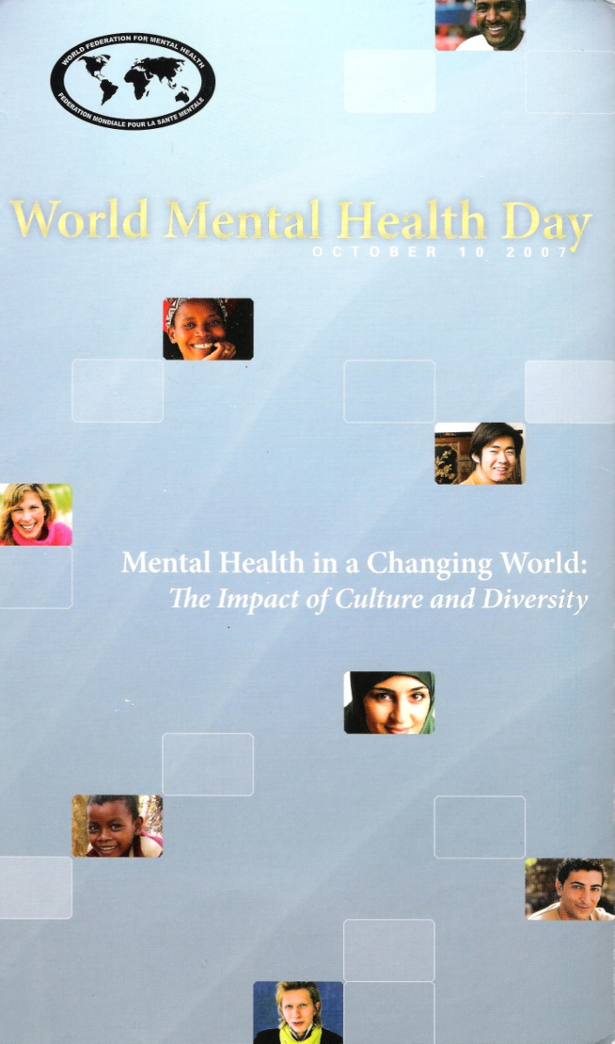
World Mental Health Day (1992-current, in October) http://www.wfmh.com/00WorldMentalHealthDay.htm
This is a unified effort to promote greater public awareness and
understanding of mental health and mental illness.
Every year, thousands of people across the world share
information and raise funds for mental health causes.
2014: Living with Schizophrenia
2013 M H and Older Adults
2012: Depression
2011: The Great Push: Investing in Mental Health
2010: Mental Health and Chronic Physical Illnesses
2009: Mental Health in Primary Care
2008: Making Mental Health a Global Priority: Advocacy/Action
2007: Mental Health in a Changing World: Culture and Diversity
2006: Building Awareness–Reducing Risk: Mental Illness/Suicide
2005: Mental and Physical Health Across the Life Span
2004: The Relationship between Physical and Mental Health
2003: Emotional/Behavioral Disorders of Children/Adolescents
2002: The Effects of Trauma/Violence on Children /Adolescents
2001: Mental Health and Work
2000: Mental Health and Work
1999: Mental Health and Ageing
1998: Mental Health and Human Rights
1997: Children and Mental Health
1996: Women and Mental Health
1995: Mental Health and Youth
1994: Improving Mental Health Services throughout the World
1992-1993 (general themes)

Slide 16
GMH-AP (p. 20 of zero draft)

Slide 17
2003

Slide 18
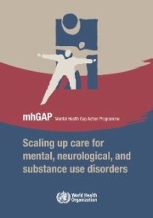
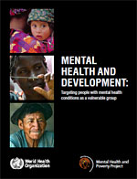
WHO GMH Publications 2008, 2010, 2010

Slide 19
GMH Briefing

Slide 20
mh GAP
Mental health is fundamental to health. This is reflected by the definition of health in the WHO Constitution as “a state of complete physical, mental, and social well-being and not merely the absence of disease or infirmity”. Research conducted in recent years has brought to our attention that mental health inherently affects physical health and physical health affects mental health. The two are inseparable in terms of achieving a more complete state of wellness.
Dr. Ala Alwan, WHO

Slide 21
mh GAP
Mental, neurological, and substance use (MNS) disorders are prevalent in all regions of the world and are major contributors to morbidity and premature mortality. 14% of the global burden of disease, measured in disability-adjusted life years (DALYs), can be attributed to MNS disorders. The stigma and violations of human rights directed towards people with these disorders compounds the problem. The resources that have been provided to tackle the huge burden of MNS disorders are insufficient, inequitably distributed, and inefficiently used, which leads to a treatment gap of more than 75% in many countries with low and lower middle incomes.
In order to reduce the gap and to enhance the capacity of Member States to respond to the growing challenge, the World Health Organization (WHO) presents the Mental Health Gap Action Programme (mhGAP). mhGAP provides health planners, policy-makers, and donors with a set of clear and coherent activities and programmes for scaling up care for MNS disorders.

Slide 22
GMH Briefing

Slide 23
WHO (2010) Mental Health And Development
This WHO report on mental health and development is a call to action to all development stakeholders - governments, civil society, multilateral agencies, bilateral agencies, global partnerships, private foundations, academic and research institutions - to focus their attention on mental health.
The report presents compelling evidence that persons with mental and psychosocial disabilities are a vulnerable group but continue to be marginalized in terms of development aid and government attention. It makes the case for reaching out to this group through the design and implementation of appropriate policies and programmes and through the inclusion of mental health interventions into broader poverty reduction and development strategies. The report also describes a number of key interventions which can provide a starting point for these efforts. By investing in persons with mental and psychosocial disabilities, development outcomes can be improved.

Slide 24
MH and Development
People with mental health conditions meet the major criteria
for vulnerability as identified by an analysis of major development stakeholders’ projects and publications:
They are subjected to stigma and discrimination on a daily basis
They experience extremely high rates of physical and sexual victimization.
Frequently, people with mental health conditions encounter restrictions in the exercise of their political and civil rights, and in their ability to participate in public affairs.
They also are restricted in their ability to access essential health and social care, including emergency relief services.
Most people with mental health conditions face disproportionate barriers in attending school and finding employment.
As a result of all these factors, people with mental health conditions are much more likely to experience disability and die prematurely, compared with the general population.

Slide 25
GMH Briefing

Slide 26
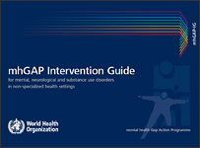
Intervention Guide
The mhGAP Intervention Guide (mhGAP-IG) for mental, neurological and substance use disorders for non-specialist health settings, is a technical tool developed by WHO to assist in implementation of mhGAP. The Intervention Guide has been developed through a systematic review of evidence followed by an international consultative and participatory process.
The mhGAP-IG presents integrated management of priority conditions using protocols for clinical decision-making. The priority conditions included are: depression, psychosis, bipolar disorders, epilepsy, developmental and behavioural disorders in children and adolescents, dementia, alcohol use disorders, drug use disorders, self-harm/suicide and other significant emotional or medically unexplained complaints.
The mhGAP-IG is a model guide and has been developed for use by health-care providers working in non-specialized health-care settings after adaptation for national and local needs.

Slide 27
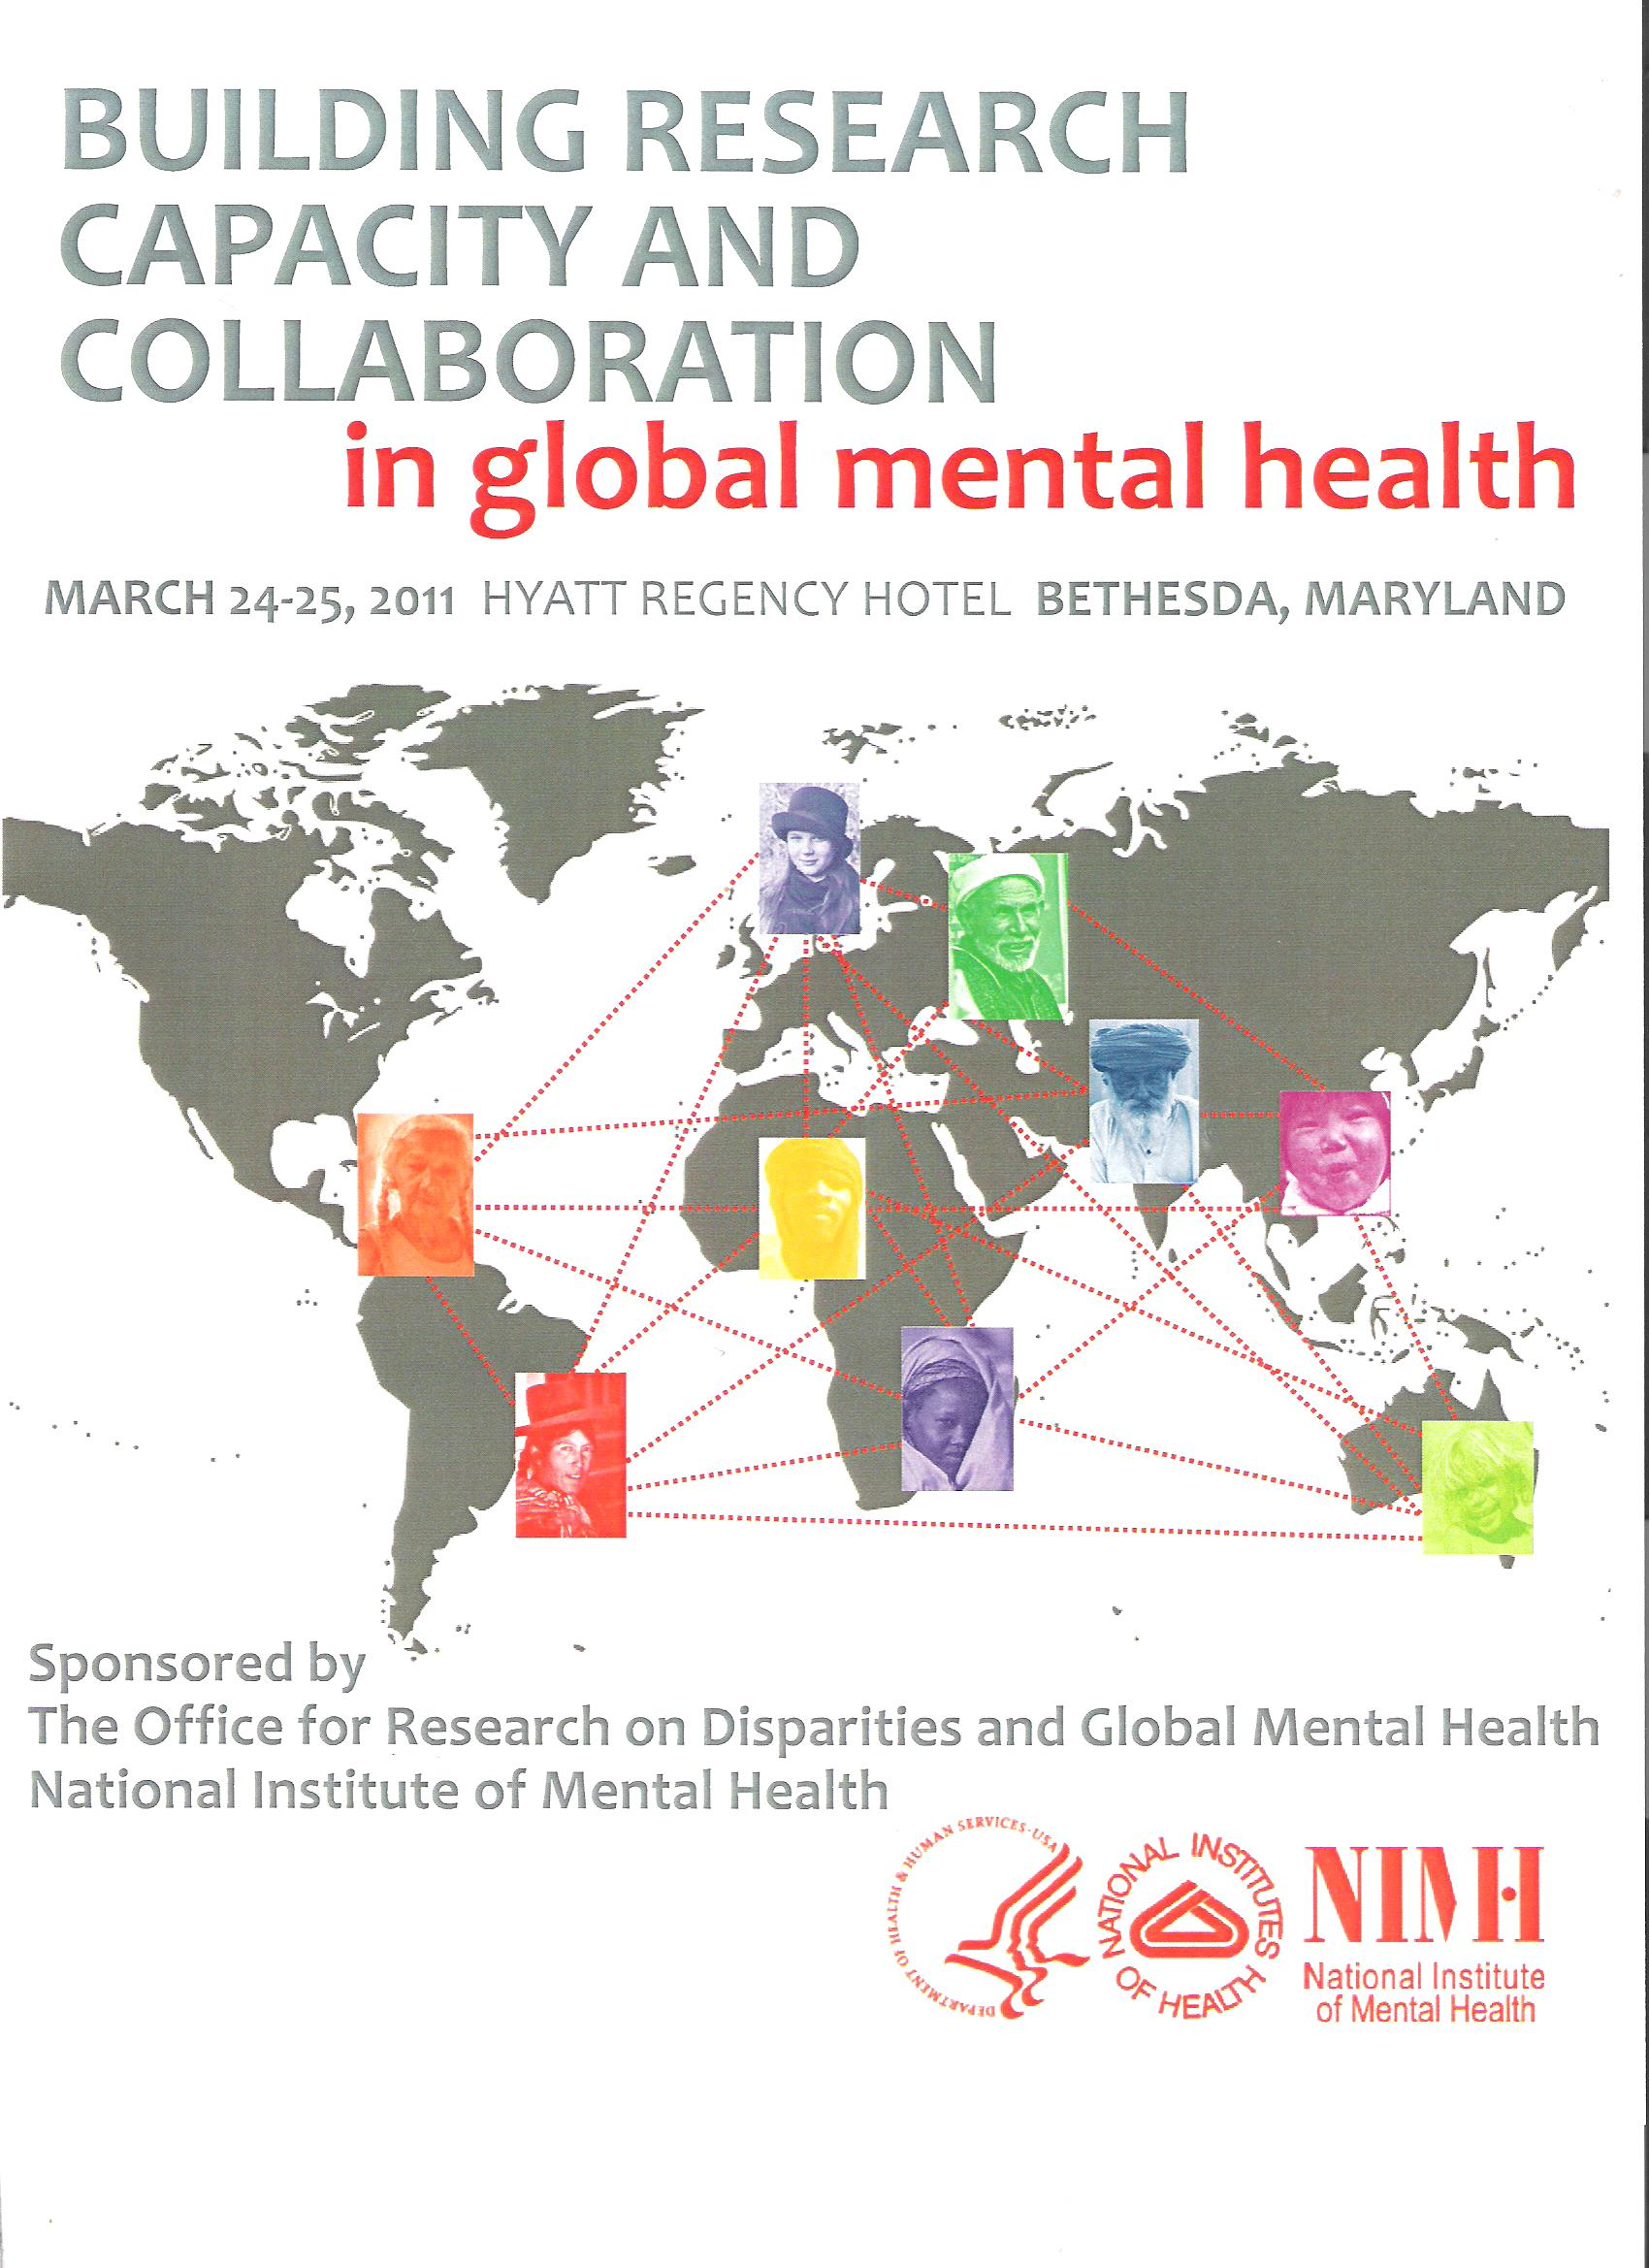

Slide 28
NIMH Building Research Capacity/Collaboration in GMH
Purpose
Participants
65 people, mostly in USA but not originally from USA and many others from every continent; training and research institutions; medical schools, public health schools, practitioners; many medical-psychiatric with MPH backgrounds; psychiatric residents and early career MH profs and residents; funders like NIMH, Fogarty, and Wellcome Trust, Carter Center
Presentations
Reflections-Directions

Slide 29
NIMH Building Research Capacity/Collaboration in GMH
Purpose
1. Identify barriers and opportunities
for innovative research capacity-building
for three specific domains in LMICs:
Genetics, Child MH, implementation research.
2. Examine existing models of N-S and S-S collaboration for research capacity building.
3. Explore new models of training and partnership
to further the research capacity-building agenda.
Participants
Presentations
Reflections-Directions

Slide 30
GMH: Caravans and Coalitions
“Keep in the forefront the opportunities for “selfless moral struggle” in partnering with others (Patel et al. 2011, p. 90)
and the “duty and choice to risk one’s owns rights and well-being” on behalf of fellow humans.
Develop your personal character and professional competence as a responsible global citizen.
Join/form a global caravan for your GMH journey in the service of humanity.”
(Adapted from GMH: A Resource Primer for Exploring the Domain, 2012; https://sites.google.com/site/gmhmap/)

Slide 31
Global Integration: Developing Fluency
I cdnuolt blveiee taht I cluod aulaclty uesdnatnrd waht I was rdanieg. The phaonmneal pweor of the hmuan mnid! Aoccdrnig to rseeacrh at Opfxrod Uinervtisy, it deosn't mttaer in waht oredr the ltteers in a wrod are, the olny iprmoatnt tihng is taht the frsit and lsat ltteer be in the rghit pclae. The rset can be a taotl mses and you can still raed it wouthit a porbelm. This is bcuseae the huamn mnid deos not raed ervey lteter by istlef, but the wrod as a wlohe. Amzanig huh?

Slide 32
Global Integration
Actively integrating our lives
(connecting and contributing)
with global realities
(the major issues facing humanity)
for God’s glory.
*******

