Slide 1
.
Global Integration
Opportunities for Consulting Psychologists
Kelly O’Donnell, PsyD and Michéle Lewis O’Donnell, PsyD
Member Care Associates, Inc.
mcaresources@gmail.com
www.membercare.org
© 2014
(note: see three page handout)

Slide 2
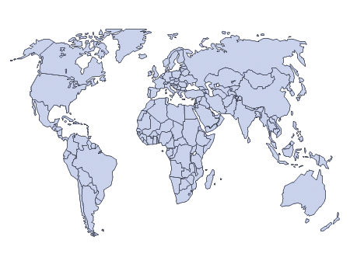
Global Integration (GI)
How we actively integrate our lives (connecting and contributing) with global realities (the major issues facing fellow humans) in light of our core values (e.g., ethical imperatives, commitment to humanity, God’s glory).
Developing skills for working in the broad range of GI settings:
from the towers, to the tearooms, to trenches!

Slide 3
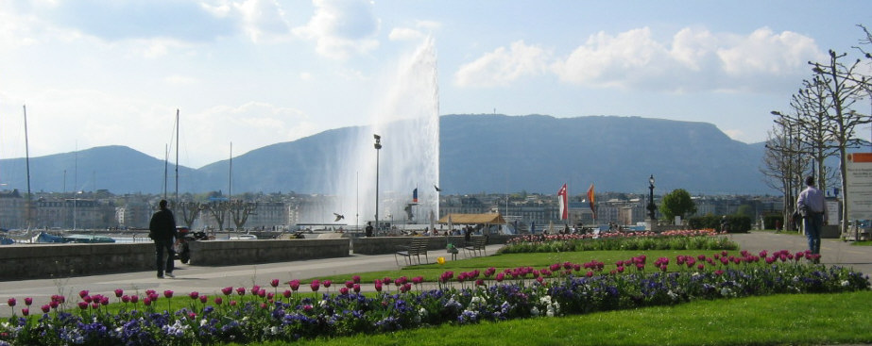
Welcome to Geneva .

Slide 4
Global Member Care (GMC)
An interdisciplinary, international, and mult-sectoral field that focuses on:
supporting the diversity of mission/aid personnel and sending groups
providing and developing quality resources to promote wellbeing, resiliency, and effectiveness
Examples: Pre-field training, field coaching, personnel departments, pastoral counselors, crisis support, and reentry preparation.

Slide 5
Some materials to help orient students and colleagues to member care consultation. Access these materials are here: https://sites.google.com/site/membercaravan/training-for-mc
1. Field Counseling: Sifting the Wheat from the Chaff (Cerny and Smith, 2002) includes five principles for ethical field care, a sample confidentiality statement, and eight case vignettes/analyses.
2. Training and Using Member Care Workers (Gardner and Gardner, 1992) offers suggestions for mental health professionals who provide services to mission agencies/mission settings.
3. What Mission CEOs Want from Mental Health Professionals (McKaughan, 2002) is in Enhancing Missionary Vitality: Mental Health Professions Serving Global Mission (56 articles). Two of the main suggestions from CEOs (based on a survey) were understandable language and thinking corporately.
4. Highlights from a One-Week Field Consult —This is a day by day brief description of a member care trip to work with mission staff in an organization/Asian country: leadership consultation, brief counseling, debriefing, conference speaking, training...and avoiding malaria.

Slide 6
Two examples of member care consultation
Central Asia—coaching, encouragement, and supervision of a director of a counseling center for victims of violence that trains and uses local women as counselors, war in the county; safety, stress, and competence issues
Middle East—family in mission, issues regarding next phase of career, addiction, children’s education, organizational differences, personal fulfilment, safety

Slide 7
Global Member Care Crossing Sectors for Serving Humanity (2013)

Slide 8
Global Mental Health (GMH)
“An international, interdisciplinary, and multi-sectoral domain which promotes human well-being, the right to health, and equity in health for all. It encourages healthy behaviours and lifestyles; is committed to preventing and treating mental, neurological, and substance use conditions; and seeks to improve policies and programs, professional practices and research, advocacy and awareness, and social and environmental factors that affect health and well-being.“
GMH--Finding Your Niches and Networks, Psychology International, March 2012

Slide 9
Hidden Pictures A personal journey into GMH (film trailer)
http://www.hiddenpicturesfilm.com/
Reflections on the video:
Who is hiding, hurting, helping?

Slide 10
Some core resources to orient students and colleagues to GMH
Transforming Lives, Enhancing Communities: Innovations in GMH by Vikram Patel and Shekhar Saxena (New England Journal of Medicine, 01/2014) http://www.nejm.org/doi/full/10.1056/NEJMp1315214
Global Mental Health: A Resource Map for Connecting and Contributing (Psychology International, July 2011, Kelly). Links to 10 core resources. http://www.apa.org/international/pi/2011/07/global-health.aspx
Global Mental Health: Strategies for Staying Updated (TBA/linked--(Psychology International, April 2014, Kelly). Describes seven “GMH flows” and their inclusion in different sectors and health/development agendas. http://www.apa.org/international/index.aspx
WHO: Mental Health Action Plan 2013-2020 is a foundational document for the global and national development of MH; MINDbank is an online platform with resources for MH, substance abuse, disability.

Slide 11
.
One of the organizations with which we work
The NGO Forum for Health is a Geneva-based consortium of 30 health organizations--promoting human rights and quality care in global health.
Our origins lie in the 1978 Alma Ata Conference on Primary Health Care.
2008: Mental Health and Psychosocial Working Group
Our mission is to contribute to making health for all a reality:
-- advocating for protection and realization of the right to health;
--promoting equity and justice in access to health for all persons at all stages of their life;
--promoting and encouraging healthy life choices.
The next slides illustrate some our GMH consultation
as we “educate and advocate” for health and mental health

Slide 12
United Nations, Geneva

Slide 13
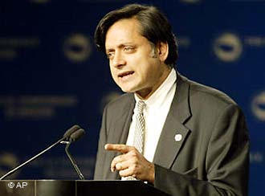
The United Nations is a 20th-century organization facing a 21st-century challenge as an institution with impressive achievements but also haunting failures, one that mirrors not just the world’s hopes but its inequalities and disagreements, and most important, one that has changed but needs to change further….
The single greatest problem facing the United Nations is that there is no single greatest problem; rather there are a dozen different ones each day clamoring for attention. Some, like the crisis in Lebanon, the Palestinian situation and the nuclear programs in Iran and North Korea, are obvious and trying.
Others we call “problems without passports”— issues that cross all frontiers uninvited, like climate change, drug trafficking, human rights, terrorism, epidemic diseases, and refugee movements.
Their solutions, too, can recognize no frontiers because no one country or group of countries, however rich or powerful, can tackle them alone.
Shashi Tharoor, The Good for Something United Nations, Newsweek, September 4, 2006

Slide 14
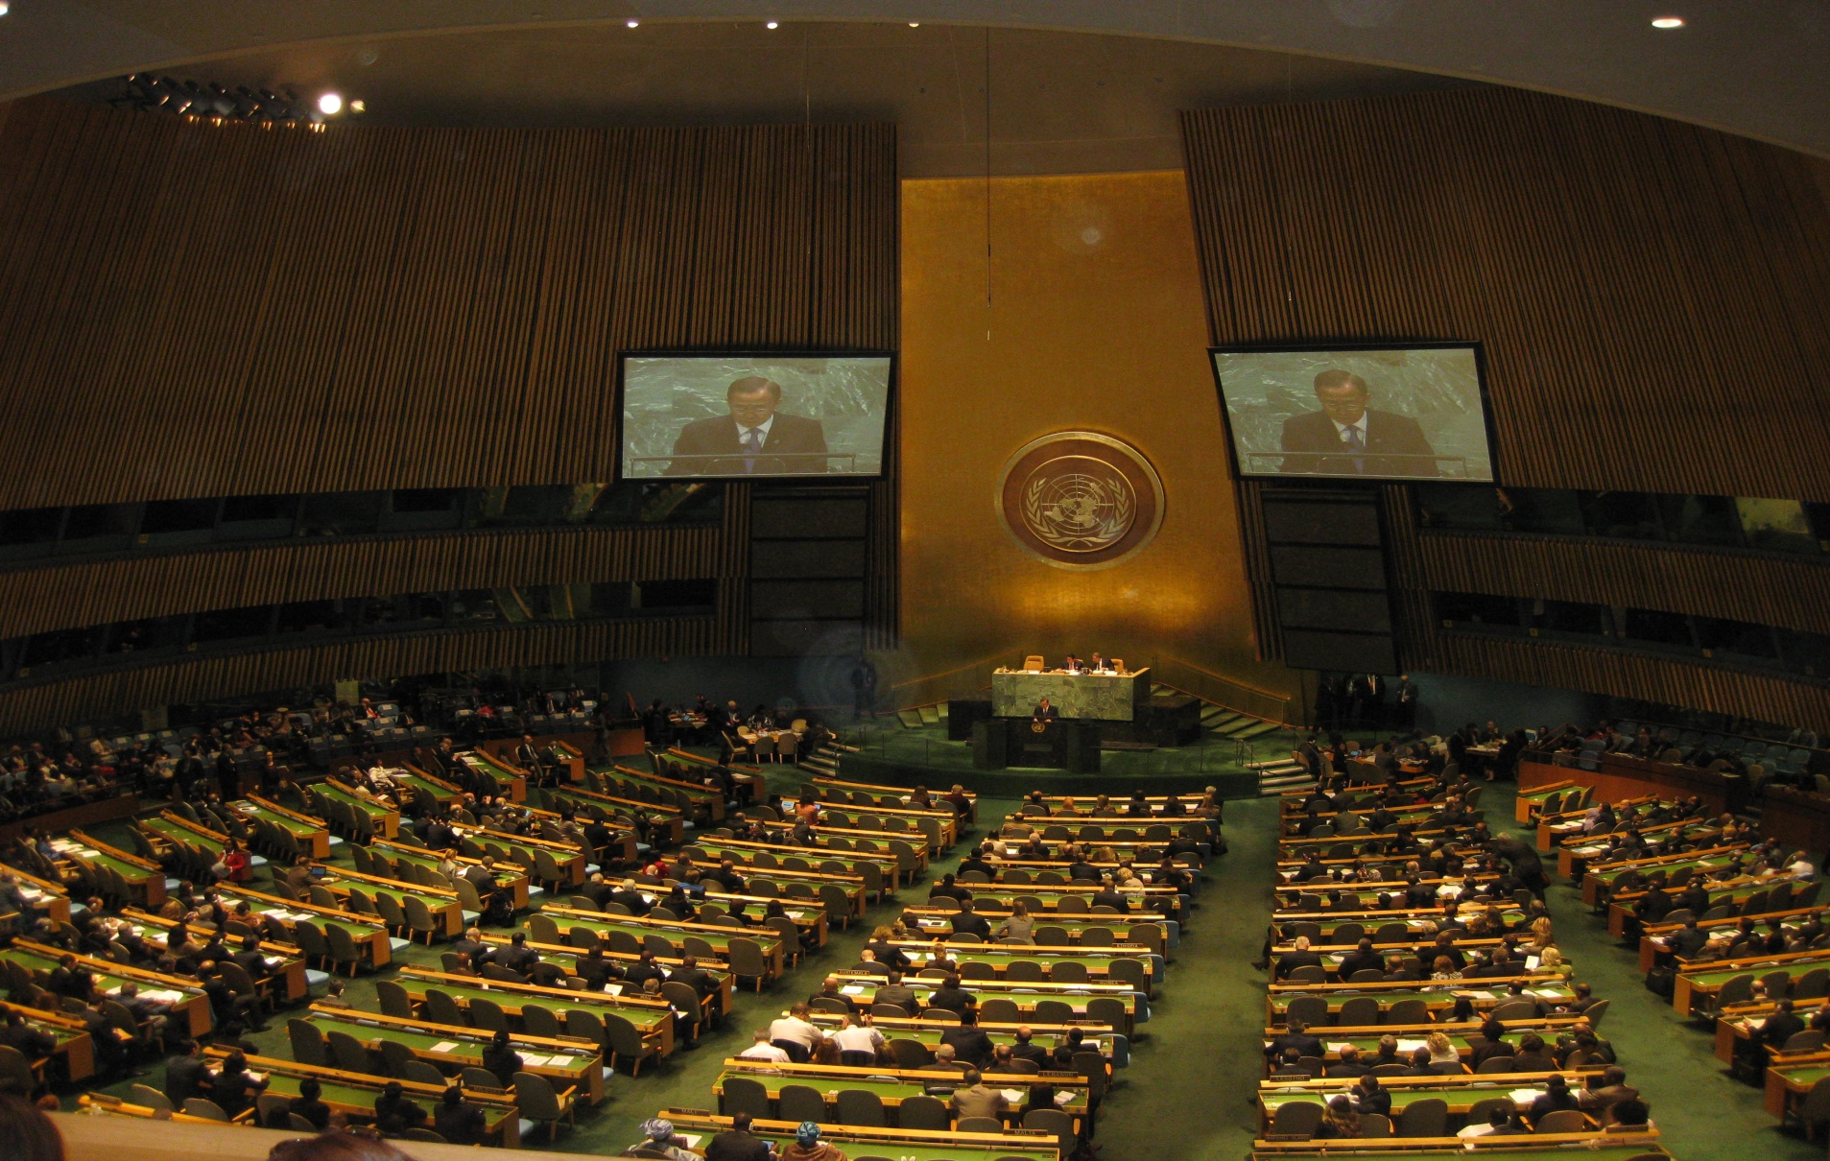
Involvement in putting MH on the NCD agenda (e.g., four joint statements) leading up to the UN General Assembly High level Meeting on NCDs, Sept 2011
Notes:
The UN is not enough nor was it ever meant to be enough….
We the peoples (plural) vs we the governments

Slide 15
Training Modules
UNITAR, EMDR Europe, NGO Forum (current). Online modules for UN Peacekeepers, focussing on traumatic stress (Confronting Global Trauma, Stress and Resilience in Peace Operations).

Slide 16
World Health Organization
.

Slide 17
Health and Mental Health
Health
A state of complete physical, mental and social well-being and not merely the absence of disease or infirmity.
Mental Health
A state of well-being in which every individual realizes his or her own potential, can cope with the normal stresses of life, can work productively and fruitfully, and is able to make a contribution to her or his community.
World Health Organization

Slide 18
Mental Health Action Plan 2013-2020
.

Slide 19
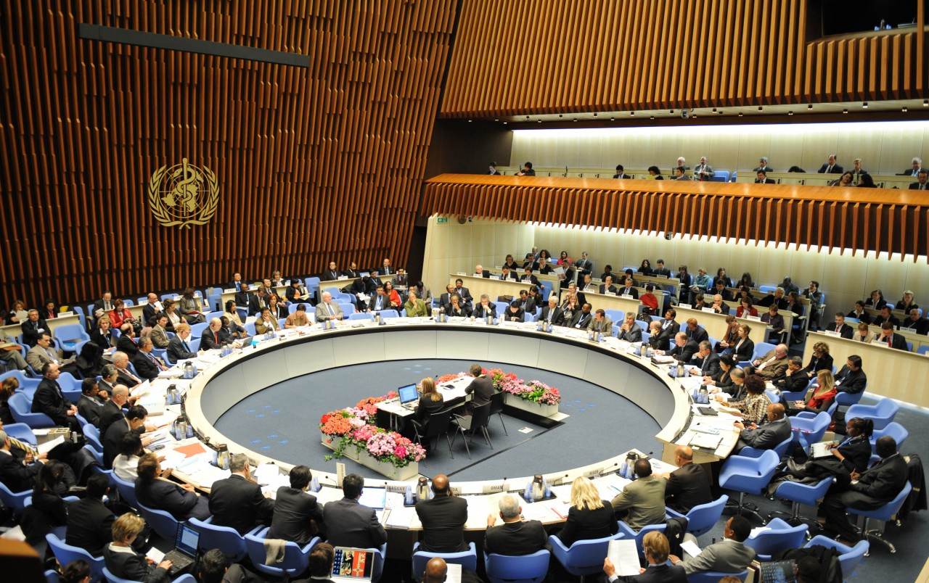
WHO Executive Board—meeting room—where the Mental Health Action Plan 2013-2020 was discussed, debated, and passed in May 2013
.

Slide 20
Overview: Mental Health Action Plan 2013-2020
Vision A world in which mental health is valued, promoted, and protected, mental disorders are prevented and persons affected by these disorders are able to exercise the full range of human rights and to access high-quality, culturally appropriate health and social care in a timely way to promote recovery, all in order to attain the highest possible level of health and participate fully in society and at work free from stigmatization and discrimination.
Cross-cutting Principles
Universal health coverage Regardless of age, sex, socioeconomic status, race, ethnicity or sexual orientation, and following the principle of equity, persons with mental disorders should be able to access, without the risk of impoverishing themselves, essential health and social services that enable them to achieve recovery and the highest attainable standard of health. | Human rights Mental health strategies, actions and interventions for treatment, prevention and promotion must be compliant with the Convention on the Rights of Persons with Disabilities and other international and regional human rights instruments. |  | Evidence-based practice Mental health strategies and interventions for treatment, prevention and promotion need to be based on scientific evidence and/or best practice, taking cultural considerations into account. | Life course approach Policies, plans, and services for mental health need to take account of health and social needs at all stages of the life course, including infancy, childhood, adolescence, adulthood and older age. | Multisectoral approach A comprehensive and coordinated response for mental health requires partnership with multiple public sectors such as health, education, employment, judicial, housing, social and other relevant sectors as well as the private sector, as appropriate to the country situation. |  | Empowerment of persons with mental disorders and psychosocial disabilities Persons with mental disorders and psychosocial disabilities should be empowered and involved in mental health advocacy, policy, planning, legislation, service provision, monitoring, research and evaluation.
Goal To promote mental well-being, prevent mental disorders, provide care, enhance recovery, promote human rights and reduce the mortality, morbidity and disability for persons with mental disorders
Objectives and Targets
1. To strengthen effective leadership and governance for mental health Global target 1.1: 80% of countries will have developed or updated their policy/plan for mental health in line with international and regional human rights instruments (by the year 2020). Global target 1.2: 50% of countries will have developed or updated their law for mental health in line with international and regional human rights instruments (by the year 2020). |  | 2. To provide comprehensive, integrated and responsive mental health and social care services in community-based settings Global target 2: Service coverage for severe mental disorders will have increased by 20% (by the year 2020). |  | 3. To implement strategies for promotion and prevention in mental health Global target 3.1: 80% of countries will have at least two functioning national, multisectoral mental health promotion and prevention programmes (by the year 2020). Global target 3.2: The rate of suicide in countries will be reduced by 10% (by the year 2020). |  | 4. To strengthen information systems, evidence and research for mental health Global target 4: 80% of countries will be routinely collecting and reporting at least a core set of mental health indicators every two years through their national health and social information systems (by the year 2020).

Slide 21
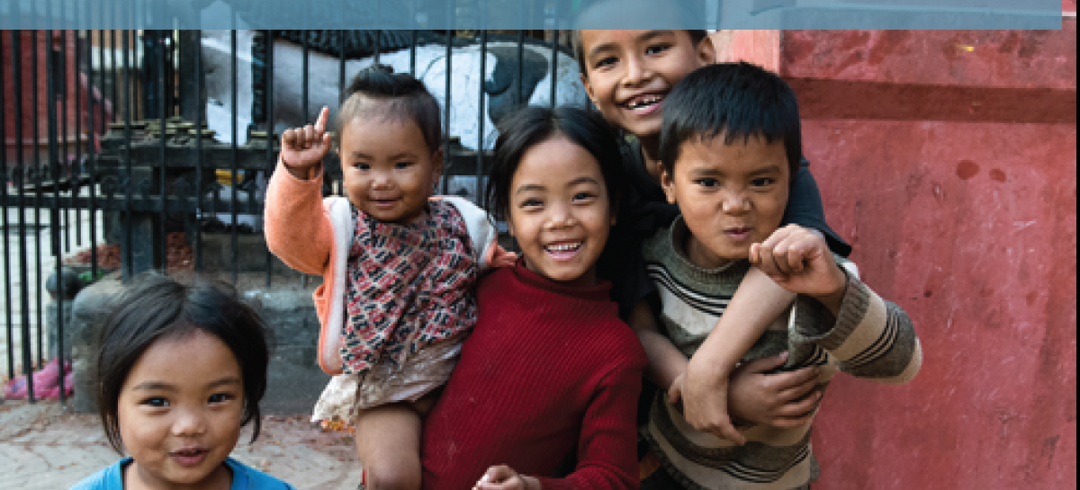
GMH and NGOs Working Together Well! Mental helse som global utfordring. Hva kan vi bidra med?
Kelly O’Donnell, PsyD
NGO Forum For Health
7 March 2014—Oslo

Slide 22
Global Mental Health
Evidence-Based Practice
in Low Resource Countries
WHO Collaborating Centre on Mental Health
of the University of Geneva, Department of Psychiatry

Slide 23
,

Slide 24
World Mental Health Day (1992-2014, 10 October)
2014: Living with Schizophrenia
2013: Mental Health and Older Adults--Note: Hidden Pictures (feature film)
2012: Depression--Note: I Had a Black Dog (self-help animation, five minutes)
2011: The Great Push: Investing in Mental Health
2010: Mental Health and Chronic Physical Illnesses
2009: Mental Health in Primary Care
2008: Making Mental Health a Global Priority: Advocacy/Action
2007: Mental Health in a Changing World: Culture and Diversity
2006: Building Awareness–Reducing Risk: Mental Illness/Suicide
2005: Mental and Physical Health Across the Life Span
2004: The Relationship between Physical and Mental Health
2003: Emotional/Behavioral Disorders of Children/Adolescents
2002: The Effects of Trauma/Violence on Children /Adolescents
2001: Mental Health and Work
2000: Mental Health and Work
1999: Mental Health and Ageing
1998: Mental Health and Human Rights?
1997: Children and Mental Health
1996: Women and Mental Health
1995: Mental Health and Youth
1994: Improving Mental Health Services throughout the World
1992-1993 (general themes)

Slide 25
Like a Death Sentence Human Rights Watch, Oct 2012
http://www.hrw.org/reports/2012/10/02/death-sentence-0
Reflections on the report:
Identify issues, actors, strategies
(next slides relate to human rights, noting that GMH is strongly influenced by human rights along with public health and clinical science)

Slide 26
UN Charter, 1945
We the peoples of the United Nations determined:
to save succeeding generations from the scourge of war, which twice in our lifetime has brought untold sorrow to mankind,
and to reaffirm faith in fundamental human rights, in the dignity and worth of the human person, in the equal rights of men and women and of nations large and small,
and to establish conditions under which justice and respect for the obligations arising from treaties and other sources of international law can be maintained,
and to promote social progress and better standards of life in larger freedom…
Notes:
Where do we begin about GMH?
After defining it….UH Charter, foundational for “recent” history

Slide 27
Universal Declaration of Human Rights, 1948
Article 1
All human beings are born free and equal in dignity and rights. They are endowed with reason and conscience and should act towards one another in a spirit of brotherhood.
Notes:
Relate the HRW video to Article 1 of the UDHR

Slide 28
Convention on the Rights of Persons with Disabilities (UN, 2006)
Article 1 - Purpose
The purpose of the present Convention is to promote, protect and ensure the full and equal enjoyment of all human rights and fundamental freedoms by all persons with disabilities, and to promote respect for their inherent dignity.
Persons with disabilities include those who have long-term physical, mental, intellectual or sensory impairments which in interaction with various barriers may hinder their full and effective participation in society on an equal basis with others.

Slide 29
Summary Thoughts
Keep in the forefront the opportunities for “selfless moral struggle” in partnering with others (Patel et al. 2011, p. 90) and the “duty and choice to risk one’s owns rights and well-being” on behalf of fellow humans (O’Donnell, 2011, p. 187). Develop your personal character and professional competence as a responsible global citizen. Form a global caravan for your GI journey in the service of humanity.
(adapted from GMH: A Resource Primer for Exploring the Domain, 2012)

Slide 30
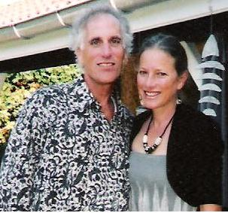
.
Thank you!
Kelly and Michéle
Member Care Associates, Inc.
mcaresources@gmail.com
www.membercare.org

